Slide 1
Lesson 1: GUIs
Programming Part 5: Strings and Lists
Computing
Ben Garside
Materials from the Teach Computing Curriculum created by the National Centre for Computing Education

Slide 2
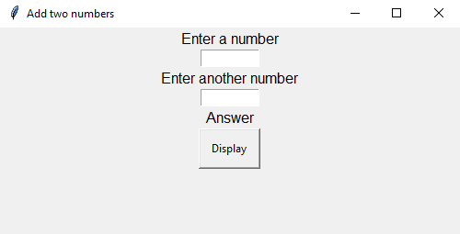
Task 1 - adding two numbers
For this mini project you will be creating an app that allows you to enter two numbers and add them together. Your app will look like the screenshot (note that Mac users will see a slight variation to the screenshots presented here)

Slide 3
Task 1 - adding two numbers
Step 1
The first step is to set up and test your app using the code below:
Step 2
Test that the program works successfully.
1 2 3 4 5 6 7 8 | # import the modules required from guizero from guizero import App # create the app with the window title “Add two numbers” app = App(title="Add two numbers") # display the app, this should always be last app.display()

Slide 4
Task 1 - adding two numbers
Step 3
Import all of the widgets that you need .
This program uses the following widgets:
App, Text, TextBox, PushButton
Make sure that all of the widgets have been imported on the top line of code.

Slide 5
Task 1 - adding two numbers
Step 4 - Build the app
Your code for adding the widgets to the app needs to be placed between the app creation line of code and the app display line of code. See below:
Step 5
Take a look at the layout on the right for the app that you are going to build and note the required widgets.
 | app = App(title="Add two numbers") # add your widget code here app.display()

Slide 6
Task 1 - adding two numbers
Step 6
You can be really specific about where your widgets are placed and you can explore these options later. In this project you will simply be placing one widget after the other in a sequence.
This sequence goes:
Text
TextBox
Text
TextBox
Text
PushButton
This means that you will need 6 lines of code to add all of the required widgets onto the app.
Each widget needs its own unique identifier, like a variable name.
On the next slide is a table to help you with the identifiers of each widget.

Slide 7
Task 1 - adding two numbers
Step 6 continued
Identifier | Widget
instructions | Text
enter_num1 | TextBox
instructions2 | Text
enter_num2 | TextBox
display_answer | Text
display_number | PushButton

Slide 8
Task 1 - adding two numbers
Step 7
Below are code snippets for each widget with explanations of how they work. Use these to help you create the first 5 widgets in your app. The PushButton will be dealt with later.
This code snippet can be used to display text. The identifier should be replaced with your unique identifier and the Text to display should be replaced with the text that you wish to display.
Note: the app part of this code instructs that this widget is controlled by the app. You can use other ‘masters’ here which you could explore later.
 | identifier = Text(app, text="Text to display")

Slide 9
Task 1 - adding two numbers
Step 7 continued
Text box
This code snippet can be used to add a text box. These work a little bit like the input() functions that you have used before. The identifier should be replaced with your unique identifier. The rest of the statement should stay the same.
 | identifier = TextBox(app)

Slide 10
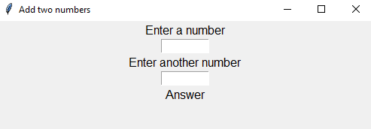
Task 1 - adding two numbers
Step 8
Test your app by running it. If it works correctly it should load like this:
If your app doesn’t look like the one above then double check that you have written your code in the correct order and that you have used the correct syntax for each widget.

Slide 11
Task 1 - adding two numbers
Step 9 - Adding a push button
Adding the PushButton is slightly different to the other widgets because you want the PushButton to call a subroutine when the button is pressed. The subroutine will add the two numbers together and display the answer in display_answer.
The identifier is the unique name for the widget. The subroutine is the subroutine that you wish to call when the button is pressed. The Button Text is what you want to appear on the button.
When the button is pressed the subroutine add is going to be called. We add the identifier for the subroutine here but we leave out the () part as including it will automatically call the subroutine before we want it to.
Create the line of code that will add the PushButton widget.
identifier = PushButton(app, command=subroutine, text="Button Text")
Note: if you try to test your code at this point then you will get an error because the add subroutine has not yet been defined.

Slide 12
Task 1 - adding two numbers
Step 10
The add subroutine needs to be defined at the beginning of the code. You should place this underneath the import statement.
To access and/or modify the value of a TextBox or Text widget you use this code snippet:
Below is all of the code required to create the add subroutine. Your job is to place the lines of code in the correct order and then add them to your program. Don’t forget the indents!
 | from guizero import App, Text, TextBox, PushButton # define your subroutine here
 | identifier.value
 | display_answer.value = answer num2 = enter_num2.value def add(): answer = int(num1) + int(num2) num1 = enter_num1.value

Slide 13
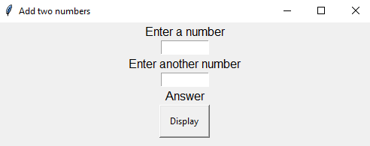
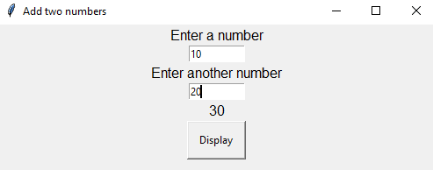
Task 1 - adding two numbers
Step 11
Now test your program. At this point it should be fully functional and should look like the screens below:
Screen on loading Screen after entering numbers and pressing display

Slide 14
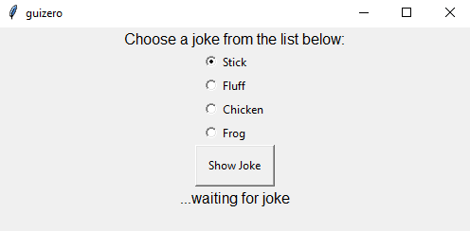
Task 2- The joke machine
For this mini project you will be creating an app that allows the user to select a joke type and click the button to reveal the joke. It will look like the screen to the right.

Slide 15
Task 2- Setting up the app
Step 1
This program uses the following widgets:
App, ButtonGroup, Text, PushButton
Make sure that all of the widgets have been imported on the top line of code.
Step 2
Now make sure that you have included the line of code that creates the app and the final line of code that displays the app.
Tip: Look at your last project if you are unsure of what to do here

Slide 16
Task 2- Build the app
Step 3
Take a look at the layout for the app that you are going to build and note the required widgets and the order in which they appear.

Slide 17
Task 2- Build the app
Step 4
Make sure that each widget has its own unique identifier.
Here is a table to help you with the identifiers of each widget.
Identifier | Widget
instruction | Text
joke_choice | ButtonGroup
joke_button | PushButton
display_joke | Text

Slide 18
Task 2- Build the app
Step 5
The new widget that you need to use is the ButtonGroup widget. Here is a code snippet:
This code snippet can be used to create a list of options. The identifier should be replaced with your unique identifier. “op1”,”op2” are the list items. You can add more as long as you add a comma and surround the option with speech marks. The selected part is where you choose which option should initially be selected in the list.
identifier = ButtonGroup(app, options=["op1", "op2"], selected="op1")

Slide 19
Task 2- Create the jokes subroutine
Step 6
Make sure that your PushButton calls the jokes subroutine when it is pressed.
Tip: Look at your previous app to remember how to properly set up the PushButton.

Slide 20
Task 2- Create the jokes subroutine
Step 7
The jokes subroutine needs to be defined at the beginning of the code. You should place this underneath the import statement.
To access the selected option from the ButtonGroup you need to use:
Below is a code snippet to get you started with the jokes subroutine.
Complete the jokes subroutine so that it covers all the jokes that a user can select from the ButtonGroup.
Joke 2: What is pink and fluffy? Pink fluff!
Joke 3: Why did the chicken cross the road? To buy some toilet paper!
Joke 4: What happens to a frog's car when it breaks down? It gets toad away!
 | identifier.value
 | def jokes(): if joke_choice.value == "Stick": display_joke.value = "What is brown and sticky? A stick!"

Slide 21
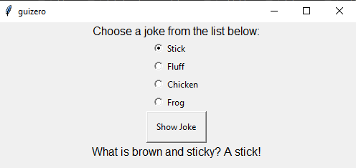
Task 2 - Testing
Step 8
Now test your program. At this point it should be fully functional and should look like the screens below:
Screen on loading Screen after pressing “Show Joke”

Slide 22
Task 3 - Procedural vs event driven programming
Sort the statements below into either procedural or event driven programming:
The flow of the program is determined by user actions, such as button clicks.
The flow of control is executed in the order it is written.
It is commonly used when creating graphical user interfaces.
It is commonly used when the order of execution is known.
The program waits for a user action before executing a block of statements.
Procedural programming | Event driven programming

