Slide 1
Lesson 5: Manipulating Objects
Vector Drawing
Computing
Jordan Bickel
Materials from the Teach Computing Curriculum created by the National Centre for Computing Education

Slide 2
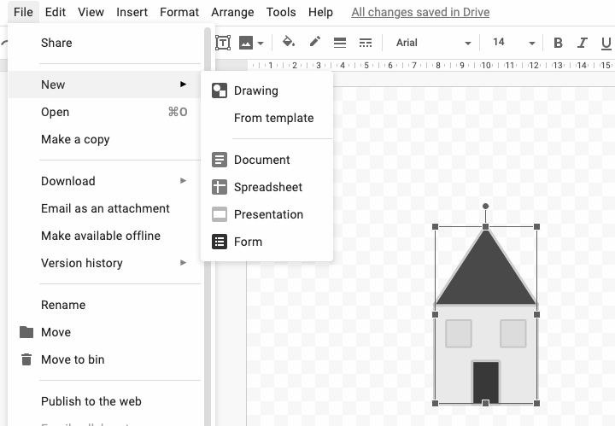
Task 1: Grouping and copying
Open up a drawing you did in one of the previous lessons. Then click File and select ‘New’.
Group the objects together and then copy and paste them in the new drawing so you have more than two.
Credit: Google Drawings

Slide 3
Task 2: Making changes to copies!
Look at the copies you have created in your new Google Drawings tab.
Can you make the following changes so they don’t all look the same:
Change how big/small they are
Change the colours of a part of them
Use the ‘flip’ function to show some ‘looking’ the other way
TIP: Remember to group your drawings again after you have made your changes!

Slide 4
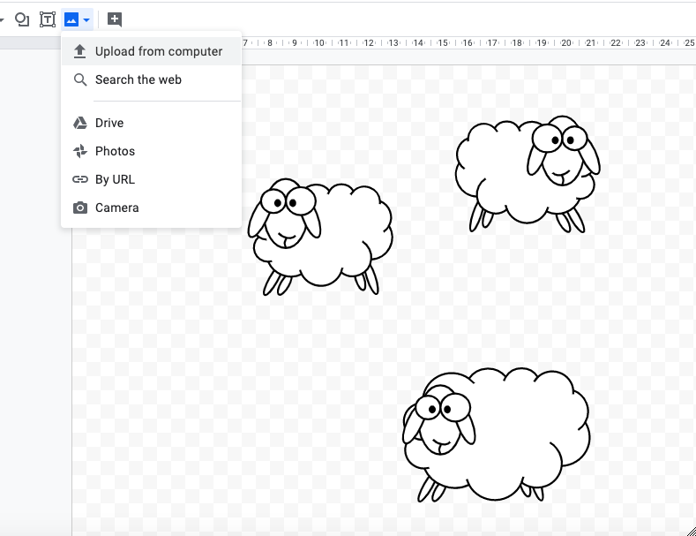
Task 3: Adding a background
Add a photograph to the background of your drawing to help it look more realistic. Don’t forget to ‘send to back’!
Credit: Google Drawings

