Slide 1
Independent Task: To identify regular and irregular polygons
Maths
Miss Miles

Slide 2
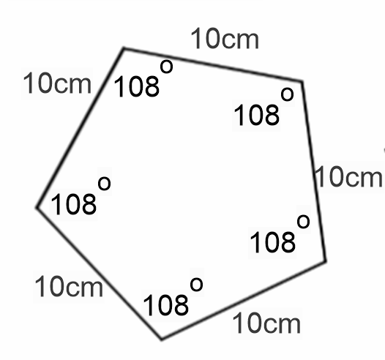
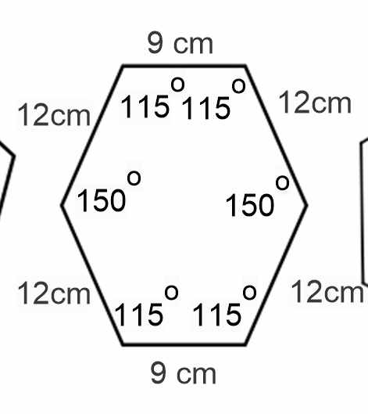
Independent Task
Name the shape.
Identify if it is regular or irregular.
Explain how you know.
Find the sum of the interior angles.
Find the perimeter.
Task 1 of 2
130°
130°

Slide 3
Independent Task
Name these shapes.
Decide if they are regular or irregular.
Explain how you know.
Task 2 of 2
Notes:
Note this is harder

