Slide 1
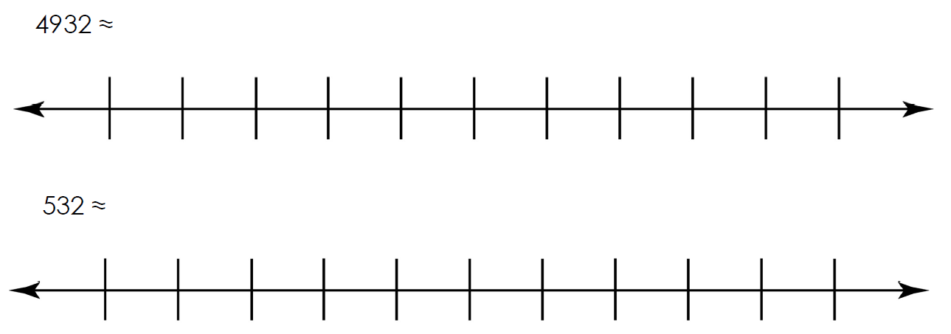
Independent Task
Locate the number.
Decide which is the nearer multiple of 1000 and write in the answer.
Question 1 and 2
4000
5000
0
1000

Slide 2
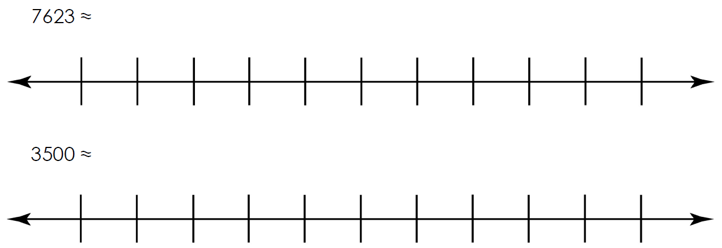
Independent Task
Using the number lines, write in the two closest multiples of 1000.
Locate the number.
Decide which is the nearer multiple of 1000 and write in the answer.
Question 3 and 4

Slide 3
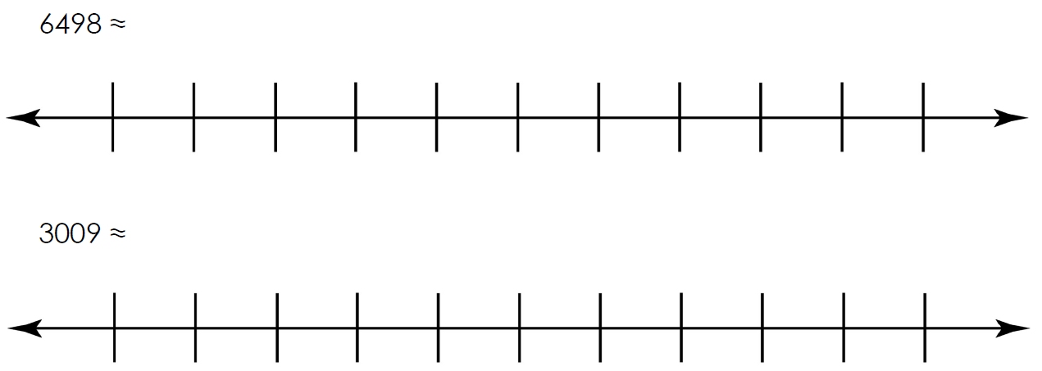
Independent Task
Using the number lines, write in the two closest multiples of 1000.
Locate the number.
Decide which is the nearer multiple of 1000 and write in the answer.
Question 5 and 6

Slide 4
Independent Task
Challenge
I have 4 number cards
I add two of the numbers together, and round this number to the nearest 1000.
My answer is 6000.
Which two cards could I have chosen?
1400 | 2400
3400 | 4400

