Slide 1
Numeracy: Measurement - Building Understanding
Lesson 3: Comparing and matching objects based on their size
Lesson 3 of 4
Helen

Slide 2
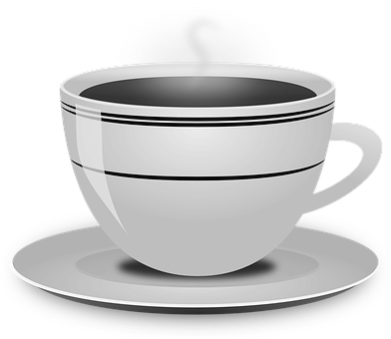
Compare and match objects
Which cup should this teddy bear have?
Images from Pixabay

Slide 3
Compare and match objects
Which banana should this robot have?
Images from Pixabay

Slide 4
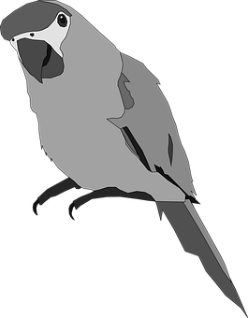
Compare and match objects
Which birdcage should this bird live in?
Images from Pixabay

Slide 5
Compare and match objects
Which cup should this teddy bear have?
Images from Pixabay

Slide 6
Compare and match objects
Which banana should this robot have?
Images from Pixabay

Slide 7
Compare and match objects
Which birdcage should this bird live in?
Images from Pixabay

Slide 8
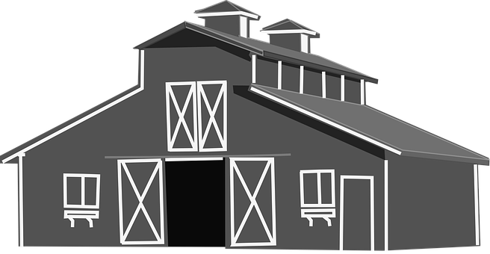
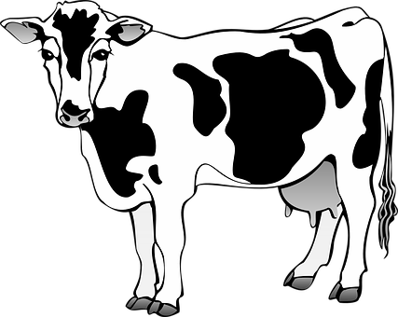
Compare and match objects
Have I matched the cows to the correct barns?
Images from Pixabay

Slide 9
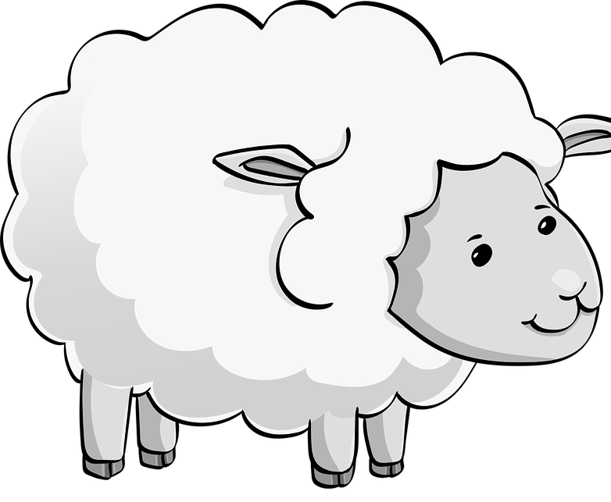
Compare and match objects
Have I matched the sheep to the correct barns?
Images from Pixabay

Slide 10
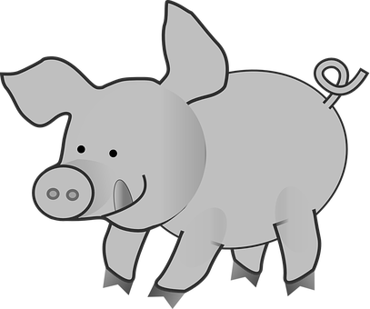
Compare and match objects
Have I matched the pigs to the correct barns?
Images from Pixabay

Slide 11
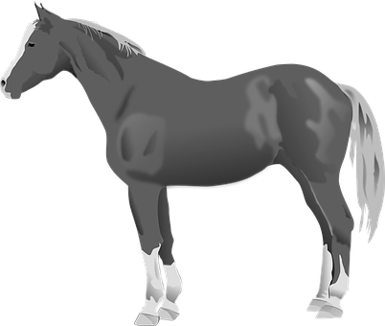
Compare and match objects
Have I matched the horses to the correct barns?
Images from Pixabay

