Slide 1
Talking about future holiday plans (Part 2/2)
modal verbs + infinitive
other verbs + zu + infinitive
wenn clauses with present and future tenses
Downloadable Resource
German
Herr Scales

Slide 2
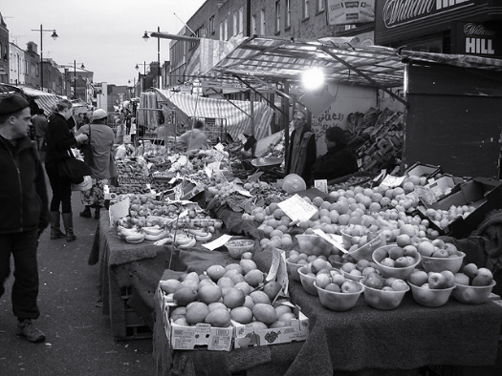
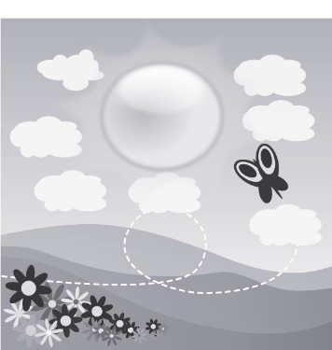
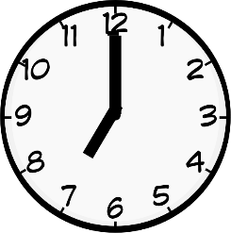
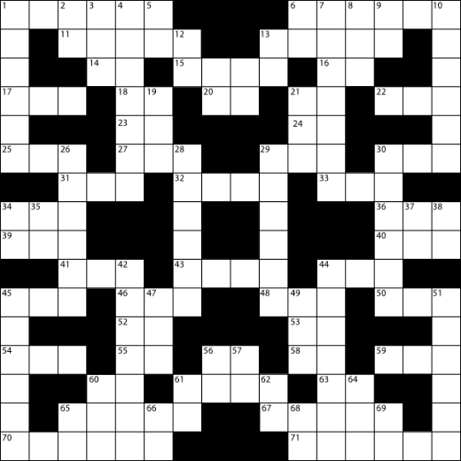
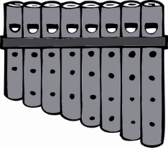
r
Markt
Morgen
Uhr
By Tarquin Binary - Own work, CC BY-SA 2.5
Kultur
Wort
dort
W O R T
Rachel Hawkes
Notes:
Introduce and elicit the pronunciation of the individual SSC ‘r’ and then the source word again (with gesture, if using). Then present and elicit the pronunciation of the five cluster words. The cluster words have been chosen for their high-frequency, from a range of word classes, with the SSC (where possible) positioned within a variety of syllables within the words (e.g. initial, 2nd, final etc.). Additionally, we have tried to use words that build cumulatively on previously taught SSCs (see the Phonics Teaching Sequence document) and do not include new SSCs. Where new SSCs are used, they are often consonants which have a similar symbol-sound correspondence in English.
Word frequency rankings (1 is the most common word in German): Uhr [349]; Markt [508] Morgen [311]; Kultur [593]; dort [104]; Wort [243]. Source: Jones, R.L. & Tschirner, E. (2006). A frequency dictionary of German: core vocabulary for learners. Routledge
By Tarquin Binary - Own work, CC BY-SA 2.5, https://commons.wikimedia.org/w/index.php?curid=406547

Slide 3
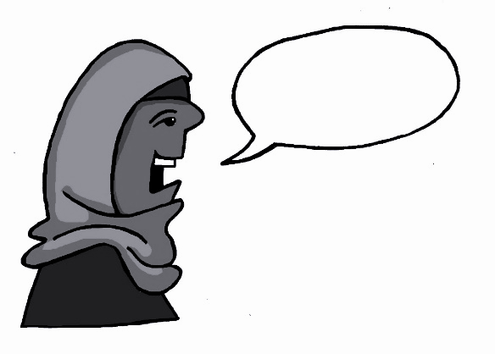
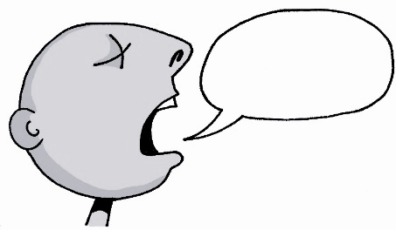
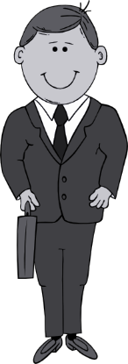
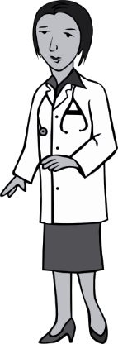
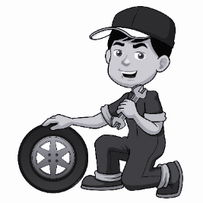
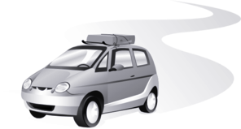
r
Regel
rot
reden
warum?
Beruf
Reise
Rachel Hawkes
Notes:
Introduce and elicit the pronunciation of the individual SSC ‘r’ and then the source word again (with gesture, if using). Then present and elicit the pronunciation of the five cluster words. The cluster words have been chosen for their high-frequency, from a range of word classes, with the SSC (where possible) positioned within a variety of syllables within the words (e.g. initial, 2nd, final etc.). Additionally, we have tried to use words that build cumulatively on previously taught SSCs (see the Phonics Teaching Sequence document) and do not include new SSCs. Where new SSCs are used, they are often consonants which have a similar symbol-sound correspondence in English.
Word frequency rankings (1 is the most common word in German): reden [356]; Regel [484] rot[381]; warum? [246]; Reise [786]; Beruf [477]. Source: Jones, R.L. & Tschirner, E. (2006). A frequency dictionary of German: core vocabulary for learners. Routledge

Slide 4
grau
braun
Traum
grey
brown
dream
Urlaub
furchtbar
ehrlich
holiday
terrible
honest

Slide 5
der See(n) | lake
die See(n)/das Meer(e) | sea
der Ausflug ("e) | excursion/trip
das Ausland | abroad
der Strand("e) | beach
die Aktivität(en) | activity
der Berg(en) | mountain
die Burg(en)/das Schloss("er) | fortress/castle
prächtig | magnificent
wunderbar | wonderful

Slide 6
The conjunction wenn is very useful if you want to make your sentences more interesting. It is a subordinating conjunction, which sends the verb to the end of the clause.
Eg. Ich spiele Tennis. Das Wetter ist gut
Ich spiele Tennis, wenn das Wetter gut ist = I play tennis, when/if the weather is good
You can also start the sentence with wenn. If you do, the word order is as follows:
Wenn das Wetter gut ist, spiele ich Tennis = When/if the weather is good, I play tennis

Slide 7
Wenn can also be used when you are talking about your future plans
Eg. Ich werde Tennis spielen. Das Wetter ist gut
Ich werde Tennis spielen, wenn das Wetter gut ist = I will play tennis, when/if the weather is good
Just like before, you can also start the sentence with wenn. if you do, the word order is as follows:
Wenn das Wetter gut ist, werde ich Tennis spielen = When/if the weather is good, I will play tennis

Slide 8
Wie ist die richtige Reihenfolge?
1. Ich möchte nach Amerika fahren Wenn Ich bin älter
2. Wir werden uns sonnen Wenn Das Wetter ist gut
3. Ich muss das Schloss besichtigen Wenn Es ist wirklich so prächtig
4. Wenn Wir haben Zeit Wir werden Ausflüge machen
5. Wenn Wir haben das Geld Wir werden ins Ausland fahren
Ich möchte nach Amerika fahren, wenn ich älter bin
Wir werden uns sonnen, wenn das Wetter gut ist
Ich muss das Schloss besuchen, wenn es wirklich so prächtig ist
Wenn wir Zeit haben, werden wir Ausflüge machen
Wenn wir das Geld haben, werden wir ins Ausland fahren

Slide 9
Summary of learning
In German, wenn (when/if) is a useful conjunction when you are talking about your holiday plans. It is subordinating and sends the verb to
to the end
Eg I will go to America when I am older =
Ich werde nach Amerika fahren, wenn ich älter
bin
It is also possible to start the sentence with wenn.
if this is done, the verb goes to the end of the subordinate clause, but is immediately followed by the verb of the main clause, with only a comma inbetween.
Eg. When I am older, I will go to America
Wenn ich älter , ich nach Amerika fahren
bin
werde

