Slide 1
German
Family Relationships [1 / 3] - ‘mit’ + Dative with nouns
Frau Driver

Slide 2
Family relationships and using ‘mit’ + dative with nouns
Phonics focus – [sch], [β]
Introducing new vocabulary
Grammar: ‘mit’ + dative with nouns
Revision vocabulary
Writing: translation
Reading activity
Speaking Activity
Summarising learning
Notes:
The plan for today’s lesson is as follows. Press return if you haven’t done the quiz, please do it now.
Bist du fertig? (bereit)? Los geht’s!

Slide 3
sch
falsch
schnell
[fast]
schreiben
schwarz
zwischen
Mensch
Rachel Hawkes
Notes:
Introduce and elicit the pronunciation of the individual SSC ‘sch’ and then the source word again (with gesture, if using). Then present and elicit the pronunciation of the five cluster words. The cluster words have been chosen for their high-frequency, from a range of word classes, with the SSC (where possible) positioned within a variety of syllables within the words (e.g. initial, 2nd, final etc.). Additionally, we have tried to use words that build cumulatively on previously taught SSCs (see the Phonics Teaching Sequence document) and do not include new SSCs. Where new SSCs are used, they are often consonants which have a similar symbol-sound correspondence in English.
Word frequency rankings (1 is the most common word in German): schreiben [245]; falsch [638] schnell [233]; zwischen [115]; Mensch [104]; schwarz [451]. Source: Jones, R.L. & Tschirner, E. (2006). A frequency dictionary of German: core vocabulary for learners. Routledge

Slide 4
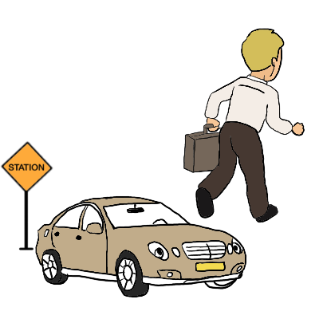
ß
Fußball
ein bisschen
groß
heißen
lassen
Misky
damals
1919
2019
Rachel Hawkes
Notes:
Introduce and elicit the pronunciation of the individual SSC ‘ß’ (ss used after short vowels) and then the source word again (with gesture, if using). Then present and elicit the pronunciation of the five cluster words. The cluster words have been chosen for their high-frequency, from a range of word classes, with the SSC (where possible) positioned within a variety of syllables within the words (e.g. initial, 2nd, final etc.). Additionally, we have tried to use words that build cumulatively on previously taught SSCs (see the Phonics Teaching Sequence document) and do not include new SSCs. Where new SSCs are used, they are often consonants which have a similar symbol-sound correspondence in English.
Word frequency rankings (1 is the most common word in German): groß [74]; Fußball [1497] ein bisschen [194]; heißen [123]; damals [271]; lassen [82]. Source: Jones, R.L. & Tschirner, E. (2006). A frequency dictionary of German: core vocabulary for learners. Routledge

Slide 5
sich verstehen mit | to get on with (sb)
sich streiten mit | to argue with
eifersüchtig auf | jealous of
mit jemandem gut auskommen | to get along with somebody
groβartig | awesome
locker | laid-back
gut / schlecht gelaunt | good / bad humoured
gemein | mean
unhöflich | impolite
komisch | strange
Notes:
Min font size = 28 for the words on the slide. Nothing below the acorn.
On the screen, you can see the new vocabulary together. Now, I’ll say the German again, but I will say them out of order. You say the correct translation out loud. If you want to challenge yourself - close your eyes, focus on what I’m saying and say the correct translation out loud.
unterstützen, die Geduld, die Freundschaft, müssen, denken, die gleichen Interessen, immer, koennen, duerfen,

Slide 6
‘mit’ + dative with nouns
‘mit’ is always followed by the dative case.
The table below shows the dative ending for ein, kein and possessive adjectives (mein, dein, sein, ihr, etc.)
 | Dative Case
Masc. | meinem Bruder
Fem. | meiner Schwester
Neut. | meinem Kind
Plural | meinen Eltern
Ich verstehe mich gut mit meinem Bruder
Ich streite mich oft mit meiner Schwester
Ich gehe oft mit meinem Kind ins Kino
Ich komme gut mit meinen Eltern aus.
Notes:
Style guide advice.
Optimum use of lesson time and key to learning/consolidation

Slide 7
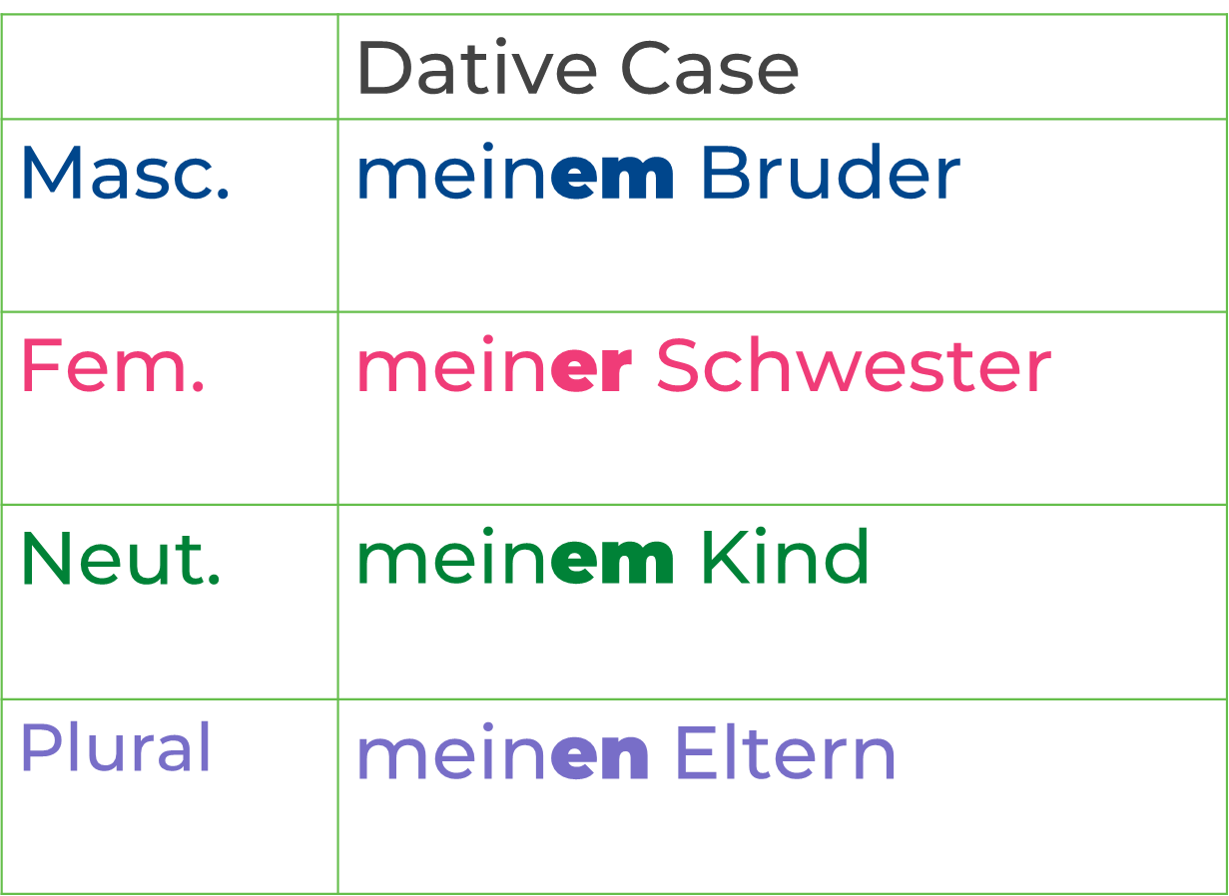
Summarising Learning
your understanding of the near future tense.
The table below shows the dative ending for ein, kein and possessive adjectives (mein, dein, sein, ihr, etc.)
The preposition ‘mit’ is always followed by the dative case.
Ich gehe mit meinen Freunden aus
Notes:
müssen
können
dürfen

Slide 8
Summarising Learning
your understanding of the near future ten se.
We use ‘mit’ with some key verbs for describing relationships.
Remember that after ‘mit’ we always use the dative case.
sich verstehen mit
sich streiten mit
mit jemandem gut auskommen
ich verstehen mich gut mit meiner Familie
Ich streite mich oft mit meinem Bruder
ich komme mit meinen Freunden gut aus
Notes:
sich verstehen mit
sich streiten mit
eifersüchtig auf
mit jemandem gut auskommen

