Slide 1
Unit 3 Lesson 2
Where does a bass line come from?
Music
Ms Friar
Notes:
Intro - big hello to Yr 8 - excited to be teaching about a really important style of music historically.
Sing broken chord notes of three blues chords

Slide 2
12 bar blues chords in G
G | G | G | G
C | C | G | G
D | C | G | G/D
(I)
(IV)
This is called a ‘turnaround’ chord - so the band starts the structure again.
(V)

Slide 3
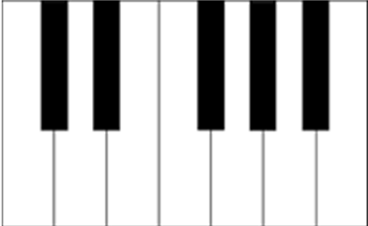
Piano Chords
G | C | D
Notes:
Demonstrate in the video box

Slide 4
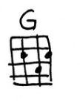
Ukulele Chords
Notes:
Demonstrate in the video box

Slide 5
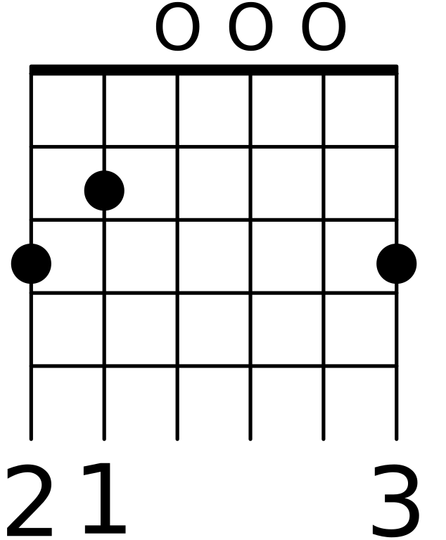
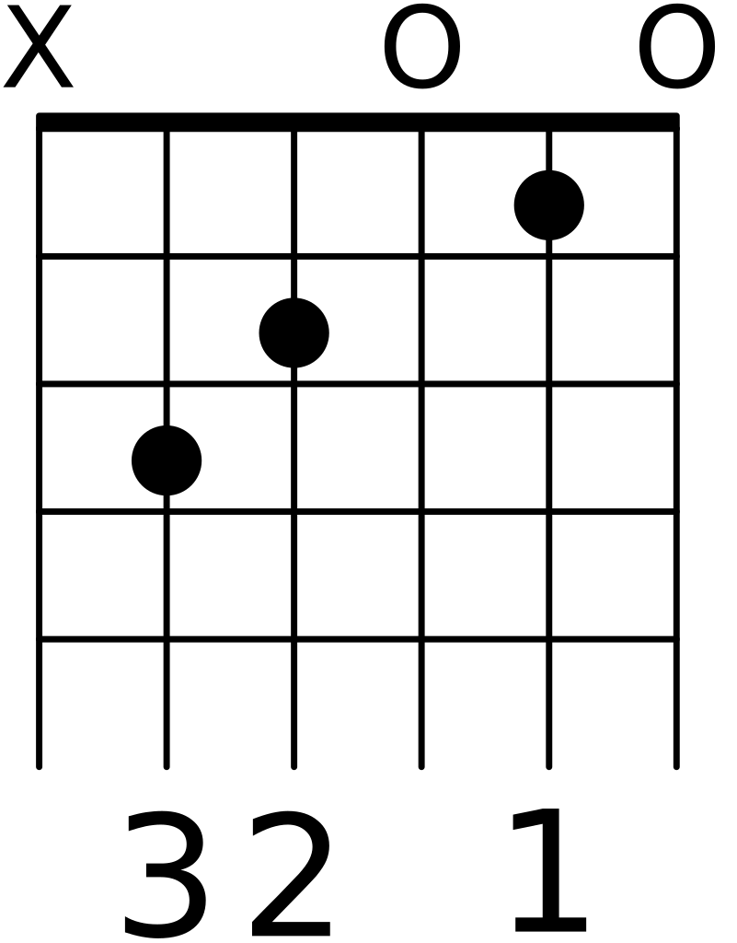
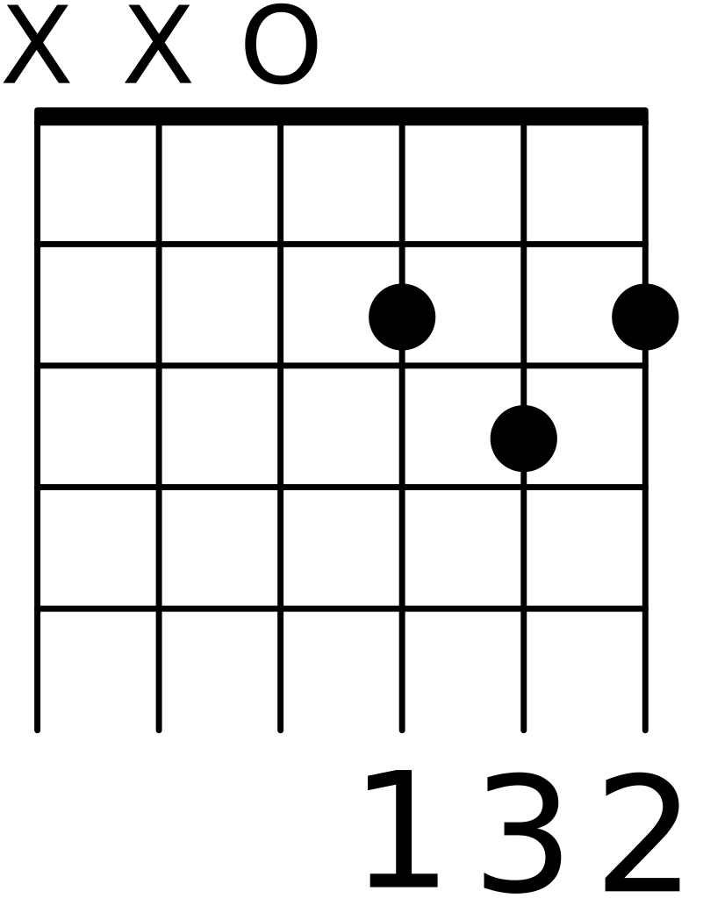
Guitar Chords
G | C | D

Slide 6
References
Slide [3] -[pixabay] - [gettyimages] - [pianokeys]
Slide [4] -[flickr] - [sashachua] - [ukulelechordsheet]
Slide [5]- [wikimediacommons] - [ashaio] - [cmajorchordforguitar]
Slide [5] - [wikimediacommons] - [ashaio] - [gmajorchordforguitar]
Slide [5] - [wikimediacommons] - [ashaio] - [dmajorchordforguitar]

