Slide 1
Mathematics
Maximum and Minimum Area
Mrs Buckmire

Slide 2
Try this
The width and height of a rectangle sum to 10 cm.
What is the greatest possible area? How do you know?

Slide 3
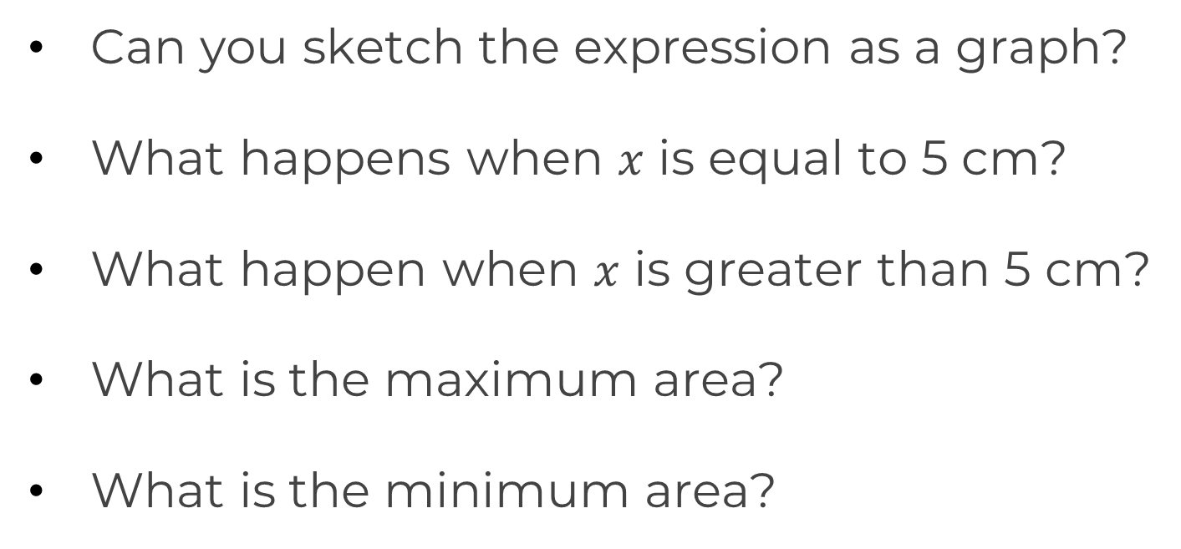
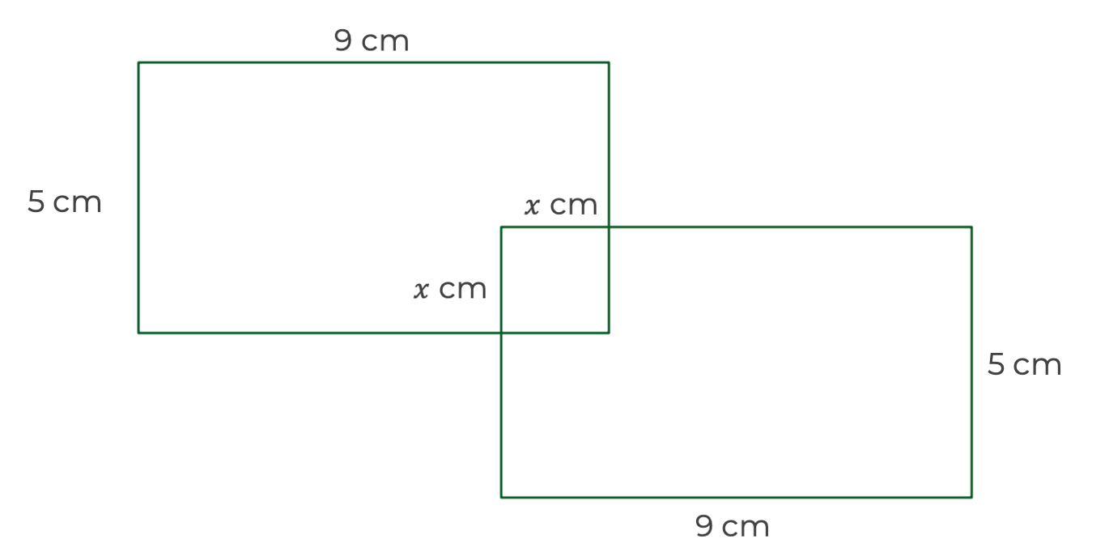
Independent task
Two 9 cm by 5 cm rectangles overlap to making the shape of a square.
Can you describe the total area as a quadratic expression?

Slide 4
Explore
Does the area of these shapes have an upper or lower bound? What are they?
A rectangle that has width 3 cm greater than its height
A triangle where the base and height sum to 12 cm
A parallelogram where the height is three times its width

Slide 5
Explore (Support)
Does the area of these shapes have an upper or lower bound? What are they?
A rectangle that has width 3 cm greater than its height
A triangle where the base and height sum to 12 cm
A parallelogram where the height is three times its width
Hint: Plot for values of x>0.

