Slide 1
Density as rate Lesson 4 of 8
Downloadable resource
Mathematics
Miss Kidd-Rossiter

Slide 2
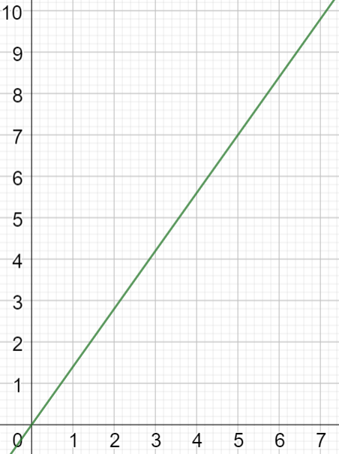
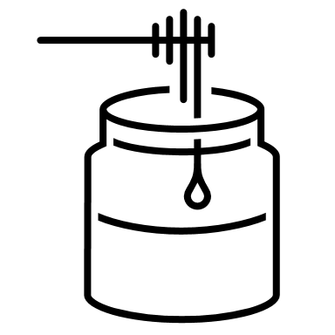
Honey
What is the graph telling us about honey?
What ‘rate’ can you see here?
kg
litres

Slide 3
Honey
kg
Litres (L)
Kilograms (kg)
5
1
7
litres

Slide 4
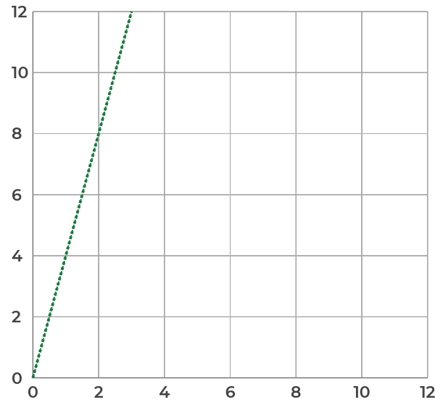
Fruit juice
What is the mass of 2 litres of fruit juice?
What is the density of the fruit juice?
How many litres of fruit juice have a mass of 9kg?
How many litres of fruit juice have a mass of 50kg?
Kilograms (kg)
Litres (L)

Slide 5
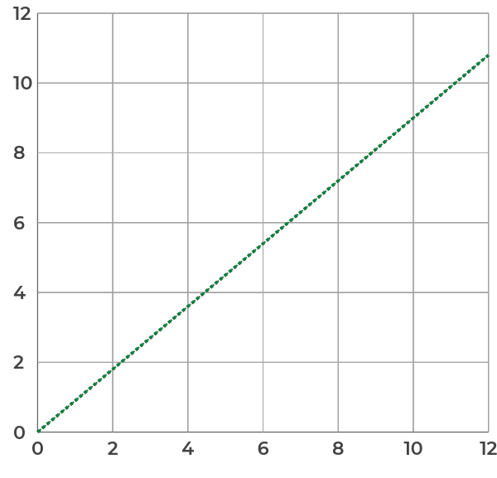
Sparkling water
Fill in the gaps: _______ litres of sparkling water have a mass of ________kg.
What is the density of the sparkling water?
How many litres of sparkling water have a mass of 5kg?
What is the mass of 200 litres of sparkling water?
Kilograms (kg)
Litres (L)

Slide 6
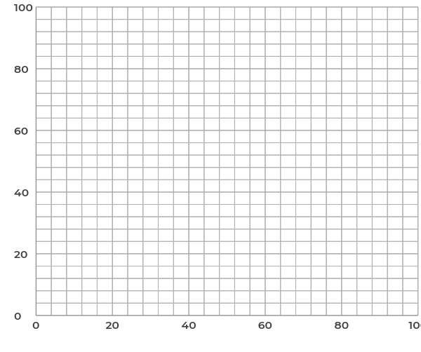
Mixture
Use the previous two graphs to help with this section.
Ten litres of sparkling water are mixed with one litre of fruit juice.
What is the mass of the mixture?
What is the density of the mixture?
More of the mixture is made in the same ratio, draw a graph to show the mass and volume of the mixture.
Kilograms (kg)
Litres (L)

Slide 7
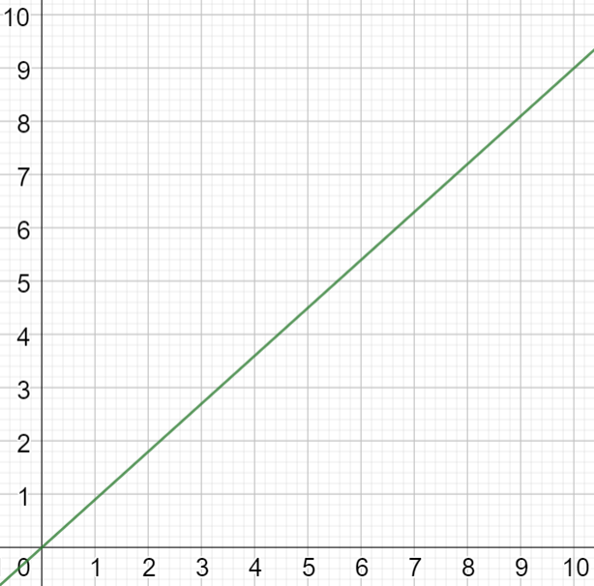
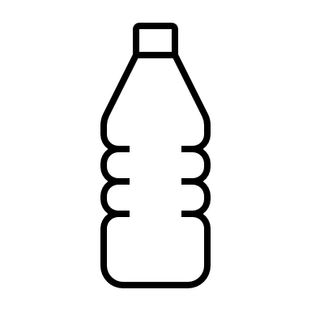
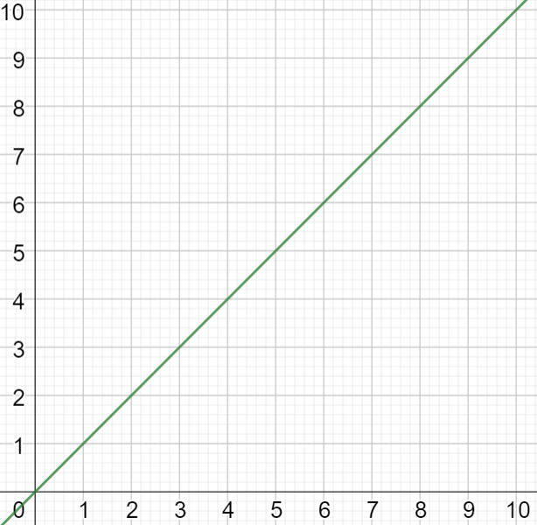
How many different sentences can you write to compare densities of vegetable oil, water and honey?
Vegetable oil
Water
Honey
kg
kg
kg
litres
litres
litres

