Slide 1
Combined Science - Chemistry - Key Stage 4
Electrolysis of Molten Compounds
Mr Campbell

Slide 2
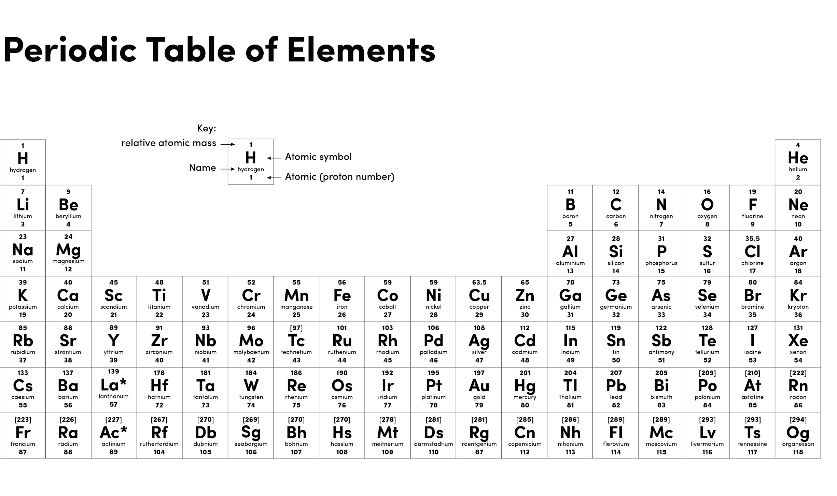
Source: Oak

Slide 3
Independent task
Molten ionic compound | Positive cation | Negative anion | Forming at the cathode | Forming at the anode
Calcium chloride CaCl₂
Potassium oxide K₂O
Sodium bromide NaBr
Aluminium oxide Al₂O₃

Slide 4
Independent task answers
Molten ionic compound | Positive cation | Negative anion | Forming at the cathode | Forming at the anode
Calcium chloride CaCl₂ | Calcium Ca²⁺ | Chloride Cl⁻ | Calcium Ca | Chlorine Cl₂
Potassium oxide K₂O | Potassium K⁺ | Oxide O²⁻ | Potassium K | Oxygen O₂
Sodium bromide NaBr | Sodium Na⁺ | Bromide Br⁻ | Sodium Na | Bromine Br₂
Aluminium oxide Al₂O₃ | Aluminium Al³⁺ | Oxide O²⁻ | Aluminium Al | Oxygen O₂

