Slide 1
Graphs of proportional relationships
Downloadable resource.
Mathematics
Dr Rim Saada

Slide 2
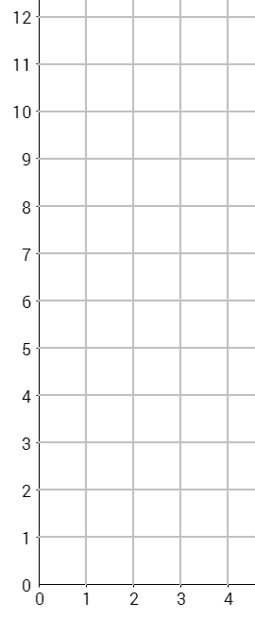
A shop sells ribbon for £3 per metre.
The table below shows the cost (𝑦, £) for different lengths (𝑥, metres).
Complete the table and then plot the graph of quantity (x) and cost (y).
 | 0 | 1 | 2 | 3 | 4 | 5

Slide 3
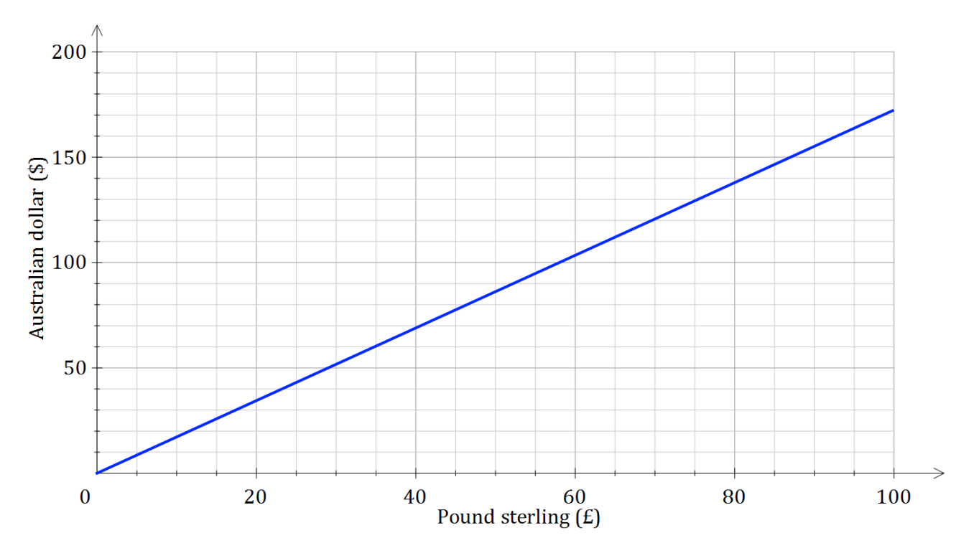
1) Here is a conversion graph between pound sterling (£) and the Australian dollar ($).
Change £40 to Australian dollars.
Change 100 Australian dollars to pounds sterling.
What is the difference between £100 and $100?
Give your answer in pound sterling and Australian dollars.
Caitlin converted £560 to dollars. How many dollars did she receive?
200
150
Australian dollar ($)
100
50
0
20
40
60
80
100
Pound sterling (£)

Slide 4
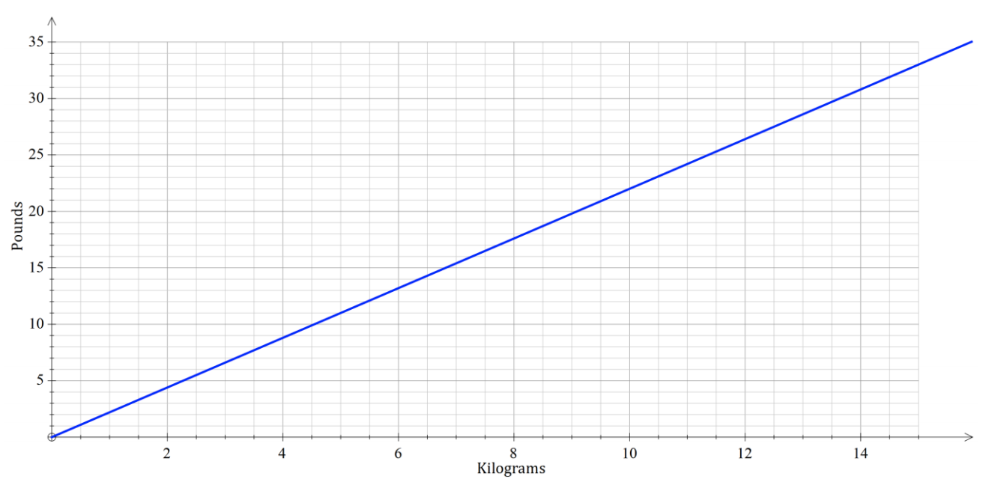
2) The graph to the right shows the approximate conversion between pounds (lb) and kilograms (kg).
Use the graph to convert 10 kilograms to pounds.
Use the graph to convert 10 pounds to kilograms.
What is the difference between 10 kilograms and 10 pounds? Give your answer in pounds and kilograms.
Sofia weighs 75kg. She says that she is heavier than Jack who weighs 154 pounds. Is she correct?
35
30
25
Pounds
20
15
10
5
2
4
6
8
10
12
14
kilograms

Slide 5
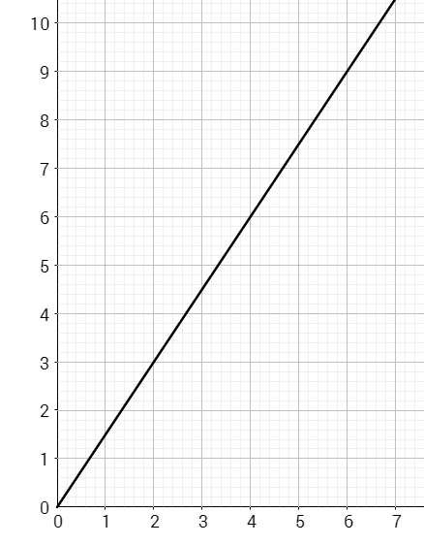
Antoni wants to convert 321 Australian dollars to Euros.​
How many different ways can he use the conversion graph to help him?
Australian dollars ($)
Euros (€)
Notes:
Choose any two and explain how they represent the same maths

