Slide 1
Repeated percentage increase and decrease
Maths
Mr Clasper

Slide 2
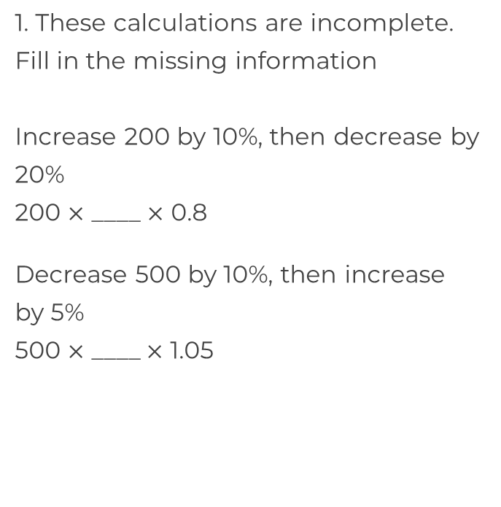
Repeated percentage increase and decrease
2. A motorbike costs £7000. It decreases in value by 6% every year. How much will it be worth after 4 years?
3. House prices increase by an average of 1.8% per year. Phillip’s house is currently worth £230 000. How much will Phillip’s house be worth in 7 years?

Slide 3
Repeated percentage increase and decrease
4. A horse weighs 700 kg. Its weight increases by 12%, before then losing 5%. How much does the horse now weigh?
5. Molly invested some savings in 2018.
By 2019 she had made a loss of 15%.
In 2020 she made a profit of 30%
What percentage has her original investment increased by?

Slide 4
Answers

Slide 5
Repeated percentage increase and decrease
2. A motorbike costs £7000. It decreases in value by 6% every year. How much will it be worth after 4 years?
3. House prices increase by an average of 1.8% per year. Phillip’s house is currently worth £230 000. How much will Phillip’s house be worth in 7 years?
£5 465
1.1
0.9
£260 593

Slide 6
Repeated percentage increase and decrease
4. A horse weighs 700 kg. Its weight increases by 12%, before then losing 5%. How much does the horse now weigh?
5. Molly invested some savings in 2018.
By 2019 she had made a loss of 15%.
In 2020 she made a profit of 30%
What percentage has her original investment increased by?

