Slide 1
Cohabitation
Lesson 8 of 15
Worksheet
Religious Education
Mr Spence
Notes:
5 seconds of silence

Slide 2
Copy out and complete the following scripture references.
____________ is to be ___________ by all, and ___________and _______ must be ____________ to each other. God will ___________ those who are __________ and those who commit _____________.
judge, husbands, faithful, honoured, marriage, immoral, wives, adultery
Scriptures and additional materials quoted are from the Good News Bible © 1994 published by the Bible Societies/HarperCollins Publishers Ltd UK, Good News Bible © American Bible Society 1966, 1971, 1976, 1992. Used with permission.

Slide 3
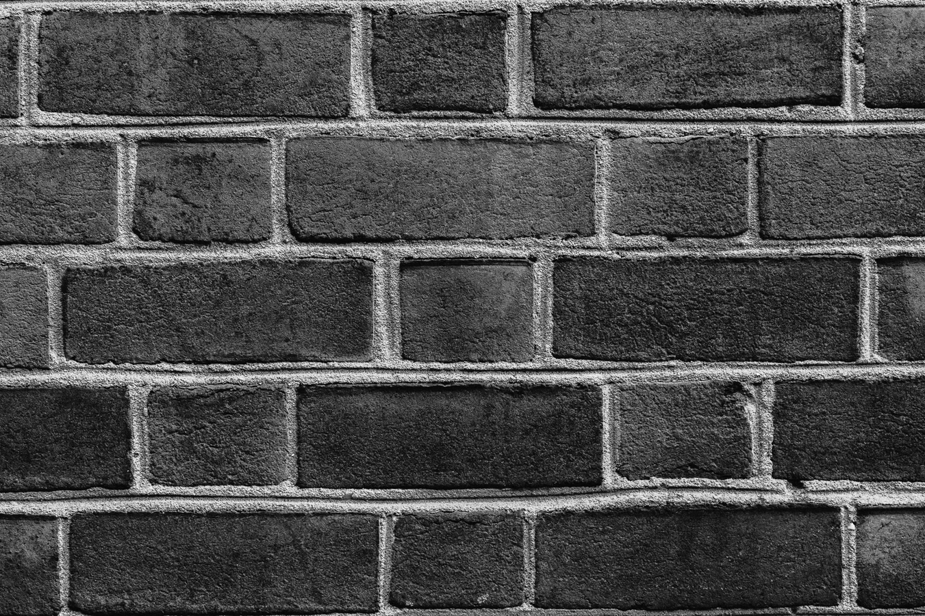
Organise the building blocks in order of how Christians and Muslims believe they should occur from bottom to top.
Living together
Living together
Pattern for Society
Union
Union
Sacrament or God’s blessing
Sacrament or God’s blessing
Procreation
Procreation
One Flesh (Sex)
One Flesh (Sex)
Endless
Endless
Seyi Ariyo - Unsplash

Slide 4
Read the passage from the Qur’an and the Bible.
What do you think will the Christian and Islamic view on Cohabitation?
________________________________________________________________________________________________________________________________________________________________________________________________
Matthew 19:4-5
Jesus answered, “Haven't you read the scripture that says that in the beginning the Creator made people male and female? And God said, ‘For this reason a man will leave his father and mother and unite with his wife, and the two will become one.’
And of His signs is that He created for you from yourselves mates that you may find tranquillity in them; and He placed between you affection and mercy. Indeed in that are signs for a people who give thought. Surah 30:21
Scriptures and additional materials quoted are from the Good News Bible © 1994 published by the Bible Societies/HarperCollins Publishers Ltd UK, Good News Bible © American Bible Society 1966, 1971, 1976, 1992. Used with permission.
Any reference to verses from the Qur’an mentioned or included within this lesson are sourced from The Qur’anic Arabic Corpus using the Sahih International translation

Slide 5
Summarise the following religious or non-religious viewpoints.
Quaker
Catholic
__________________________________________________________________________
__________________________________________________________________________
Islamic
Non-Religious
__________________________________________________________________________
__________________________________________________________________________

