Slide 1
The Collatz conjecture Unsolved maths problems
Downloadable resource
Mathematics
Miss Kidd-Rossiter

Slide 2
Yasmin and Zaki are writing number sequences.
To get to the next number, they apply these rules to their sequence.
If your number is even, divide it by two.
If your number is odd, multiply it by three and then add one.
Zaki
Yasmin
Choose a number between 1 and 10 to start your sequence.
Continue your sequence. What do you notice?
Choose a different number and try again.

Slide 3
Lothar Collatz (1910-1990)

Slide 4
Which number between 1 and 10 gives the longest sequence?
Which number between 1 and 20 gives the longest sequence?
Are there any shortcuts you can take with the conjecture?

Slide 5
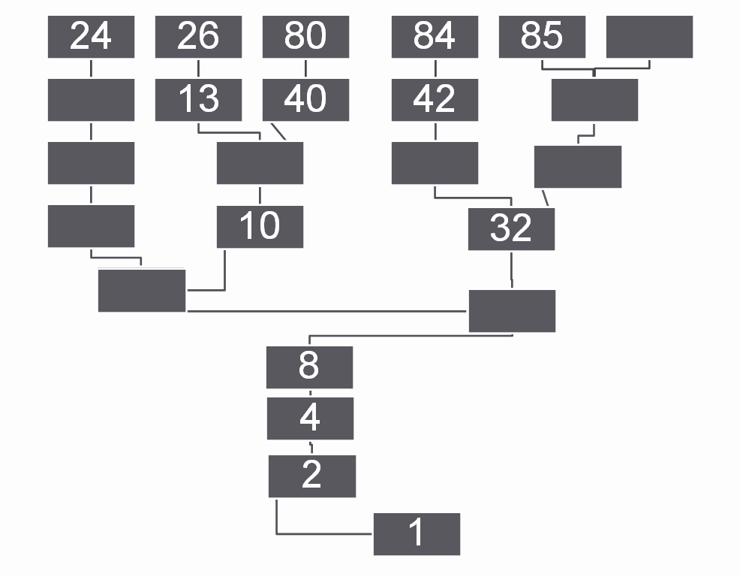
4. Fill in the missing boxes in this representation of the Collatz conjecture.

Slide 6
Cala is thinking about the Collatz conjecture.
Some sequences will only contain even numbers.
Cala
Do you agree with Cala?
Can you find some examples that either show or don’t show this to be true?

