Slide 1
Using the internet [2 / 3]
Using je + present tense verb vs using the infinitive
French
*Lesson contains references to social media which is restricted to ages 13+
Madame Clare

Slide 2
[SFC]
fais
Notes:
Let’s look at an example. How would you pronounce this word? Dis-moi! That’s right we would say fais. RETURN. The ‘s’ on the end of the word is silent.

Slide 3
[SFC]
c r f l
Be c a r e f u l with these!
Notes:
“The first thing I’d like us to consider today is the concept of SFC - silent final consonants. This is the most important pronunciation rule in French. .What can you tell me about silent final consonants in French?” That’s right they are silent - apart from CRFL. We need to be careful with these letters. These are the consonants which we pronounce at the end of words.”

Slide 4
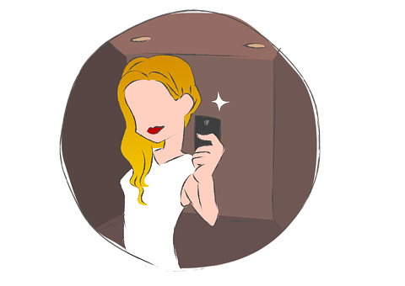
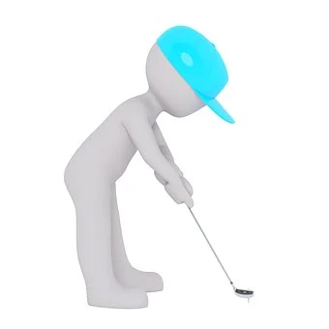
[SFC]
prends
lis
mets
Notes:
Let’s look at some more examples. Here’s our first example word - the word for takes, like take a photo. We pronounce this word as ‘prends’ Can you say this word aloud? Écoute et répète. What about this example the French word for ‘read/ reads’. How will we pronounce this word then? dis-moi! That’s right. We pronounce this word as ‘lis’. Can you say this word aloud? Écoute et répète. Our final example is the word for word. How will we pronounce this word then? dis-moi! That’s right. We pronounce this word as ‘mets’. Can you say this word aloud? Écoute et répète.
You could also ask the students how they would pronounce these words. Then say dis-moi! Then give them the feedback.

Slide 5
[er / é / et]
aller
Notes:
Another sound that is going to be really important in today’s lesson is the sound ‘ay’ It’s written at the end of many infinitives like this: -ER but we mustn’t pronounce it the English way. In French it is pronounced…….can you tell me? Dis-moi! Yes, that’ right, it’s pronounced- ay’

Slide 6
[ é / er / et ]
télécharger
aller
jouer
Notes:
Phonics practice slide [Presentation slide to practice cluster words.
Let’s take a look at some more examples………..How am I going to pronounce these -ER verbs? In today’s lesson there will be lots of opportunity to practise these key phonic sounds. Timing: 1 minute
Procedure: 1. Say the SSC sound 2. Ask student to repeat (use TL for ‘repeat’). 3. Bring on five CLUSTER words which have the same sound. Ask student to repeat. Then you say each word and leave space for the student to say them after you.

Slide 7
passer | to spend time / spending time
retrouver | to meet up / meeting up
partager | to share / sharing
apprendre | to learn / learning
l’ordinateur (m) | computer
des réseaux sociaux (mpl) | social networks
des achats (mpl) | purchases
des recherches (fpl) | research
cependant | however
par contre | on the other hand
Notes:
If you don’t have the core words written in your book, please pause the video and make a note of them now.

Slide 8
Using the infinitive vs je + present tense
After impersonal phrases, I use the infinitive of the verb.
After the subject pronoun, I conjugate the verb.
il est possible de
infinitive -er
-ir
-re
je
verb ending in -e
-s
Il est possible de télécharger de la musique.
Je télécharge de la musique
Il est important de faire les devoirs.
Je fais beaucoup de recherches en ligne.
Notes:
On the screen now you can see a summary of our learning. The structure of the impersonal expressions are on the left with a reminder for how to use the ‘je’ form of the verb in the present tense on the right. Please make a note of this learning in your books before we practice using these 2 structures together.

Slide 9
Using the internet (2/3)
1. When I change -ER verbs to the je form, I take off the -ER and I add
2. When I change -RE verbs to the je form, I take off the -RE and I add
3. When I use an impersonal expression, the il est means:
a) he is b) it is
4. When I use the impersonal expression, the verb that follows de is the 5) ending in
-e
-s
b) it is
infinitive
-er / -ir/ -re

