Slide 1
Angles and Shape:
To understand acute and obtuse angles
Main Independent Activity
Miss Brinkworth

Slide 2
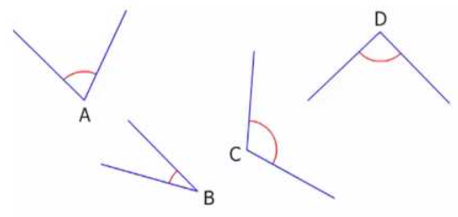
Part A
Q1 - Are these
angles acute,
obtuse or
right-angle
A =
B =
C =
D =
Q2
Find the
obtuse angle
here

Slide 3
Part B
Look at these shapes and decide what each of the different angles are (acute, obtuse or right-angle)
Challenge - Can you draw a shape which has an acute angle, an obtuse angle and a right angle?

