Slide 1
Coordinates recap
Downloadable resource
Mathematics
Mr Maseko

Slide 2
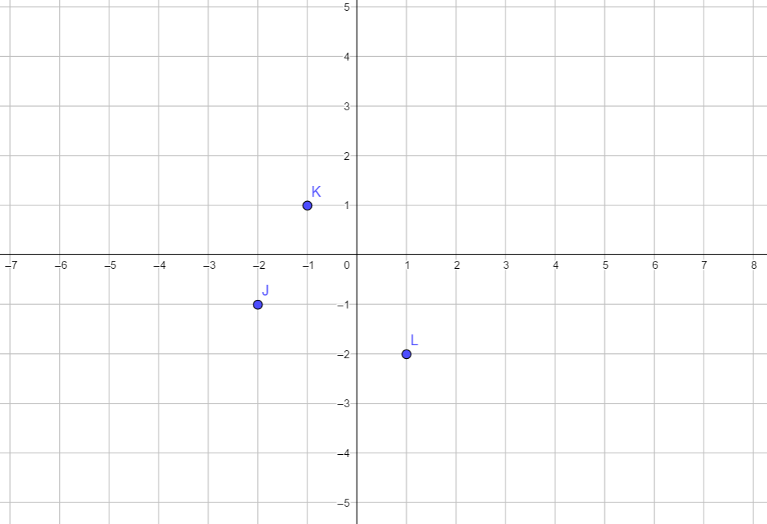
Try this
Using right, left, up and down. Describe the path between the coordinates J, K and L
What other coordinates are the same distance apart?
(-3, 2) is the same distance from J as L.
From J to L, it’s one down and 3 right

Slide 3
Connect
Coordinates are used to describe a path on grid called a Cartesian plane.
This path is always from the origin
When stating the path we always travel horizontally then vertically

Slide 4
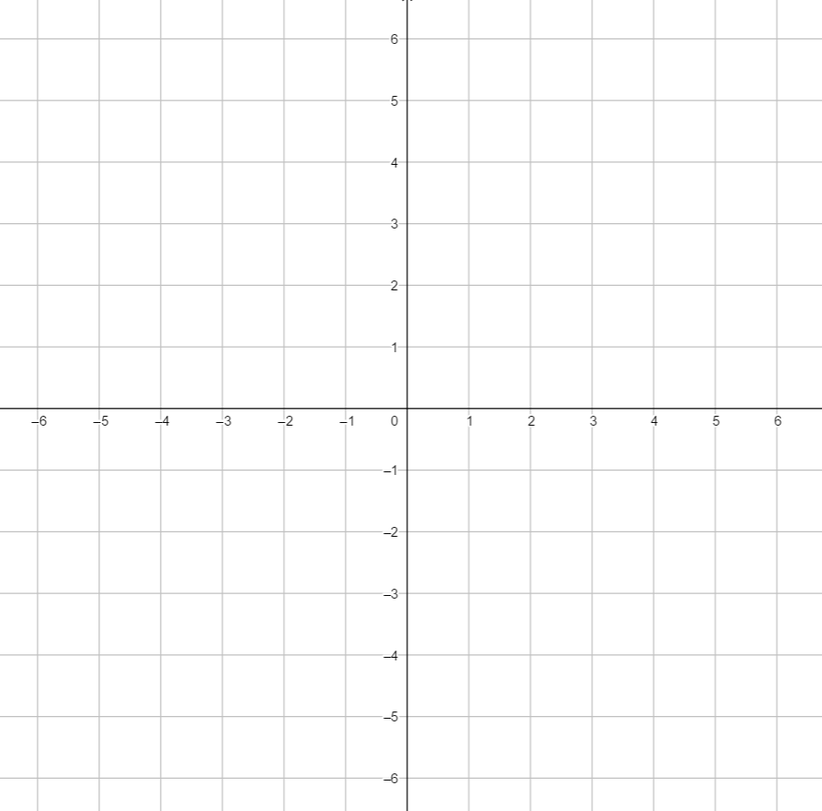
Independent task
Plot as many points on the grid as you can, that are all the same distance from the origin
What is the maximum number of points you can plot that are the same distance from the origin?

Slide 5
Explore
I start at (0, 0) then:
I move right/left spaces
I move up/down spaces
If the sum of the numbers in the 2 boxes is 6, what are the possible coordinates I end up at?

