Slide 1
How did Pachelbel successfully compose and weave together melodies?
Music
Miss Charatan

Slide 2
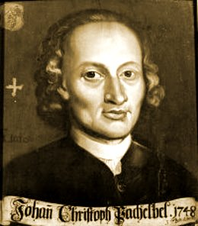
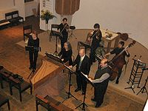
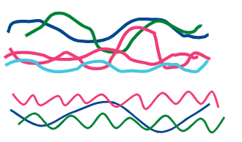
What do we now know about Baroque music?
Instrumentation
Composers
Melody/Harmony/Tonality
Texture and structure
Notes:
Is canon a texture, rather than a structure? Or both?

Slide 3
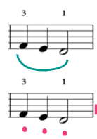
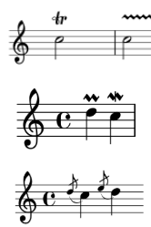
How can we play something musically?

Slide 4
Playing musically
2
3
Slur
4
Notes:
Demonstrate

Slide 5
Melodies 1 and 2
1
B A B C#
2
G F# G E
Notes:
Play eg. from garageband (keyboard)
Students write down answer

Slide 6
3
D B D A G B A G
4
B D D C B C A
5
6
D C B C A A G D C#
Notes:
Demonstrate

Slide 7
Chords
Ground Bass
Notes:
Demonstrate

Slide 8
References
Slide [2] - [Wikimedia Commons] - [Denelson83] - [Trill notation]
Slide [3] - [Wikimedia Commons] - [Denelson83] - [Trill notation]
Slide [3] - [Wikimedia Commons] - [Camembert ] - [ Acciaccatura notation]
Slide [3] - [Wikimedia Commons] - [Kisipila] - [ Upper.lower.mordent.notation]
Slide [4] - [Wikimedia Commons] - [JLTB84] - [ Crescendo-decrescendo]

