Slide 1
Describing a region [5 / 5]
Using depuis
Using the pronoun y
French
Monsieur Lowe

Slide 2
Phonétique

Slide 3
[ j / ge ]
jour

Slide 4
[ j / ge ]
j’ai
jamais
[I have]
génial
[never]

Slide 5
Grammaire
Using depuis

Slide 6
Depuis
means for or since
5 years
J’habite à la campagne depuis 5 ans.
=
I have been living in the countryside for 5 years.
or
=
I have lived in the countryside for 5 years.
When we use depuis the verb is in the present tense.

Slide 7
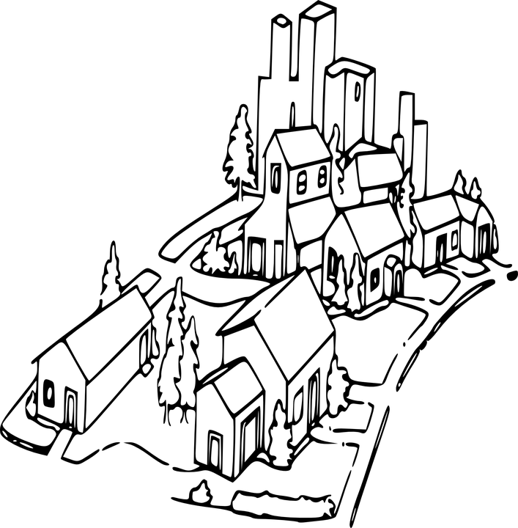
Depuis
means for or since
the age of 5
J’habite dans un village depuis l’âge de 5 ans.
=
I have been living in a village since the age of 5.
or
=
I have lived in a village since the age of 5.
When we use depuis the verb is in the present tense.

Slide 8
Depuis
means for or since
depuis l’âge de 5 ans
= since the age of 5
depuis 5 ans
= for 5 years
2015-2020
for
since
Use depuis with the present tense in French:
J’habite à la campagne depuis 5 ans = I have been living in the countryside for 5 years.
J’habite dans un village depuis l’âge de 5 ans = I have been living in a village since I was 5.

Slide 9
Grammaire
Using the pronoun y

Slide 10
Y - there
J’habite en France - I live in France
J’y habite - I live there
The pronoun ‘y’ goes after the personal pronoun/before the verb.
Je y becomes j’y
J’habite en France depuis 4 ans → J’y habite depuis 4 ans.
Il habite au Japon depuis 15 ans → Il y habite depuis 15 ans.

Slide 11
Describing a region
Depuis means
Y means
We use the tense with depuis.
J’y habite =
L’âge de 3 ans =
Il/Elle y habite =
For or Since
there
present
I live there
The age of 3
He/She lives there

