Slide 1
Enlargement with a negative scale factor
Maths
Mr Chan

Slide 2
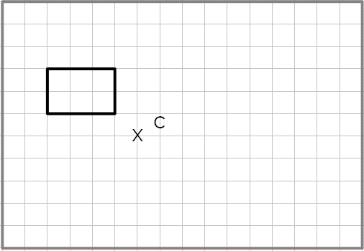
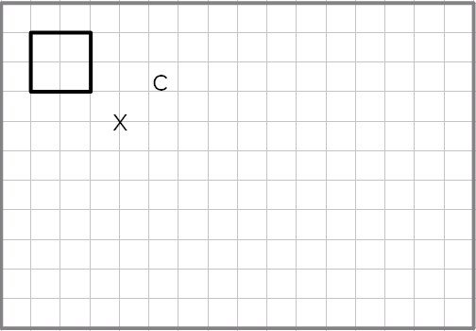
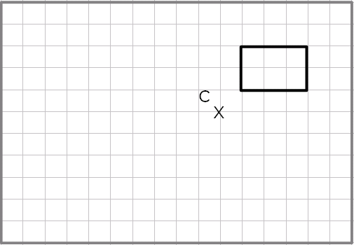
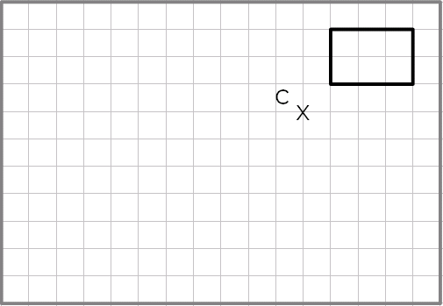
Enlargement with a negative scale factor
1. Enlarge each shape by a scale factor of -1 from the centre of enlargement C
a)
b)
2. Enlarge each shape by a scale factor of -2 from the centre of enlargement C
a)
b)

Slide 3
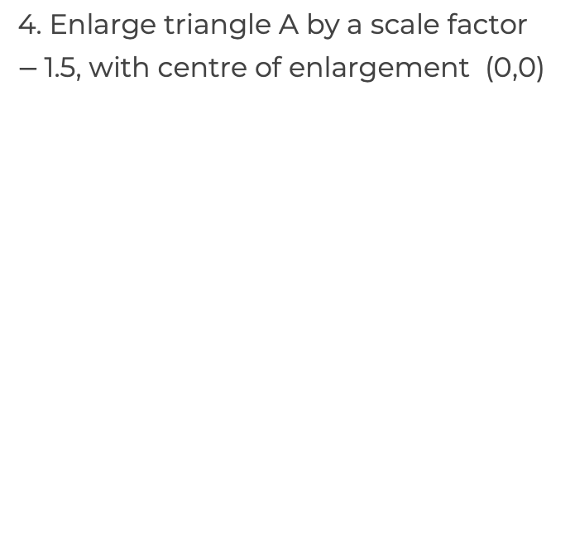
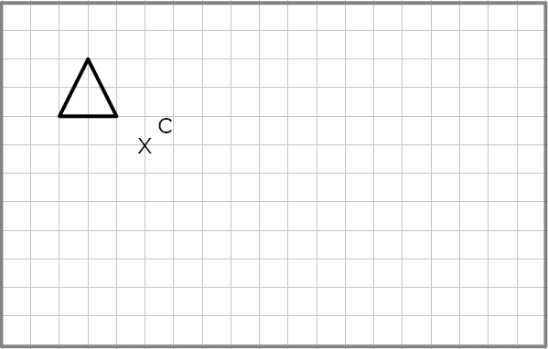
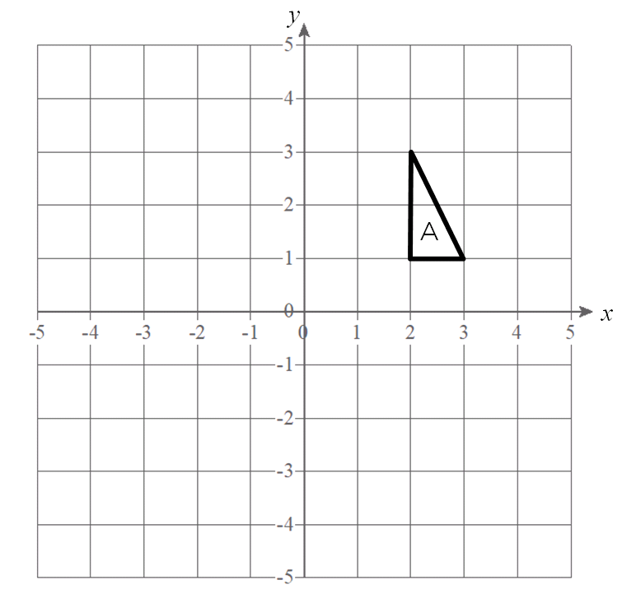
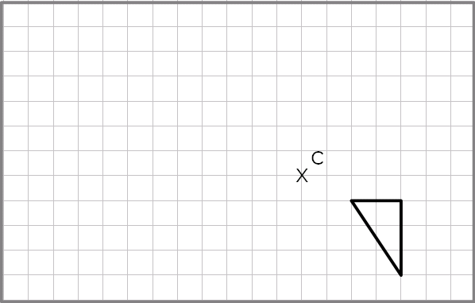
Enlargement with a negative scale factor
3. Enlarge each shape by a scale factor of -1 from the centre of enlargement C
a)
b)

Slide 4
Answers

Slide 5
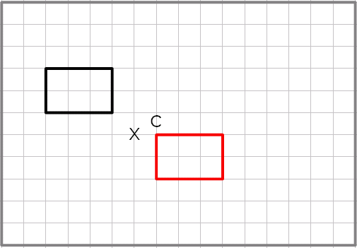
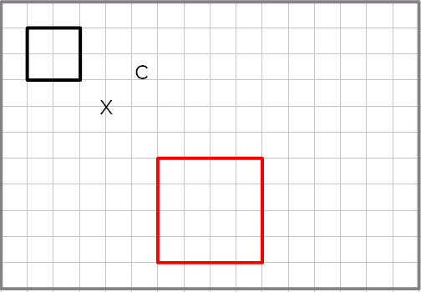
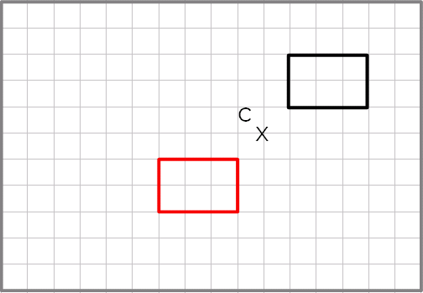
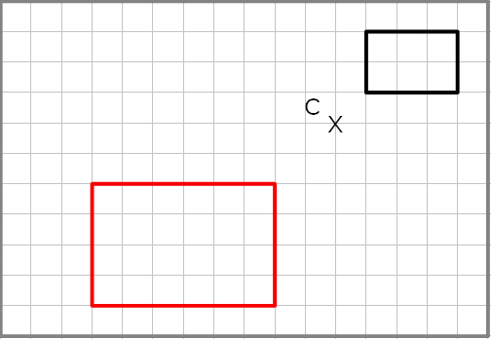
Enlargement with a negative scale factor
1. Enlarge each shape by a scale factor of -1 from the centre of enlargement C
a)
b)
2. Enlarge each shape by a scale factor of -2 from the centre of enlargement C
a)
b)

Slide 6
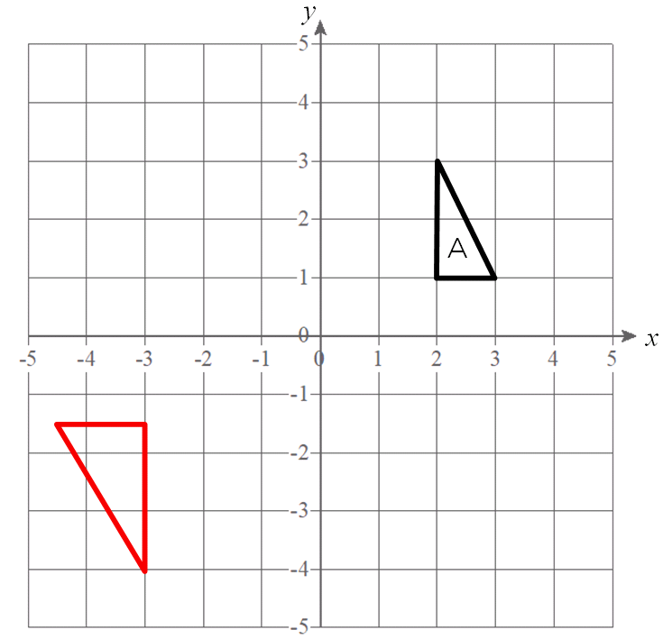
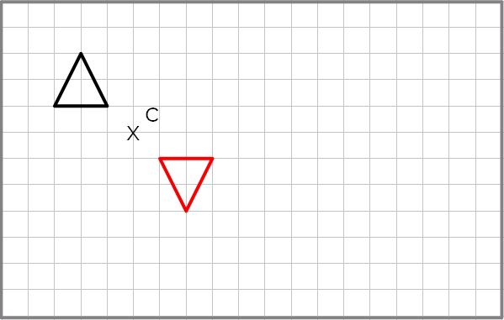
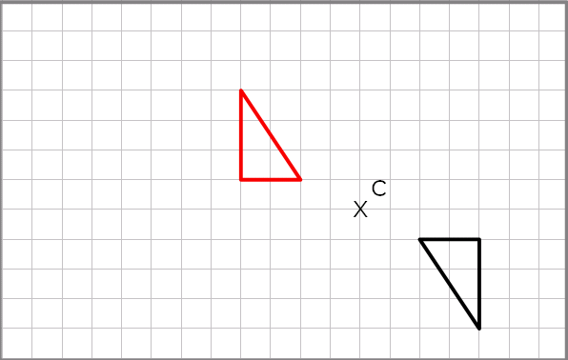
Enlargement with a negative scale factor
3. Enlarge each shape by a scale factor of -1 from the centre of enlargement C
a)
b)

