Slide 1
3-D Shape: Identifying the properties of constructed 3-D shapes
Mathematics
Ms Jeremy

Slide 2
3-D shape vocabulary
Face
Edge
Vertex
Vertices
Apex
A corner where edges meet.
A flat or curved surface on a 3-D shape.
Corners where edges meet.
The area where 2 faces meet.
The vertex at the top of the shape.

Slide 3
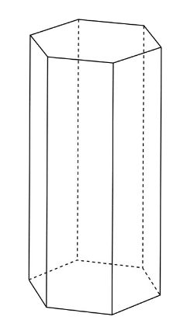
Pause the video to complete your task
Resume once you’re finished
Use the vocabulary to describe:
‘This shape has ____ faces with
_____ edges.
There are ______ vertices with/without an apex.’

Slide 4
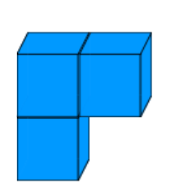
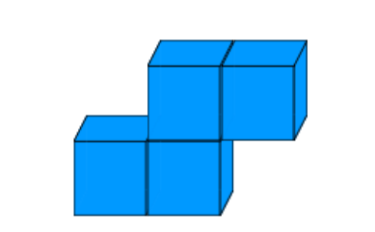
Pause the video to complete your task
Resume once you’re finished
What is the difference between the properties of these 3-D shapes?
1
2

Slide 5
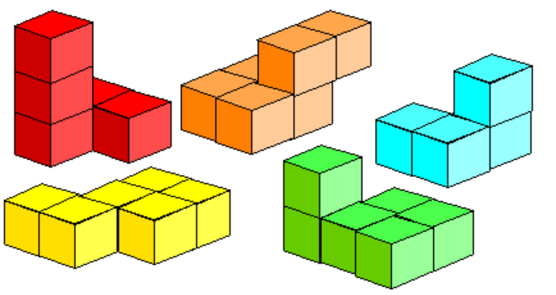
Independent Task
Pause the video to complete your task
Write 1 sentence for each shape to describe its properties.
Use the vocabulary: faces, edges and vertices.
Resume once you’re finished
Image taken from NRICH

