Slide 1
Acceleration RPA 1
Combined Science - Physics - Key Stage 4 - Forces
Mr Saville
Miss Whittick

Slide 2
Warm up
1.What relationship is there between force and acceleration?
2.Which of Newton’s laws is this?
3.What is the equation linking force, mass and acceleration?
4.What is the force applied if a 2.5 kg mass has an acceleration of 4 m/s²?
5.What is the acceleration when a mass of 10 kg has 20 N of force applied?

Slide 3
Independent Practice
What is your hypothesis for the practical?
As the …………………………. is increased, the ……………………………. will ……………………………..
What is the independent variable for this practical?
What is the dependent variable for this practical?
What are the control variables for this practical?

Slide 4
Independent Task
Complete the table below, giving the reasons for each of these steps in our method .
Method | Reason
Set up the air track and vacuum cleaner on ‘blow’
Set the light gates a set distance apart, and connect to software. Set the card on the glider
Ensure weight stack does not reach the floor
Calculate acceleration with 200g mass added to the trolley, repeat 3 times.
Add a further 200g mass and repeat. Do this for a further 3 times adding 200g each time

Slide 5
Results - Independent Practice
Copy and complete the results table; complete the table headings (units) and calculate the mean accelerations.
Mass added | Acceleration 1 | Acceleration 2 | Acceleration 3 | Mean Acceleration
0.2 | 2.90 | 2.90 | 2.84
0.4 | 2.22 | 2.37 | 2.21
0.6 | 1.94 | 1.81 | 1.84
0.8 | 1.66 | 1.54 | 1.55
1.0 | 1.45 | 1.31 | 1.42

Slide 6
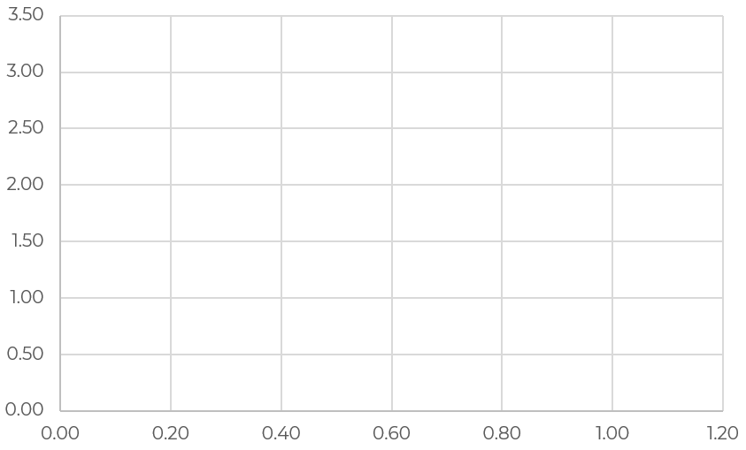
Analysis - Independent Practice
Draw out an appropriate scale
Label each axis correctly
Plot the results
Draw a line of best fit
State what the results show - is there any relationship between the 2 variables?
Does this prove the hypothesis?

