Slide 1
Multiplication table of three
Independent Task
Maths
Mrs Crane

Slide 2
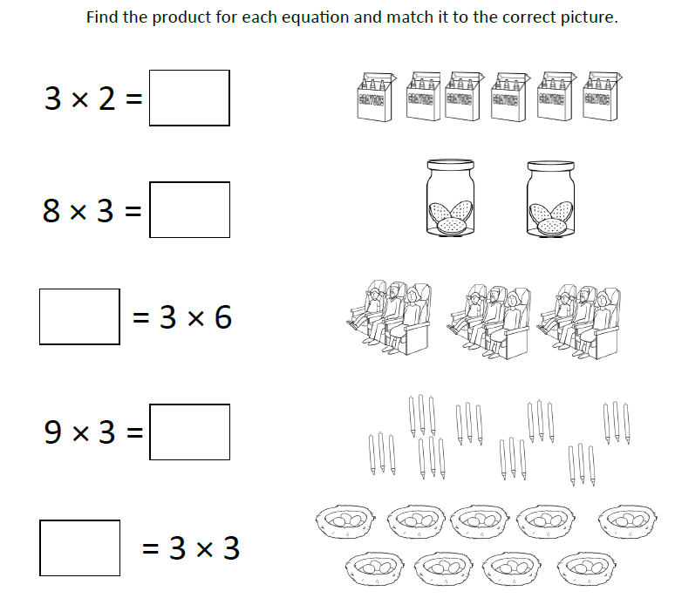
Independent Task
Find the product for each equation and match it to the correct picture.
0 1 2 3 4 5 6 7 8 9 10 11 12 13 14 15 16 17 18 19 20 21 22 23 24 25 26 27 28 29 30

Slide 3
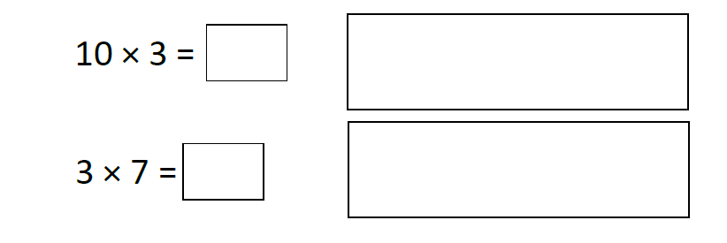
Independent Task
Solve the following
0 1 2 3 4 5 6 7 8 9 10 11 12 13 14 15 16 17 18 19 20 21 22 23 24 25 26 27 28 29 30

