Slide 1
Know Tangent, Sine and Cosine
Maths
Miss Davies

Slide 2
Know Tangent, Sine and Cosine
1. Label the sides of the right-angled triangles.
a) b)
c) d)
2. Identify a right-angled triangle which includes the labelled angle and label its sides.
a) b)
c) d)
37º
24º
42º
37º
37º
37º
34º
60º

Slide 3
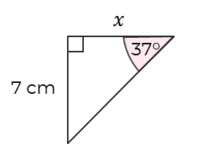
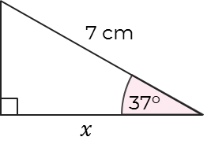
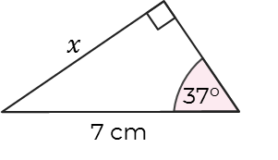
Know Tangent, Sine and Cosine
3. Label the sides of the right-angled triangles and identify which ratio will be used.
a) b)
c) d)
4. Dustin is finding the side labelled x.
What mistake has he made in his labelling?
5. Amir is finding the side labelled x.
What mistake has he made?
“The hypotenuse is always the longest diagonal side”.
H
A
37º
O
O
“We don’t know the adjacent side, so need to use Cosine”
H
A
7 cm
37º

Slide 4
Answers

Slide 5
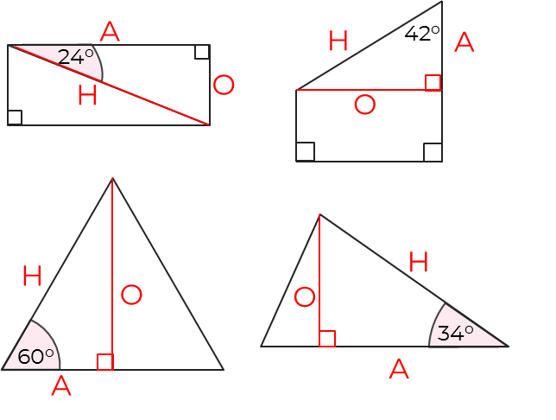
Know Tangent, Sine and Cosine
1. Label the sides of the right-angled triangles.
a) b)
c) d)
2. Identify a right-angled triangle which includes the labelled angle and label its sides.
a) b)
c) d)
A
37º
H
O
O
H
37º
A
O
O
A
A
H
37º
37º
H

Slide 6
Know Tangent, Sine and Cosine
3. Label the sides of the right-angled triangles and identify which ratio will be used.
a) b)
c) d)
Tangent
A
Cosine
H
O
A
Sine
O
Sine
O
H
H

Slide 7
Know Tangent, Sine and Cosine
4. Dustin is finding the side labelled x.
What mistake has he made in his labelling?
5. Amir is finding the side labelled x.
What mistake has he made?
“The hypotenuse is always the longest diagonal side”.
H
A
The hypotenuse is always the longest side, opposite the right angle. It doesn’t have to be diagonal.
37º
O
O
“We don’t know the adjacent side, so need to use Cosine”
Amir is trying to find the opposite side, he should use Sine.
H
A
7 cm
37º

