Slide 1
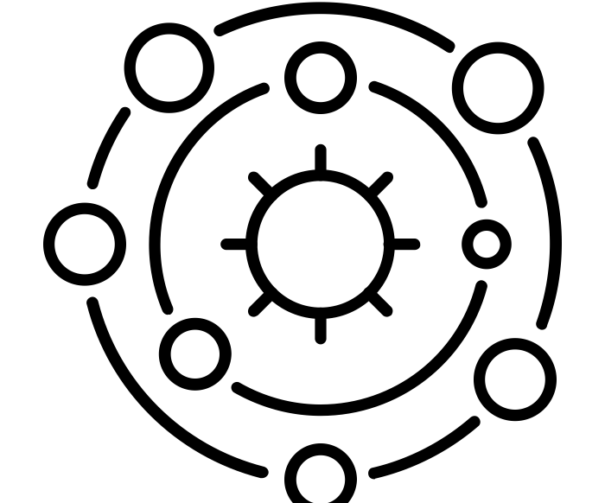
How do the planets in the solar system differ?
Science - Space
Miss Hummel
solar system by Andrei Yushchenko from the Noun Project
Notes:
Hi everyone! My name is Miss Hummel and together, we will be answering the question: What is the solar system?
In this lesson we will discuss what we can find in our solar system. We will also discuss what a planet, moon and space dust is. Finally, we will examine the differences between Asteroids, Meteoroids, Meteors and Meteorites.

Slide 2
Preparation for the lesson:
Planet | Mnemonic | Picture | Size description | Temperature | Other description
Mercury
Venus
Earth
Mars
Jupiter
Saturn
Uranus
Neptune

Slide 3
Complete this mnemonic
Mercury | M
Venus | V
Earth | E
Mars | M
Jupiter | J
Saturn | S
Uranus | U
Neptune | N

Slide 4
Complete this mnemonic
Mercury | M | My
Venus | V | Very
Earth | E | Easy
Mars | M | Method
Jupiter | J | Just
Saturn | S | Summed
Uranus | U | Up
Neptune | N | Now

Slide 5
Thinking Task:
How long does it take Mercury to orbit the Sun?
Notes:
You are now going to pause the video to label the diagram with the parts of the lever.

Slide 6
Thinking Tasks
Why does Mars’s atmosphere trap a large amount of heat?
Why is the surface of Mars red?
Notes:
You are now going to pause the video to label the diagram with the parts of the lever.

Slide 7
Write the names of the object from the solar system being described below:
- the largest object in the solar system that the solar system was named after
- large spheres of rock that orbit around the sun
- large balls of rock that orbit planets
- an example of another rocky object that can be found in the solar system
- leftover material from stars that have exploded in the past
Notes:
Image from Oak illustrator
I would now like you to pause the video to answer this question
What are three examples of things that use pulleys?
Resume once you are finished answering the question.

Slide 8
Thinking Task:
What is the Big Red Spot?
Notes:
You are now going to pause the video to label the diagram with the parts of the lever.

Slide 9
Thinking Task:
What is Saturn famous for?
Notes:
You are now going to pause the video to label the diagram with the parts of the lever.

Slide 10
Question to answer:
Write down one difference between Uranus and Neptune.
Notes:
You are now going to pause the video to label the diagram with the parts of the lever.

Slide 11
Sort these descriptions into ‘Inner rocky planets’ or ‘Outer gas giants’:
- Closer to the Sun
- Further away from the Sun
- Mostly made from gas
- Mostly solid rock
- The colder planets
- The warmer planets
- Often have rings of dust and rock around them
Inner Rocky Planets | Outer Gas Planets
Notes:
Image from Oak illustrator
I would now like you to pause the video to answer this question
What are three examples of things that use pulleys?
Resume once you are finished answering the question.

Slide 12
Read the clues and work out which planet is which below:
1) Which planet is the hottest planet? ___________________
2) Which is the largest planet? ___________________
3) Which planet spins on its side? ___________________
4) Which planet is the closest to the Sun? ___________________
5) Which planet is red due to iron minerals in its surface? ________________
6) Which planet is the furthest away from the Sun? ___________________
7) Which planet is known for its 7 rings that are easy to see? _______________
Notes:
Image from Oak illustrator
I would now like you to pause the video to answer this question
What are three examples of things that use pulleys?
Resume once you are finished answering the question.

Slide 13
Thinking Task:
Why might it be difficult to study planets in detail?
Notes:
I would now like you to pause the video to answer this question
What are three examples of things that use gears?
Resume once you are finished answering the question.

