Slide 1
Velocity-Time Graphs
Combined Science - Physics - Key Stage 4 - Forces
Mr Saville
Miss Whittick

Slide 2
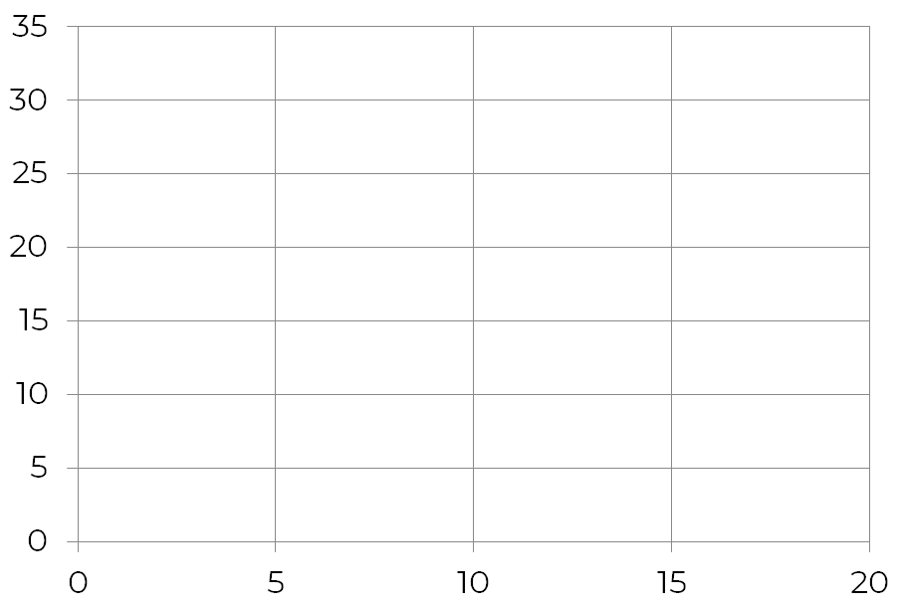
Identify what each area represents on the graph:
A & C:
B:
D:
How many times did the object accelerate?
At what point is the object accelerating quickest?
How long did the object remain at a constant velocity?
C
Velocity (m/s)
D
B
A
Time (s)

Slide 3
Calculating Acceleration - You Do
Calculate the acceleration of A.
Calculate the acceleration of C.
Calculate the deceleration of D.
C
Velocity (m/s)
D
B
A
Time (s)

Slide 4
HT ONLY - Independent Practice
Calculate the distance travelled at points A and B.
C
Velocity (m/s)
D
B
A
Time (s)

