Slide 1
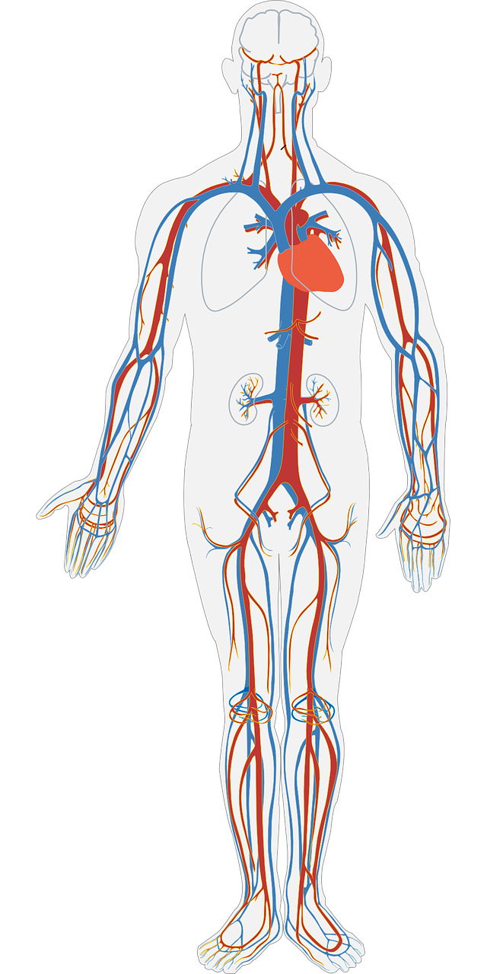
How is oxygen transported around our bodies?
Science - Human Anatomy
Miss Hummel
Notes:
Hi everyone! My name is Miss Hummel and together, we will be answering the question: How is oxygen transported around our bodies?
In this lesson, we will learn about the circulatory system. We will also focus on the contents of blood, the types of blood vessicles, and how the heart works.
In this lesson we will learn about the differences between humans and other animals. We will first learn about vertebrates and invertebrates, followed by the differences of animals who use lungs and gills to breathe. Then, we will briefly compare brains of animals. Finally, we will complete some application questions.

Slide 2
Thinking Task:
What are the three parts the circulatory system is formed out of?

Slide 3
Fill in the gaps in the passage below:
The human circulatory system is a group of ___________ and vessels which transports _________ around the body. Without it, your _________ would never receive the ____________ and food they need to function. Your _________ is busy beating all the time in order to pump ________ through your arteries and keep it in ______________. Once it has dropped off the food and oxygen the blood is transported back to your heart through your __________. The lungs are also a part of the ________________ system. Blood is pumped to the ______________ where it drops off waste __________ dioxide and picks up fresh ____________ before going around the body again.

Slide 4
Fill in the gaps in the passage below:
Need help?
The human circulatory system is a group of ___________ and vessels which transports _________ around the body. Without it, your _________ would never receive the ____________ and food they need to function. Your _________ is busy beating all the time in order to pump ________ through your arteries and keep it in ______________. Once it has dropped off the food and oxygen the blood is transported back to your heart through your __________. The lungs are also a part of the ________________ system. Blood is pumped to the ______________ where it drops off waste __________ dioxide and picks up fresh ____________ before going around the body again.
cells | organs | blood | circulatory | oxygen | lungs
heart | oxygen | carbon | circulation | veins | blood

Slide 5
Fill in the table:
Component of blood | Function
 | Help protect against disease.
platelets
 | A liquid that carries blood cells and other nutrients.
red blood cells

Slide 6
Thinking Task:
What is the difference between arteries and veins?
Do they have any similarities?

Slide 7
Describe the steps of the circulatory system:
First,
Then,
Afterwards,
Finally, the blood travels back to the heart with carbon dioxide and it all begins again.

