Slide 1
Creative Writing (poetry): Simile and metaphor
Lesson 2 of 5
English
Sarah Krzebietka

Slide 2
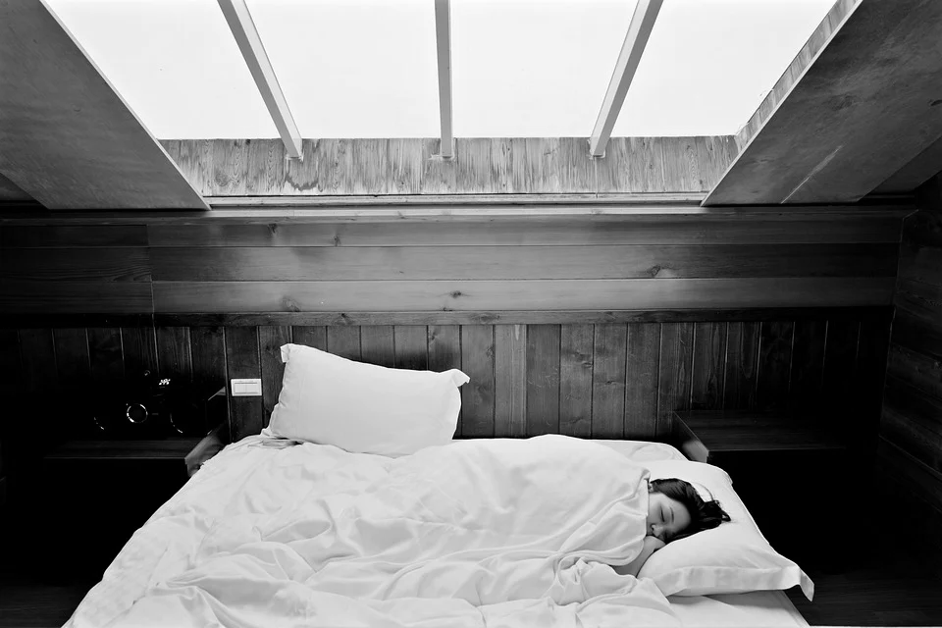
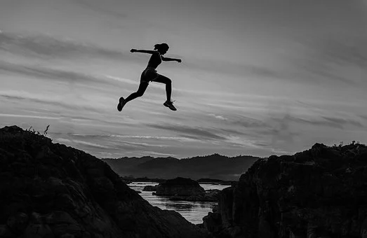
Use these images to create some similes of your own.
Top Tip: before you start writing think of objects, people, animals or things in nature that you could compare to or describe as.
Sleep Bed Woman by Free-Photos (Pixabay)
Achieve Woman Girl by Sasint Free-Photos (Pixabay)

Slide 3
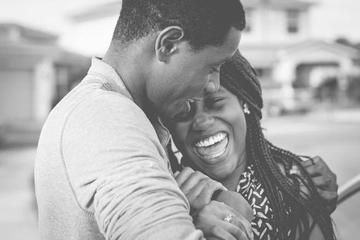
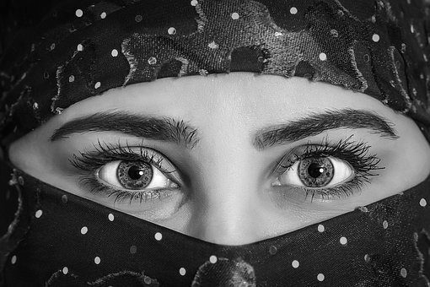
Use these images to create some metaphors of your own.
Top Tip: before you start writing think of objects, people, animals or things in nature that you could compare to or describe as.
Only use the prompts if you want to.
Black and white people by StockSnap (Pixabay)
3. Her smile was a warm ______________.
4. The eyes that stared out at me were filled with ______________.
Model Beauty Woman by Besi (Pixabay)

