Slide 1
Mathematics
Downloadable Resource
Mr Maseko

Slide 2
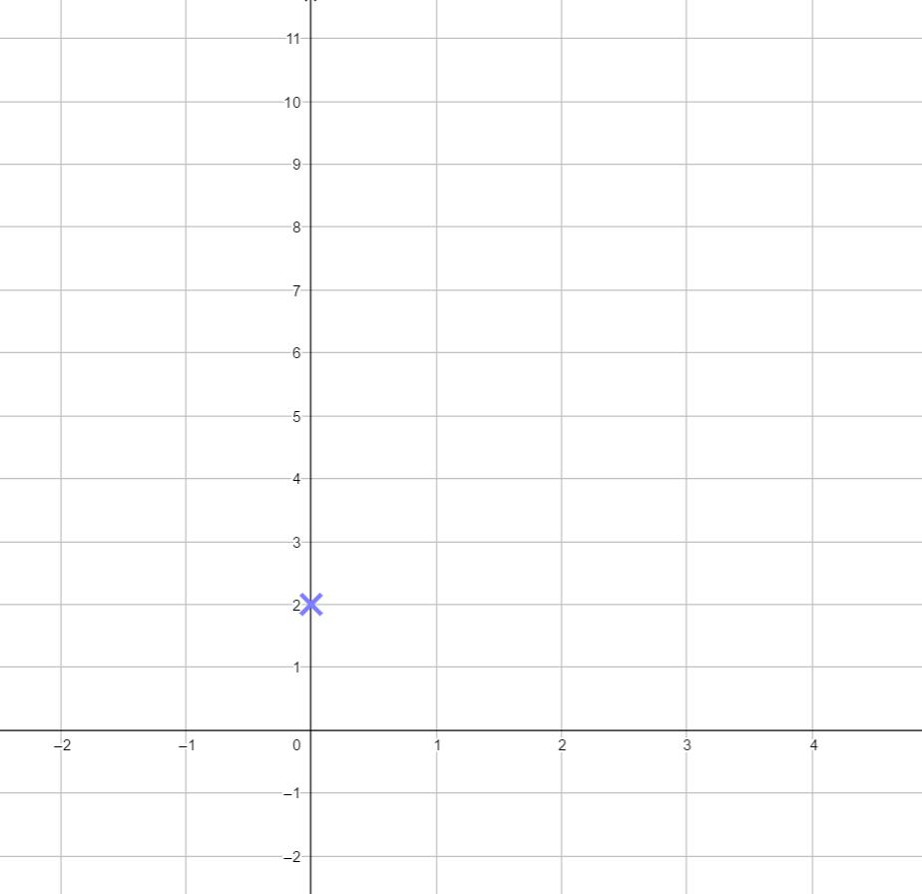
I’m thinking of a linear graph with a gradient of 2 that goes through (0, 3).
What other coordinates are of Binh’s line?

Slide 3
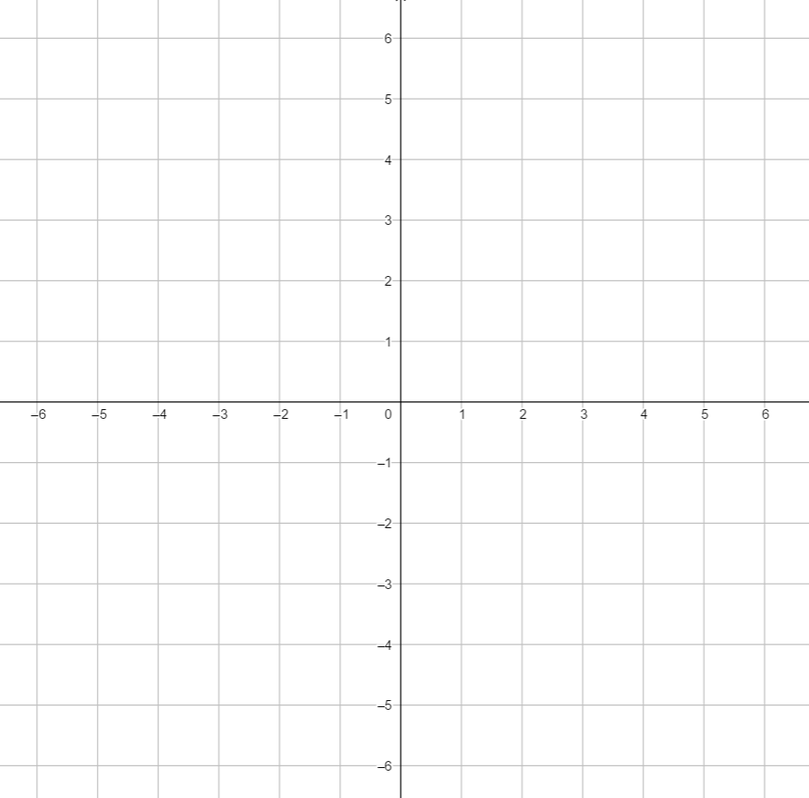
What is the equation of each of the lines?
What is the same?
What’s different?

Slide 4
y = mx + c
This is the general form that equations of lines are written in.
y = 2x + 3
y = 2x
y = 2x - 4

Slide 5
For each of the following equations state the gradient and the y-intercept coordinate.
y = 2x + 1
y = 3x – 1
y = 5x + 4
y = 5 – 2x
2) A line has a gradient of 4 and goes through the point (0,4). What is the gradient of the line?

Slide 6
Use these cards to fill the spaces and make an accurate statement
1
3
5
7
9
2
4
6
8

