Slide 1
Making a sock puppet
Communication and Language: Clothes and Fashion – Applying Learning
Alison

Slide 2
For this lesson, you will need:
A sock
Scissors - be careful as these may be sharp
Sellotape
Paper
Coloured pens
Stick on eyes (if you have some)

Slide 3
Following instructions
In this lesson we are going to make a sock puppet. We will follow simple instructions.
Adult support will be required.
Images from Pixabay.com

Slide 4
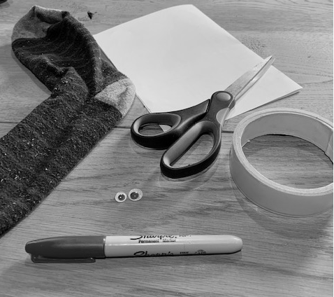
Getting ready
Use the symbols to help you find these things:

Slide 5
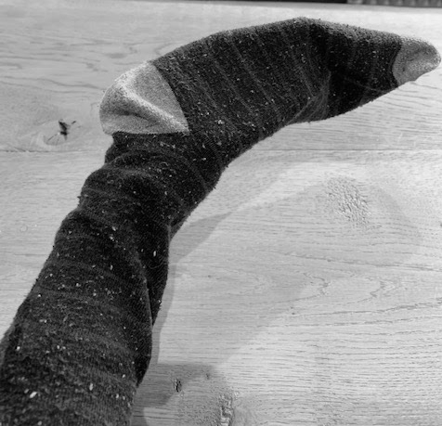
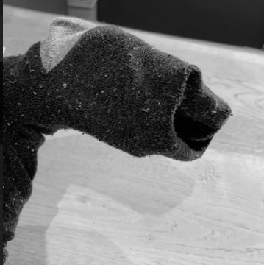
Step 1
Put your hand in the sock
Push in the end of the sock to create a mouth

Slide 6
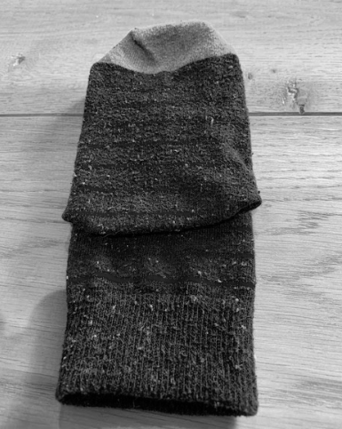
Step 2
Place your sock (with the mouth pushed in) flat on the table

Slide 7
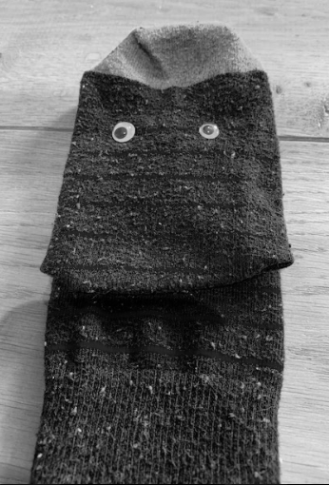
Step 3
Stick on the eyes

Slide 8
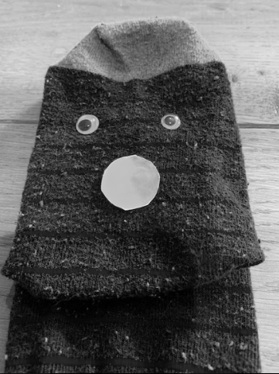
Step 4
Draw a nose
Cut out the nose
Stick onto the sock
Note: adult support
required when using
scissors

Slide 9
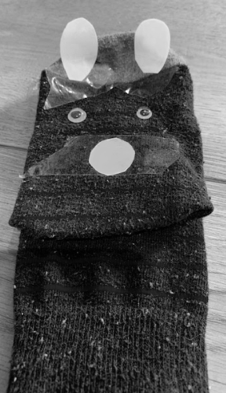
Step 5
Draw ears
Cut out the ears
Stick onto the sock
Note: adult support
required when using
scissors

Slide 10
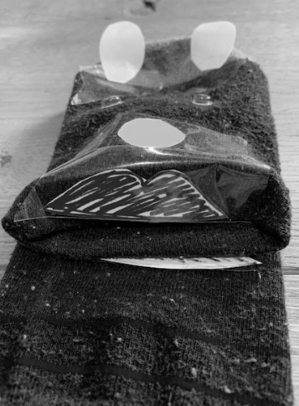
Step 6
Draw a mouth
Cut out the mouth
Stick onto the sock
Note: adult support
required when using
scissors

Slide 11
Now it’s time to complete the activity
Follow the instructions to make your sock puppet
Follow the step by step instructions to make your sock puppet

Slide 12
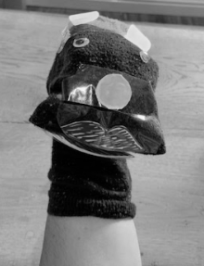
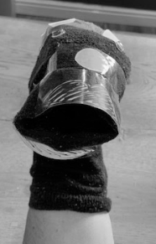
Have a conversation with your sock puppet
Put hand in sock puppet
Make mouth open
Make mouth close

Slide 13
Now it’s time to complete the activity
Make your puppet talk
Put your hand inside the sock to make the mouth open and close
Can you make a funny voice for your puppet?
What is your puppet called?

Slide 14
Make it easier
Make it harder
More ideas
Use symbols and photos to help you to follow the instructions
Limit choices to two objects when matching object to symbol
Reduce the adult support
Use words instead of symbols
Make choices from three or more objects
Make a whole family of sock puppets
Put on a sock puppet show
Make a puppet from a glove

