Slide 1
Mathematics
Multiplying Unit Fractions with Integers
Downloadable Resource
Mr Langton

Slide 2
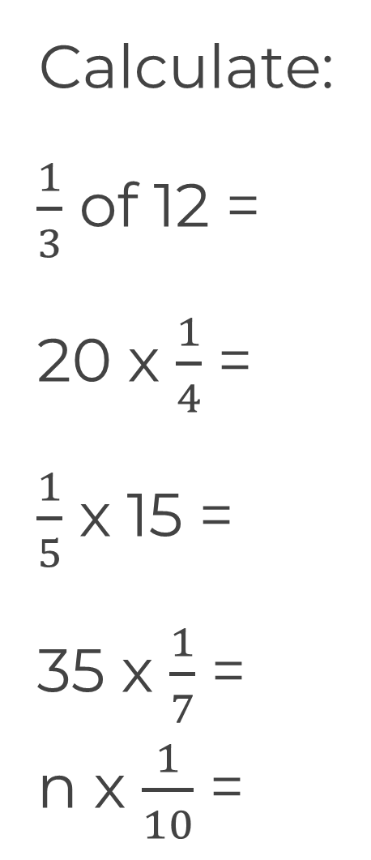
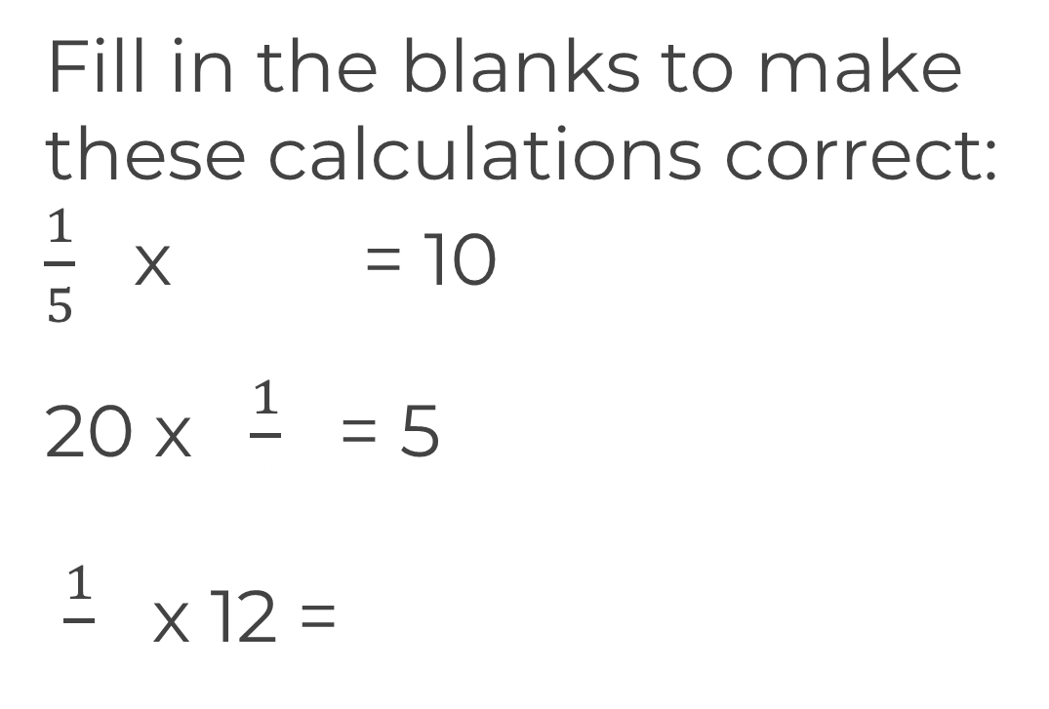
Multiplying unit fractions with integers
Calculate:
4 ÷ 3 x 9 ÷ 2

