Slide 1
Place Value
Order and compare 3 digit numbers
Mathematics
Miss Hill

Slide 2
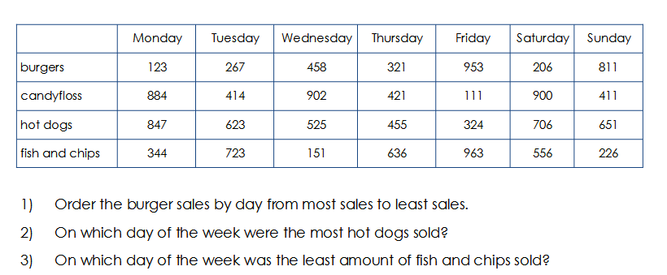
Independent Task

