Slide 1
Expand a Term over a Single Bracket
Maths
Miss Davies

Slide 2
Expand a Term over a Single Bracket
1. Rosie has expanded 5(a + 4)
5(a + 4) ≡ 5 × a + 5 × 4 ≡ 5a + 20
Expand these brackets.
a) 3(2a + 5)
b) 10(3a + 2)
c) 6(3 + 7b)
d) 5(2d – 3x)
2. Write down an expression for the area of the rectangles in their expanded form.
a)
b)
3x + 6
e) 3(5 + 4c)
f) 4(5c – 4)
g) –5(3f + 7)
h) –7(9 – 4g)
4
5
2y ─ 1

Slide 3
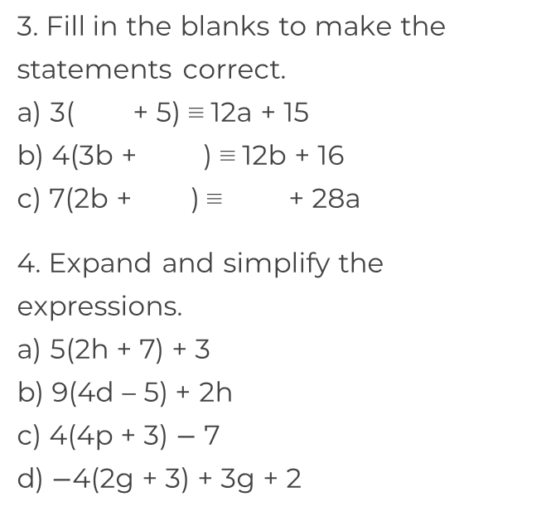
Expand a Term over a Single Bracket
5. Rosie expands 4(2x – 1)
Here is her working out
4(2x – 1) ≡ 8x − 1
What mistake has she made?
6. Amir is 3 years older than Ben.
Ben is twice the age of Clare.
Clare is 5 years younger than David.
David is d years old.
Write a simplified expression to represent Amir’s age.
h

Slide 4
Answers

Slide 5
Expand a Term over a Single Bracket
1. Rosie has expanded 5(a + 4)
5(a + 4) ≡ 5 × a + 5 × 4 ≡ 5a + 20
Expand these brackets.
a) 3(2a + 5)
b) 10(3a + 2)
c) 6(3 + 7b)
d) 5(2d – 3x)
2. Write down an expression for the area of the rectangles in their expanded form.
a)
b)
3x + 6
e) 3(5 + 4c)
f) 4(5c – 4)
g) –5(3f + 7)
h) –7(9 – 4g)
Area = 12x + 24
Area = 10y - 5
≡ 6a + 15
≡ 30a + 20
≡ 18 + 42b
≡ 10d – 15x
≡ 15 + 12 c
≡ 20c – 16
≡ -15f – 35
≡ -63 + 28g
4
5
2y ─ 1

Slide 6
Expand a Term over a Single Bracket
3. Fill in the blanks to make the statements correct.
a) 3( + 5) ≡ 12a + 15
b) 4(3b + ) ≡ 12b + 16
c) 7(2b + ) ≡ + 28a
4. Expand and simplify the expressions.
a) 5(2h + 7) + 3 ≡ 10h + 38
b) 9(4h – 5) + 2h ≡ 38h – 45
c) 4(4p + 3) – 7 ≡ 16p + 5
d) -4(2g + 3) + 3g + 2 ≡ – 5g – 10
5. Rosie expands 4(2x – 1)
Here is her working out
4(2x – 1) ≡ 8x − 1
What mistake has she made?
6. Amir is 3 years older than Ben.
Ben is twice the age of Clare.
Clare is 5 years younger than David.
David is d years old.
Write a simplified expression to represent Amir’s age.
4a
4
4a
14b
She needs to multiply 4 by -1.
2d – 7

