Slide 1
Linking meals to times of the day
Lesson 3 of 4
Numeracy: Time - Building Understanding
Helen
Notes:
Into full intro slide

Slide 2
What food could we eat for breakfast?
Draw or write your ideas below.

Slide 3
What food could we eat at lunchtime?
Draw or write your ideas below.

Slide 4
What food could we eat at teatime?
Draw or write your ideas below.

Slide 5
What food could we eat for supper?
Draw or write your ideas below.
Notes:
Into full screen match food to time of day

Slide 6
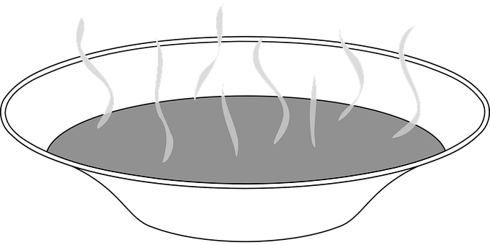
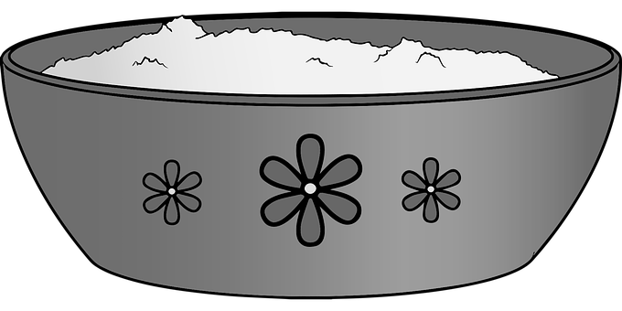
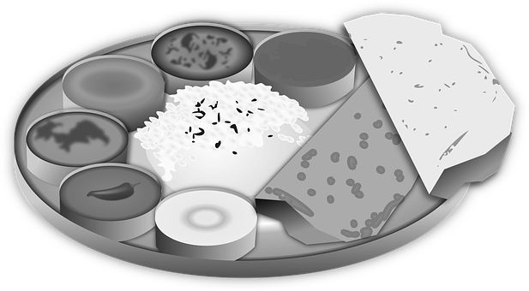
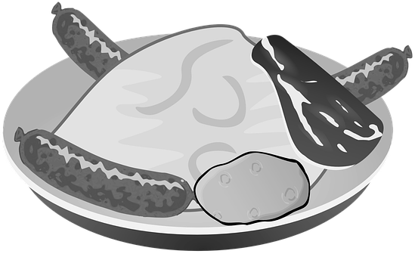
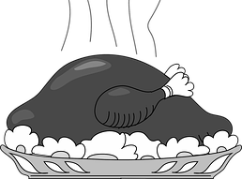
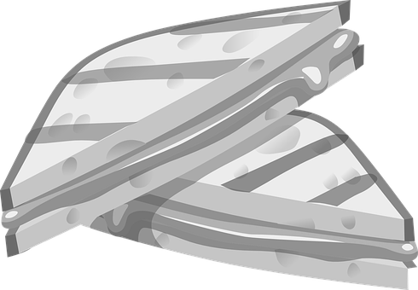
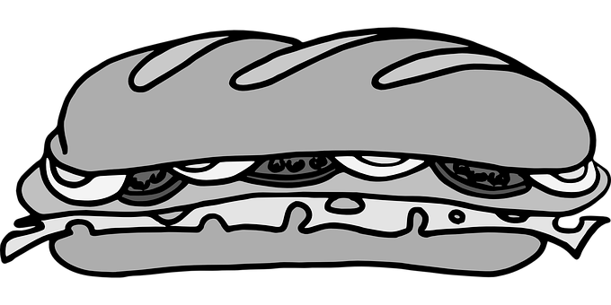
Muddled up menu!
Can you rearrange the menu to make the meals more sensible?
breakfast lunchtime teatime supper
Soup
Croissant
Porridge
Curry
Bacon and eggs
Sausage & mash
Croissant
Cereal
Roast dinner
Toastie
Sandwich
Cereal

Slide 7
Muddled up menu!
Put the meals in their correct places below.
breakfast lunchtime teatime supper

