Slide 1
Lesson 2: Creating Digital Graphics
Media Studies
Bethany Davies
Materials from the Teach Computing Curriculum created by the National Centre for Computing Education

Slide 2
Task 1 - Inkscape
Our client, Fab Gadget Ltd., has asked us to create a logo for them. Many different pre-production meetings have been held and the final design has been decided upon. It is your job to create the logo as a vector graphic so that it can be used across all of their different promotional materials. The final design is pictured on this slide:

Slide 3
Task 1 - Creating a website
Assets that are needed to complete this task can be obtained here: oaknat.uk/comp-digital-graphics

Slide 4
Task 1 - Inkscape
Create the logo by completing the steps below
Step 1
Step 2
Step 3
Open InkScape on your computer
Select the Circle tool from the left-hand side
This is the icon for the circle tool:
Draw a circle by clicking and dragging with your mouse.
To keep your circle in proportion, hold down CTRL and Shift together while you draw it.

Slide 5
Task 1 - Inkscape
Create the logo by completing the steps below
Step 4
Step 5
Move the circle into the centre of the page
Use the Select tool and click and drag the circle to position it where you want
Adjust the Fill and outline (called Stroke in Inkscape) of the circle.
With the circle selected, choose your Fill colour from the colour bars across the bottom of the screen. In the example, we have used 7.5% grey

Slide 6
Task 1 - Inkscape
Create the logo by completing the steps below
Step 5 - Continued
Step 6
Now, while holding the Shift key, select the colour for your Stroke. In the example, we have used 70% grey. You should now have a circle that looks like this:
Add the text
Click on the Create text tool from the left-hand side and click on some white space on the page and type FAB GADGET LTD..

Slide 7
Task 1 - Inkscape
Create the logo by completing the steps below
Step 7
Step 8
Change the font
Press Shift + Ctrl + T to open the Text and Font tools and select a font. Press Apply when you have found the one that you want.
Wrap the text around the circle.
Using the Select tool, select the text and then hold Shift and select the circle too. Now, from the main menu, select Text > Put on Path.

Slide 8
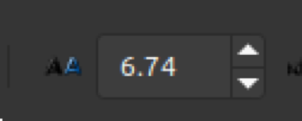
Task 1 - Inkscape
Create the logo by completing the steps below
Step 9
Step 10
Flip the text inside the circle.
With both the circle and text still selected, press the Flip selected objects horizontally button or press H on the keyboard.
Increase the letter spacing.
Click on the Create text tool from the left-hand side again, and then from the top menus, increase the Spacing between letters value until it looks right.

Slide 9
Task 1 - Inkscape
Create the logo by completing the steps below
Step 11
Step 12
Position the text at the bottom of the circle.
Select just the circle with the Select tool and click on it a second time so the Rotate tools appear Now, rotate the circle to position the text at the bottom of the circle.
Turn the text into a vector path.
Select just the text and go to Path > Object to Path from the main menu, or press Shift + Ctrl + C. You have now disassociated the text from the circle.

Slide 10
Task 1 - Inkscape
Create the logo by completing the steps below
Step 13
Step 14
Enlarge the circle.
Select just the circle and, while holding Shift + Ctrl, stretch the circle from the top left-hand corner to make it slightly larger so that the text sits inside the circle.
Change the text colour.
Select the text and change the colour. We have used a goldish colour in the example.

Slide 11
Task 1 - Inkscape
Create the logo by completing the steps below
Step 15
Step 16
Add a drop shadow to the text.
With the text still selected, right-click on it and select Duplicate, then change the colour to dark grey. Now, lower the new text down a layer by pressing Page down, and finally, offset it by pressing the down cursor once.
Create the yellow sun.
Draw a circle in the middle of your grey circle while holding Shift + Ctrl. Don’t worry if it is not in exactly the right place; you will align it next.

Slide 12
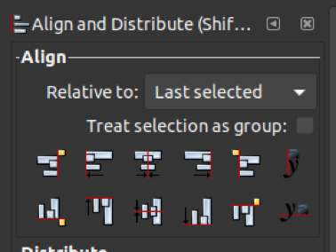
Task 1 - Inkscape
Create the logo by completing the steps below
Step 17
Align the yellow sun.
Click on the Select tool, and with the new circle still selected, hold down Shift and select the outer circle. Now, press Ctrl + Shift+ A to open the Alignment tools.
Change the Relative to: to Last selected and then click both the Centre on vertical axis and Centre on horizontal axis buttons.

Slide 13
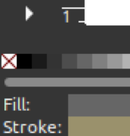
Task 1 - Inkscape
Create the logo by completing the steps below
Step 18
Remove the stroke from the yellow sun
Select just the inner circle by clicking in the white space and then selecting the inner circle again. Now, hold down the Shift key and select the white square with a red cross through it at the start of the colour selector.

Slide 14
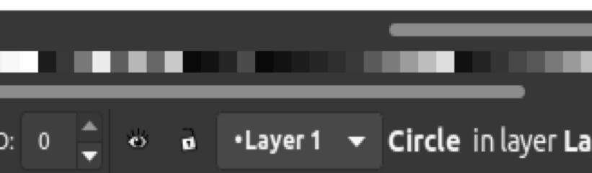
Task 1 - Inkscape
Create the logo by completing the steps below
Step 19
Change the Fill colour of the yellow sun.
With the inner circle still selected, let go of Shift and select the colour from the bottom menu; you may need to scroll to the right to see all the colours.

Slide 15
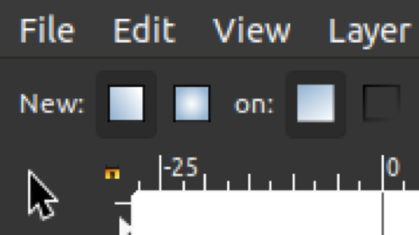
Task 1 - Inkscape
Create the logo by completing the steps below
Step 20
Change the Fill to a Gradient.
Select the Gradient tool from the left-hand side and from the tool presets at the top of the screen, select to create a radial gradient.

Slide 16
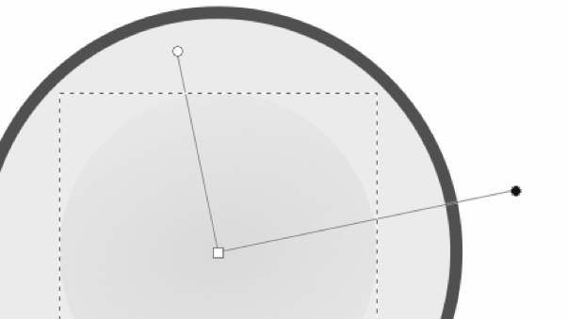
Task 1 - Inkscape
Create the logo by completing the steps below
Step 20 - Continued
Now, double-click on the circle to create the radial gradient. Adjust the two handles to get the size and effect of gradient that you want.

Slide 17
Task 1 - Inkscape
Create the logo by completing the steps below
Step 21
Create the lightning bolt. Start with a square.
Select the Create rectangles and squares tool from the left-hand side and draw in a square in the white space around your logo, holding down Shift + Ctrl while you draw the shape to make it a perfect square.

Slide 18
Task 1 - Inkscape
Create the logo by completing the steps below
Step 22
Rotate the square.
Now, use the Select tool and click on the square again so that the Rotate handles appear: Then, while holding Ctrl, move the top right-hand corner down three times so that your square is rotated through 45 degrees.

Slide 19
Task 1 - Inkscape
Create the logo by completing the steps below
Step 23
Convert the square into a vector path.
Select the square and then choose Path > Object to path from the main menu or press Shift + Ctrl + C.

Slide 20
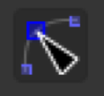
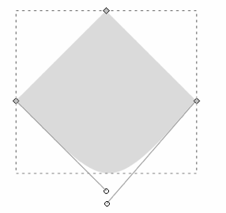
Task 1 - Inkscape
Create the logo by completing the steps below
Step 24
Turn the square into a triangle.
Select the Edit paths by nodes tool from the left-hand side and select your square. Click to select the handle at the bottom of your square, then press Delete. You will then have two handles and your shape should look a little like the image to the right. Move the two handles up to the left and right respective handles so that your shape becomes a triangle.

Slide 21
Task 1 - Inkscape
Create the logo by completing the steps below
Step 25
Reduce the height of the triangle.
Select the triangle using the Select tool again and decrease the height of the triangle until your shape looks a little like this:

Slide 22
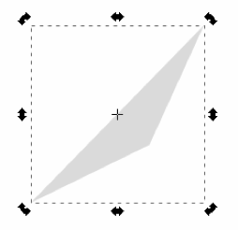
Task 1 - Inkscape
Create the logo by completing the steps below
Step 26
Rotate the triangle.
Click on the triangle again to bring up the Rotate tools, and rotate the shape until it is in this position:

Slide 23
Task 1 - Inkscape
Create the logo by completing the steps below
Step 27
Duplicate the triangle, flip it, and make the lightning bolt.
Right-click on the triangle and select Duplicate or press Ctrl + D, then press V and H to flip the duplicated shape both horizontally and vertically.
Now, use your cursor keys to position the shapes until they make the shape of a lightning bolt.

Slide 24
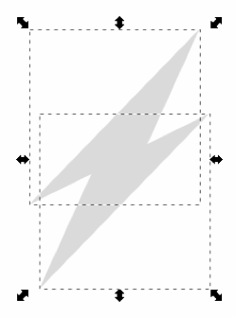
Task 1 - Inkscape
Create the logo by completing the steps below
Step 28
Join the two triangles together.
Select both triangles by drawing a box around them. Select Path > Union from the main menu to join the shapes together.

Slide 25
Task 1 - Inkscape
Create the logo by completing the steps below
Step 29
Change the colour of the lightning bolt and position it.
You can now change the colour of the lightning bolt or set a gradient in the same way as you did for the inner circle. Once you are happy with the colour, position the lightning bolt in the centre by selecting the lightning bolt and then the outer circle, and then aligning it horizontally and vertically, as you did in Step 17.

Slide 26
Task 1 - Inkscape
Create the logo by completing the steps below
Step 29
Save and export your logo.
Save your logo as an SVG file by selecting File > Save as.
Export it to a PNG image by selecting File > Export PNG Image….

Slide 27
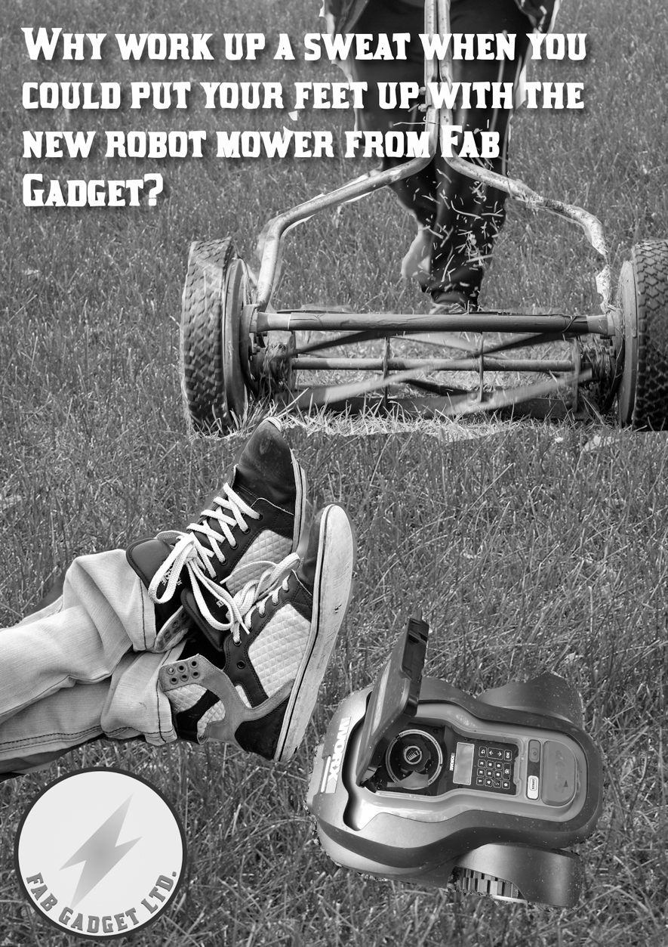
Task 2 -GIMP
Our client, Fab Gadget Ltd., has asked us to create a poster for their latest robotic lawnmower. The pre-production meetings have been completed and the graphical assets and wording have all been decided upon already. The have been supplied to you within the Zip Folder. When there are multiple pictures of the same thing, you are free to select the one that you prefer. The wording is indicated in the steps on the coming slides. You will make use of the open source application GIMP to design your poster.
.

Slide 28
Task 2 - GIMP
Create the poster by completing the steps below
Step 1
Step 2
Open GIMP on your computer.
Create an empty A4 document.
Create a new file by pressing Ctrl + N. Select A4 (300 ppi) from the template and click on OK.

Slide 29
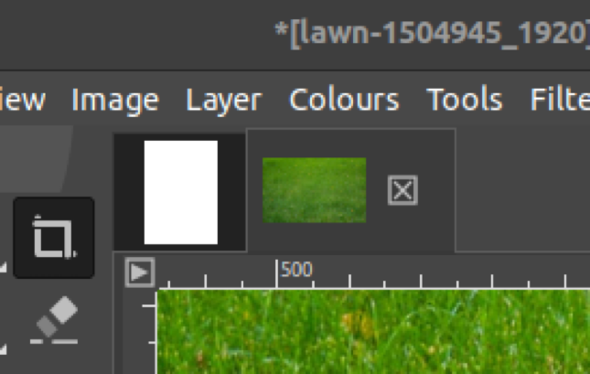
Task 2 - GIMP
Create the poster by completing the steps below
Step 3
Add a lawn picture as a background.
Press Ctrl + o to open a new file and browse to one of the pictures of a garden lawn.
Select all of this image by pressing Ctrl + A and then copy it by pressing Ctrl + C.
Select your original tab as indicated here
Paste the lawn image as a new layer into the poster by selecting Edit > Paste as > New Layer from the main menu.

Slide 30
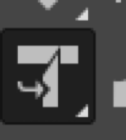
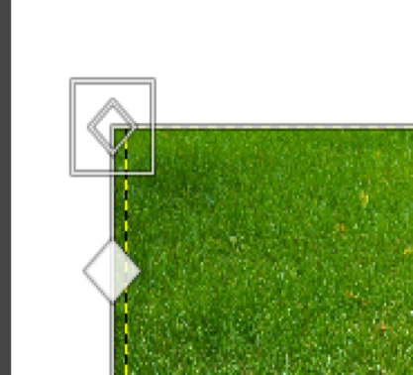
Task 2 - GIMP
Create the poster by completing the steps below
Step 4
Resize the layer.
Select the Unified Transform Tool from the top left-hand side.
Click on the lawn image. Stretch the image to cover the whole background by dragging it by the corner of the outer square handle as indicated here:
Press Enter to perform the transform.

Slide 31
Task 2 - GIMP
Create the poster by completing the steps below
Step 5
Add a robot lawnmower picture
Open the image that you want to use and copy and paste it as a new layer in the same way as you did in Step 3.

Slide 32
Task 2 - GIMP
Create the poster by completing the steps below
Step 6
Remove the background of the robot lawnmower.
Use the Eraser tool to erase the background from around your robot lawnmower so that it looks like it is sitting on top of the lawn that you pasted before.
If you want to resize this layer, use the Unified Transform Tool in the same way as when you resized the background.

Slide 33
Task 2 - GIMP
Create the poster by completing the steps below
Step 7
Position the robot lawnmower.
Use the Move tool to position your robot lawnmower where you want it on your poster.

Slide 34
Task 2 - GIMP
Create the poster by completing the steps below
Step 8
Add a relaxing picture to the poster.
Follow the same steps as above to include one of the relaxing pictures.
Remove its background using the Eraser tool.
Scale and position the image using the Unified Transform Tool.
Tip: If you make a mistake, use Ctrl + Z to undo your changes. You can zoom in by pressing the + button and zoom out by pressing the - button.

Slide 35
Task 2 - GIMP
Create the poster by completing the steps below
Step 9
Add a manual lawnmower picture to the poster.
Repeat these steps again to add one of the pictures of a manual lawnmower to your poster.

Slide 36
Task 2 - GIMP
Create the poster by completing the steps below
Step 10
Add text to the poster.
Click on the Text tool and click on your poster. Type the following:
Why work up a sweat when you could put your feet up with the new robot mower from Fab Gadget?

Slide 37
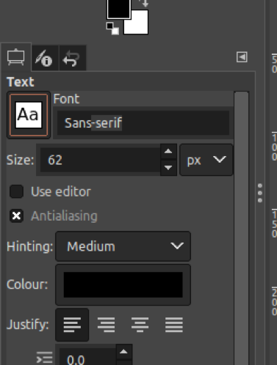
Task 2 - GIMP
Create the poster by completing the steps below
Step 11
Change the font and size of the text.
Use the Text tools to change the font and size of the text. Use the handles to control the size of the text box.

Slide 38
Task 2 - GIMP
Create the poster by completing the steps below
Step 12
Add a drop shadow to the text.
Make sure you have your text layer selected, and then go to Filters > Light and shadow > Drop shadow from the main menu.

Slide 39
Task 2 - GIMP
Create the poster by completing the steps below
Step 13
Add the Fab Gadget logo.
Open the PNG file of the logo that you created in the ‘Create vector graphics with Inkscape’ activity.
Now, copy and paste it as you did with the other images. Note: There is no need to delete the background of this image, as it was saved with a transparent background from Inkscape.
Use the tools to scale and position the logo where you want it.

Slide 40
Task 2 - GIMP
Create the poster by completing the steps below
Step 14
Save and export your file.
Use File > Save as to save your file as an .xcf file. This is GIMP’s native file format and will preserve all of the layers so that you can edit it later if you need to.
Now, export your poster as a raster graphic file by selecting File > Export from the main menu. It will default to saving a .png file with the same name as the file that you just saved. Click on Export twice to complete the poster.

