Slide 1
Comparing usual activities and summer plans (Part 2/2)
Adverbial time phrases
Present tense future meaning 1st person singular and plural
Downloadable Resource
German
Frau Johnson
Notes:
Take the title for the lesson from the context column of the SOL. Take the grammar focus from the grammar column. Show full green screen to start with and then bring in your face in the top right hand corner.
E.g. Hola. Soy [Doctora Hawkes] ¿Cómo estás? In this lesson we [practise the present tense with some regular verbs so we can talk about what people do]. I hope you are in a quiet space without distractions, and have a pen and paper to hand.

Slide 2
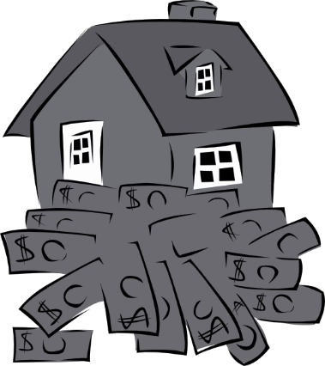
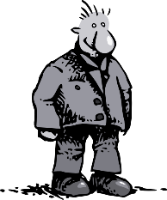
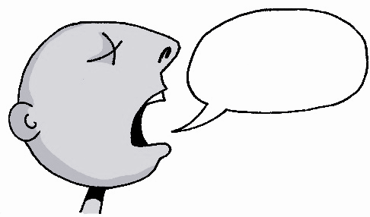
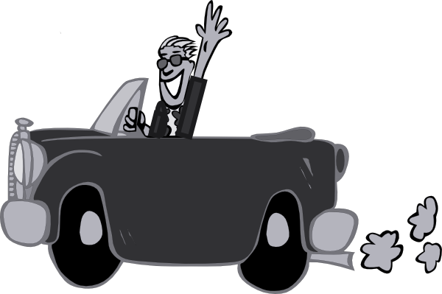
a
sagen
Paar
haben
Tag
fahren

Slide 3
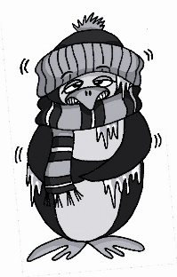
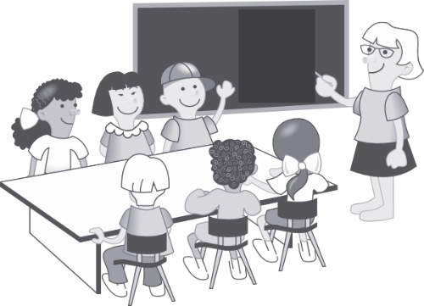
a
Mann
6 Meter
kalt
lang
danke
Klasse

Slide 4
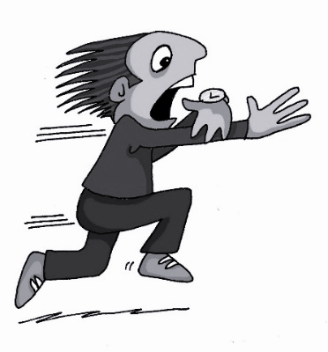
ä
1, 2, 3, …100
spät
ähnlich
zählen
Berlin 1KM
Nähe
wählen

Slide 5
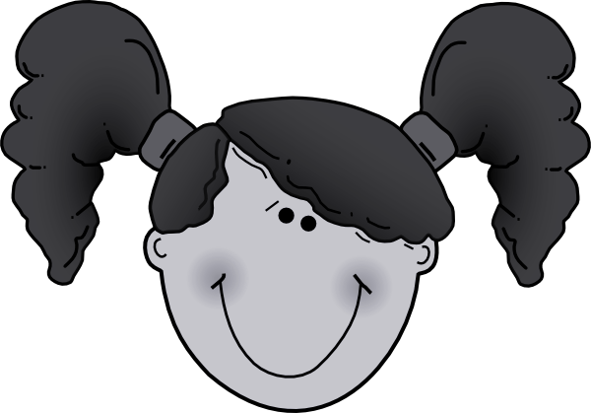
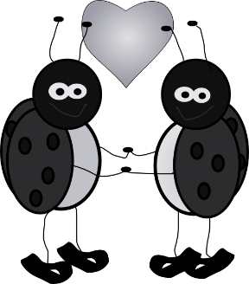
ä
Verhältnis
lächeln
Mädchen
ändern
Hälfte

Slide 6
Adverbial Time Phrases
In German, the adjective nächst means ‘next’.
It’s ending changes depending on the gender of the noun that follows:
der Monat
nächsten Monat
die Woche
nächste Woche
das Jahr
nächstes Jahr

Slide 7
Adverbial Time Phrases
If you are talking about what you do normally you can use ‘jede’. This means every.
It’s ending also changes depending on the gender of the noun that follows:
der Monat
jeden Monat
die Woche
jede Woche
das Jahr
jedes Jahr

Slide 8
Putting a time adverbial into a sentence
When you put the time adverbial in a sentence it has to follow a particular pattern.
Nächste Woche spielen wir Tennis.
Next week we are playing tennis.
Jede Woche spielen wir Rugby.
Every week we play rugby.
The verb nearly always likes to be the second idea in German. We call this change in word order WO2. (Word Order 2)
time
verb
person

Slide 9
Present tense future meaning
In German, just like in English, we can use the present tense with an adverbial time phrase to say what we are doing in the future.
Nächste Woche gehe ich in die Stadt.
Next week I am going into town.
Nächstes Jahr gehen wir ins Schwimmbad.
Next year we are going to the swimming pool.
Remember the verb and pronoun swap because of the time phrase at the start of the sentence.
Notes:
Click for info. Blue box is the last click.

Slide 10
Forming the present tense
When you are making the present tense with ‘ich’ you remove the -en from the infinitive and add an -e.
gehen
ich gehe
I go/ I am going
When you are making the present tense with ‘wir’ you just add wir to the infinitive because the ending is -en.
gehen
wir gehen
We go/ we are going
When you are making the present tense with ‘sie’ (they) you also just add ‘sie’ to the infinitive because the ending is -en too.
gehen
sie gehen
They go/ they are going
Notes:
Click for info.

Slide 11
Comparing usual activities and summer plans
1 You use the adjective ‘nächst’ to describe what you will do in the _________.
2 The ending of ‘nächst’ changes depending on the ________ of the noun.
3 After the phrase with ‘nächst’ you need the _______.
4 You can use the present tense to say what you are doing in the _________.
5 If you use ‘jede’ and a noun it describes what you ____________ do. You use it with the ___________ tense.
future
gender
verb
future
normally
present
Notes:
Now it’s time to summarise what we have learnt today. Copy out the sentences and put a word in the gap to complete the sentence.

