Slide 1
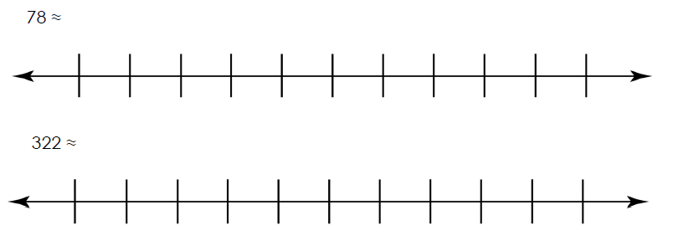
Independent Task
Locate the number.
Decide which is the nearer multiple of 10 and write in the answer.
Question 1 and 2
70
80
320
330

Slide 2
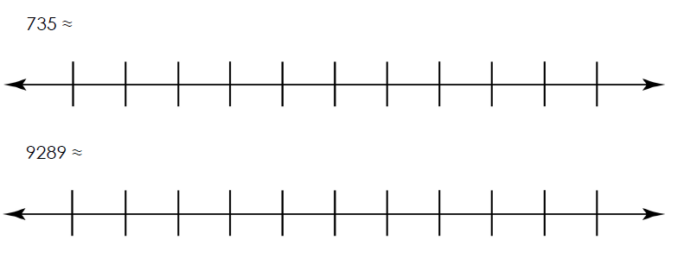
Independent Task
Using the number lines, write in the two closest multiples of 10.
Locate the number.
Decide which is the nearer multiple of 10 and write in the answer.
Question 3 and 4

Slide 3
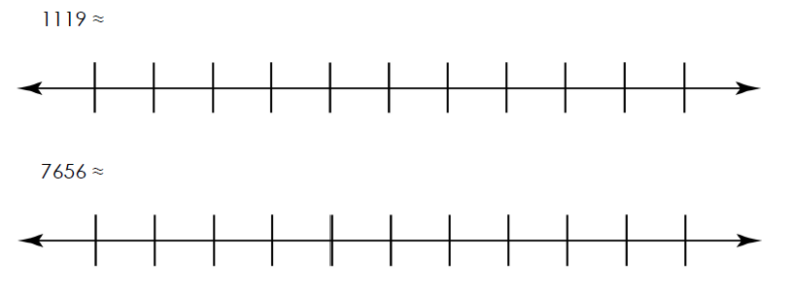
Independent Task
Using the number lines, write in the two closest multiples of 10.
Locate the number.
Decide which is the nearer multiple of 10 and write in the answer.
Question 5 and 6

Slide 4
Independent Task
Challenge
I’ve rounded a number to the nearest 10, my answer is 2830.
What could my number have been?

