Slide 1
Finding 10, 100 or 1000 less than a given number
Downloadable Resource
Mathematics
Mrs Crane
Mrs Crane

Slide 2
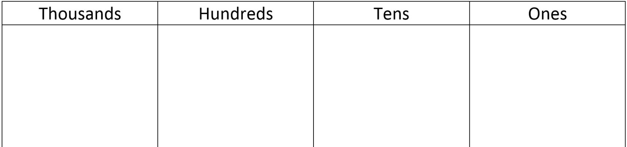
Independent Task
Question 1
Using the place value grid, complete the following equations.
Remember, draw on the Deines if it will help you!

Slide 3
Independent Task
Question 2
Using the place value grid, complete the following equations.
Remember, draw on the Deines if it will help you!

Slide 4
Independent Task
Question 3
Complete the following function machine!
4897
1000

Slide 5
Independent Task
Question 4
Complete the following function machine!
3402
?
3392

Slide 6
Independent Task
Question 5
Finish the number line.
Remember, draw on the Deines if it will help you!

Slide 7
Independent Task
Question 6
Finish the number line.
Remember, draw on the Deines if it will help you!

