Slide 1
Oak Specialist
Independent Living Unit 1- Home Management
Applying Learning

Slide 2
Unit 1- Home Management
Lesson 1- Using cleaning products
Lesson 2- Hygiene at home
Recognising common cleaning products and warnings on the labels.
Using the correct cleaning product and cloth for the job.
Lesson 3- Reading clothes labels
Lesson 4- Organising clothes
Option 3
Option 4
Identifying key washing symbols and what they mean.
Sorting clothes by category and folding correctly.
Lesson 5- Using the kitchen safely
Option 3
Lesson 6- Reading food labels
Option 4
Recognising different kitchen utensils and appliances, and how to use them safely.
Counting equipment needed and using a visual to set the table.

Slide 3
Lesson 1 - Using cleaning products safely

Slide 4
Teacher notes- Lesson 1
Cleaning in the home
-Learning Intention: To identify the warning symbols on different cleaning products and their meaning.
Introduce each cleaning product. Ask students to match the cleaning products with the task.
Show the students a cleaning product with warning symbols. Discuss what they could mean.
Match the symbol to its meaning.
Resources needed: cleaning spray, pen and paper.

Slide 5
Safety notice
This lesson involves cleaning products which may be harmful to you or the learner if used incorrectly. Please follow the safety guidelines on the products and ensure adult supervision when handling these products.

Slide 6
Home Management
Using cleaning products safely
Applying Learning

Slide 7
Lesson Activity Stages
This lesson will be taught in 5 stages-
Matching the cleaning products to the job.
Identify the warning symbols on the cleaning products.
Predict the meaning of each symbol.
Check to see how close to the real meanings you are.
Create your own safety leaflet.

Slide 8
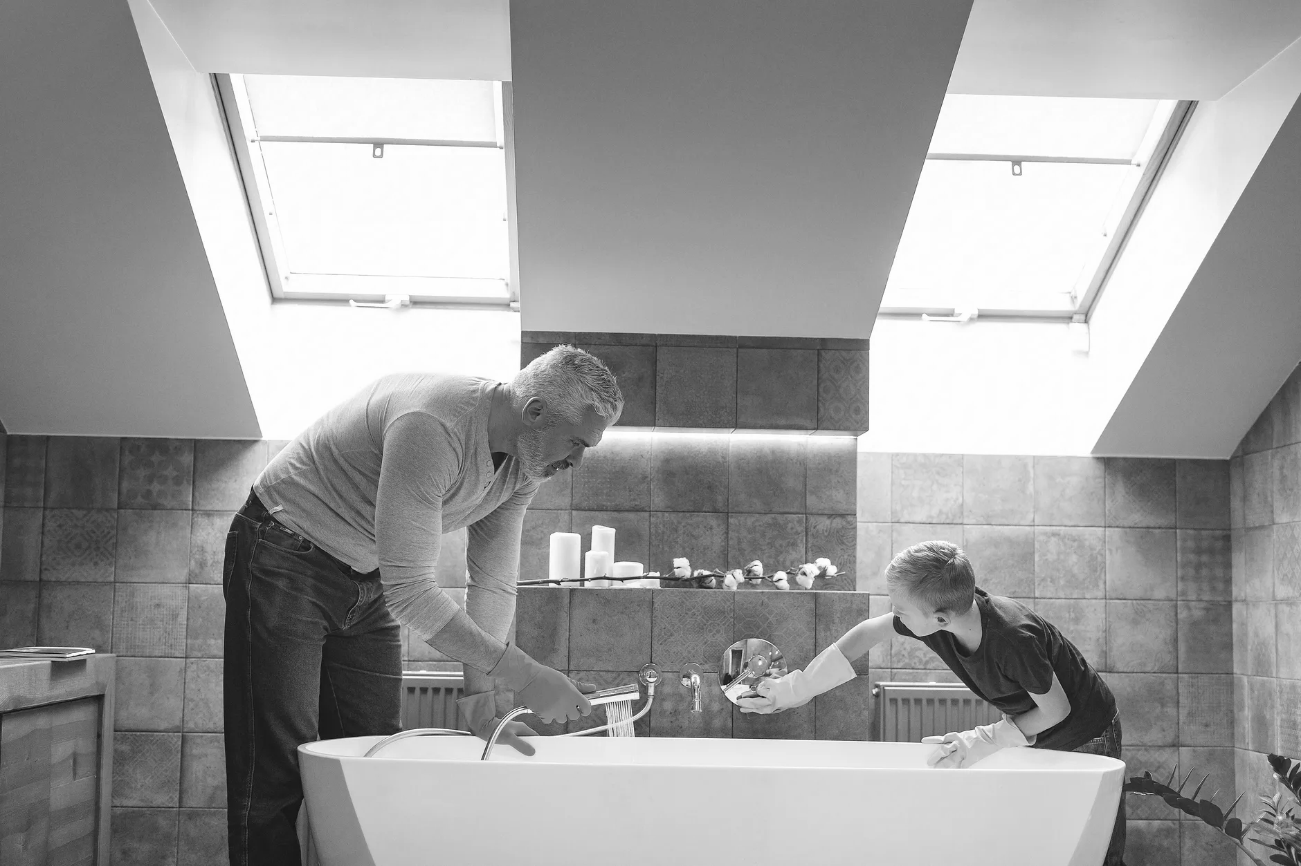
A.
Credit: Father and son cleaning bathroom, Gustavo Fring (sic), Pexels
Notes:
Discuss;
Look at the picture and discuss what you can see.
How do you know it’s a bathroom?
What is the man using to clean the room?

Slide 9
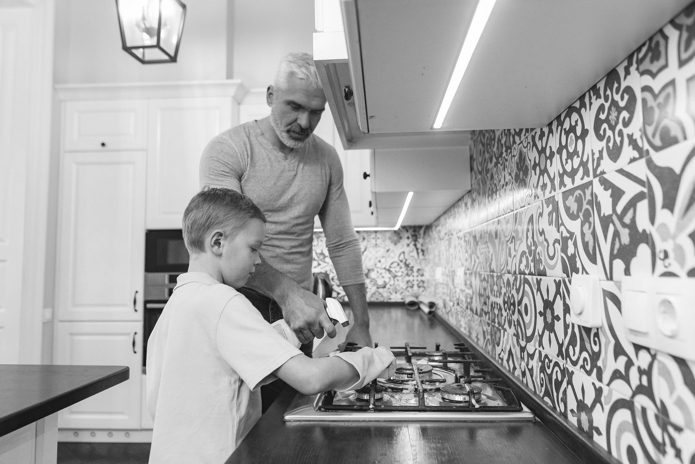
B.
Credit: Father with son cleaning stove at kitchen, Gustavo Fring (sic), Pexels
Notes:
Discuss;
Look at the picture and discuss what you can see.
What room do you think this is?
How can you tell it’s a kitchen?
What are the people in the picture doing?

Slide 10
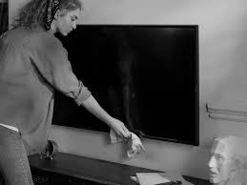
C.
Credit: Woman cleaning television, cottonbro, Pexels
Notes:
Discuss;
Look at the picture and discuss what you can see.
What room do you think this is?
How can you tell it’s a lounge?
What is the lady in the picture doing?

Slide 11
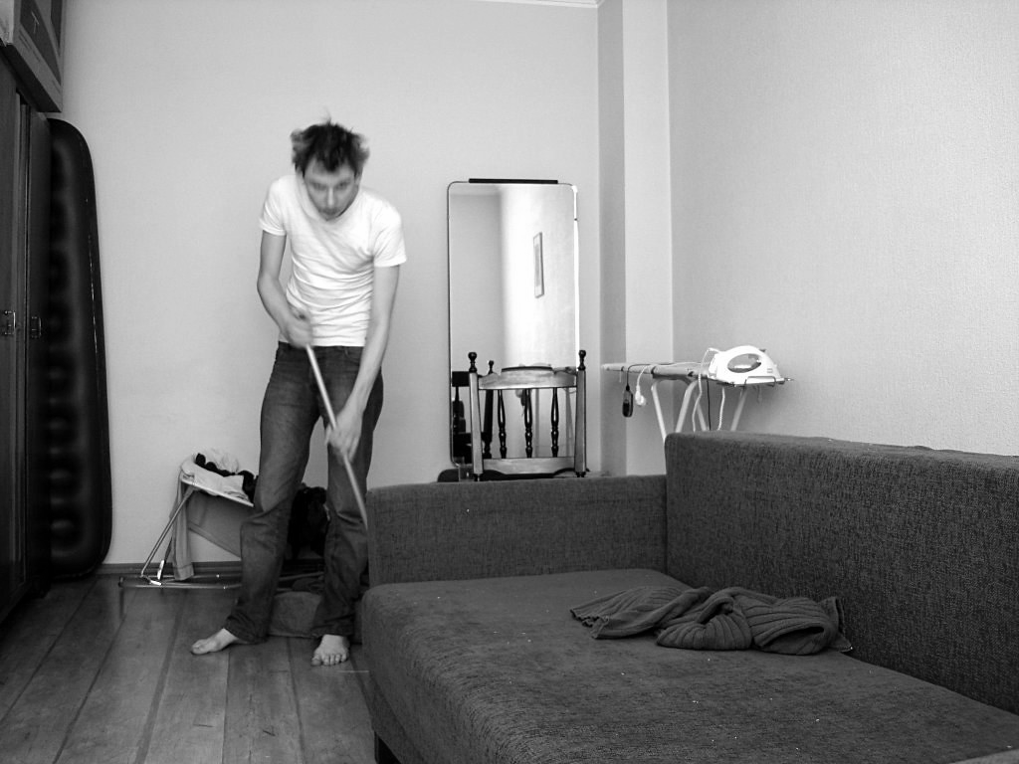
D.
Credit: Cleaning up the mess, Toms Baugis, Flickr Attribution 2.0 Generic -(CC BY 2.0)
Notes:
Discuss,
Look at the picture and discuss what you can see.
What room do you think this is?
What is the man in the picture doing?

Slide 12
1.
Credit: Lemon Pledge, Mike Motzart, Flickr Attribution 2.0 Generic (CC BY 2.0)
Notes:
Discuss;
Look at the cleaning product, what can you see?
What could this be used for?

Slide 13
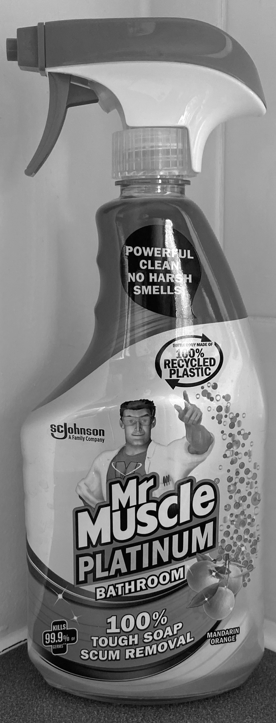
2.
Teachers own
Notes:
Discuss;
Look at the cleaning product, what can to see on the bottle?
What is this product used for?

Slide 14
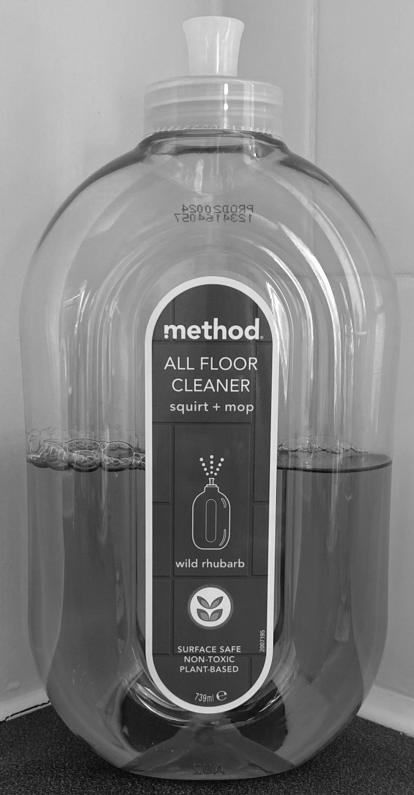
3.
Teachers own
Notes:
Discuss;
Look at the cleaning product, what can to see on the bottle?
What is this product used for?

Slide 15
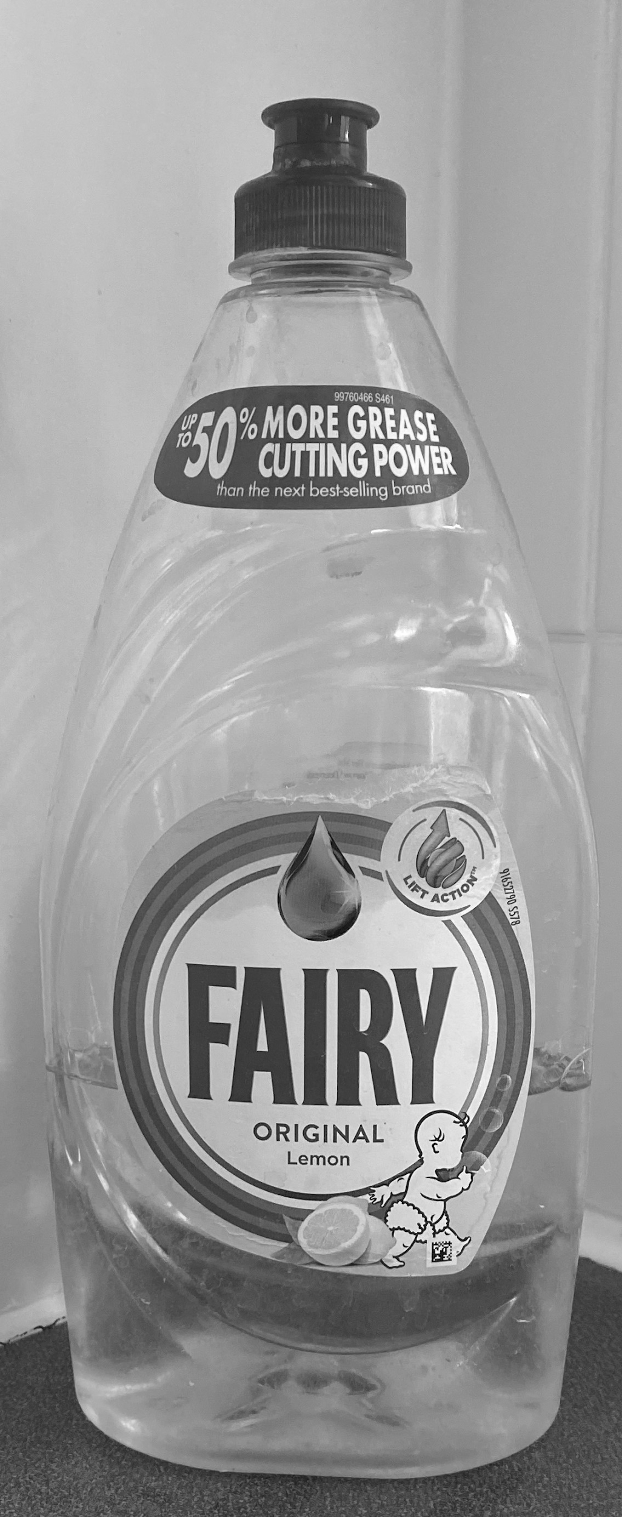
4.
Teachers own
Notes:
Discuss;
Look at the cleaning product, what can to see on the bottle?
What is this product used for?

Slide 16
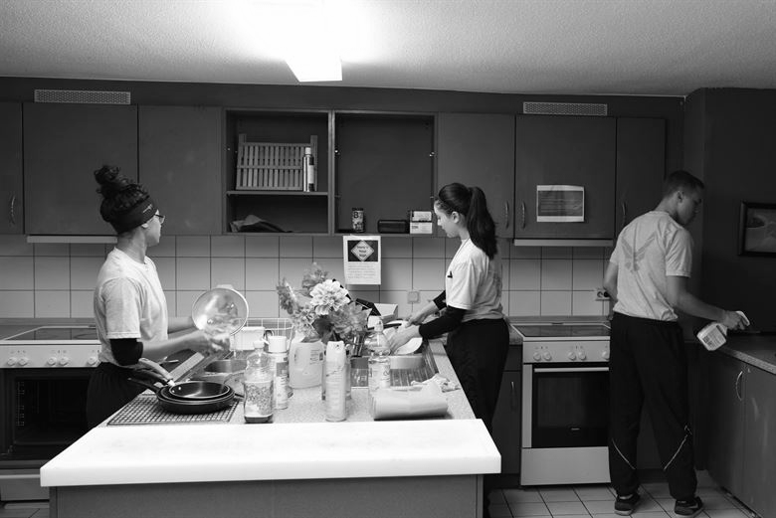
Match the cleaning product with the cleaning job shown in the picture.
A.
B.
C.
D.
1.
2.
3.
4.

Slide 17
Take a look at the 4 chemical warning symbols found on many cleaning products in your home.
1.
2.
3.
4.
Images credit: Pixabay
Notes:
Activity;
Show the learner a cleaning product. Ask them to see if they can find one on the symbols on the bottle.
Look at eh images closely, what do you think they could mean?

Slide 18
Activity
Look carefully at the symbols and think about what you think they could mean and write down what you think each symbol means.
1.
2.
3.
4.

Slide 19
Activity
Now see if you can match the symbols with their true meaning.
CAN CAUSE FIRE
‹#›

Slide 20
Let's check your answers.
CAN CAUSE FIRE

Slide 21
Activity
Try creating your own leaflet with three ‘Top Safety Tips’ about cleaning your home safely.
Things to consider:
How will you protect your hands whilst using the cleaning products?
How will you store your cleaning products to make sure they are away from small children?
What can you do to make sure the room is ventilated whilst using the cleaning products?
‹#›

Slide 22
Independent Living
Applying Learning
Using cleaning products safely
Make it easier
Make it harder
More ideas
Make a list of the rooms in your home and think about what you need to keep it clean.
Look in your cleaning cupboard to see what products you have and list their uses.
Create a table and list the products you find from strongest to weakest using the warning symbols as a guide.
Ask your parent/carer to help you find an online shopping website to explore household cleaning cleaning products and find out what they do.

Slide 23
Further Learning with Oak National
Independent Living:
Building Understanding- Cleaning in the home (Unit 1)
Applying Learning- Hygiene at home (Unit 1)
‹#›

