Slide 1
Double and half of numbers within 20
Mathematics
Independent Task
Miss Robson

Slide 2
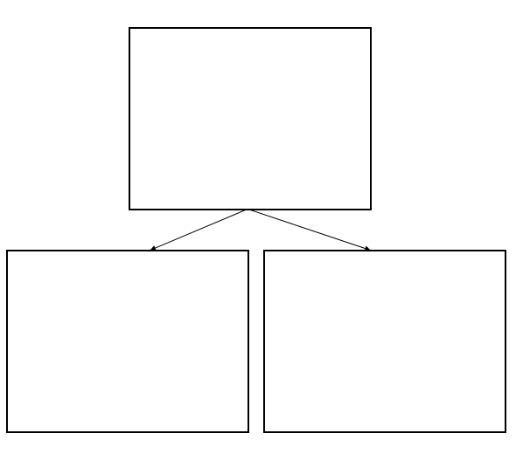
Activity
Find half of numbers to 20. Sort them into numbers that can be halved, and numbers that cannot. What do you notice?

