Slide 1
Specialised cells
(Downloadable student document)
Combined Science - Biology - KS4
Cell Biology
Miss Wong

Slide 2
Revising the structure of cells

Slide 3
Recap: Different types of cells
Cells
Prokaryotic cells
Eukaryotic cells
These are cells without a nucleus.
These are cells with a nucleus.

Slide 4
Recap task:
Sub-cellular structures | Function
 | Make proteins.
 | Release energy.
 | Provide support to plant cells when filled with water (turgid).
 | Contains extra genetic information that is not essential for survival.

Slide 5
Answers to recap task:
Sub-cellular structures | Function
 | Make proteins.
 | Release energy.
 | Provide support to plant cells when filled with water (turgid).
 | Contains extra genetic information that is not essential for survival.
Ribosomes
Mitochondria
Vacuole
Plasmid

Slide 6
Specialised cells and their formation

Slide 7
Specialised cells are cells with specific features to perform a particular function.

Slide 8
Answers to recap task:
All cells in our body are derived from stem cells.
These cells are very simple cells without any adaptation.
Stem cells are able to change and transform into other types of cells found in the body. This process is cell differentiation and is in charge of the development of all of the cells in one’s body.
Notes:
Humans and other animals are multicellular organisms meaning they are made up of multiple cells, in fact the average human is made of 37 TRILLION cells! The animal cell you have learnt about in the past is the general animal cell but animal cells have to be specialised for the body to function correctly.

Slide 9
Quick recap:
What is a specialised cell?
What are stem cells?
How do specialised cell form from stem cell?

Slide 10
Answer to specialised cell
Specialised cells are cells with specific features to perform a particular function.
2. Stem cells are very simple cells. They are not specialised and they do not have special features.
3. Stem cells differentiates to form specialised cell.

Slide 11
Examples of specialised cells and their functions

Slide 12
Red blood cell
Contains chemical haemoglobin that binds with oxygen.
There is no nucleus so there is more room to hold more oxygen.
The biconcave shape increases the surface area.
Notes:
· Lots of dendrites to make connections to other cells
· A very long axon that carries the electrical impulse from one place to another
· Synapses to pass the impulse between nerve cells
· Synapses contain lots of mitochondria to provide the energy needed to make special transmitter molecules

Slide 13
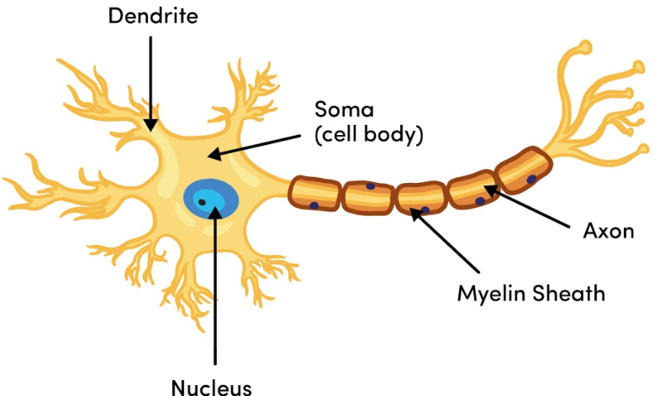
Nerve cell
Many dendrites to form many connections with many other nerve cell.
The cell is long to allow transmission of nerve impulses at a long distance.
Fatty tissue surround the cell to speed up transmission.
Image: Oak National Academy
Notes:
· Lots of dendrites to make connections to other cells
· A very long axon that carries the electrical impulse from one place to another
· Synapses to pass the impulse between nerve cells
· Synapses contain lots of mitochondria to provide the energy needed to make special transmitter molecules

Slide 14
Sperm cell
Tail/ flagellum
The mid piece is full of mitochondria.
Image: Oak National Academy
The nucleus is located here. The genetic material is found here.
Notes:
· A tail for movement
· Middle section full of mitochondria to provide energy for tail to move
· Digestive enzymes in acrosome to break through egg
A large nucleus containing half the genetic information needed to make a human.

Slide 15
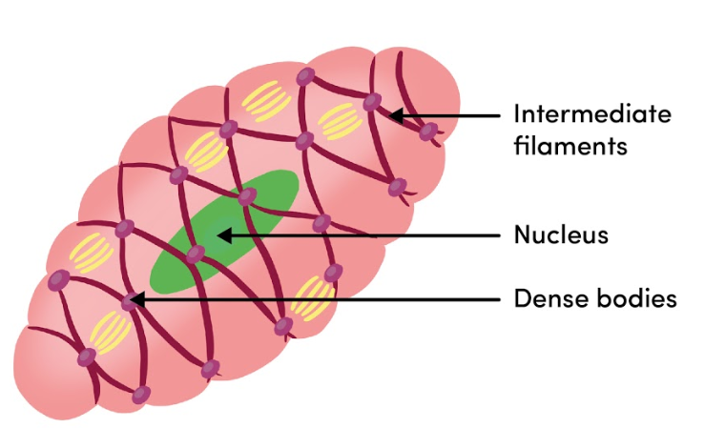
Muscle cells
Many muscle cells group together to form a muscle tissue.
The muscle cells contain a lot of mitochondria to release more energy than other cells.
Image: Oak National Academy
Notes:
· Contain special fibres that can slide over one another to allow the fibres to contract
· Contain lots of mitochondria to provide energy for contraction
Store glycogen which can be converted into glucose for respiration

Slide 16
Pause the video to complete your task
Quick concept check
Why do muscle cells contain many mitochondria?
Why is the nerve cell long?
Why does the sperm has a tail?

Slide 17
Answer to concept check
Many mitochondria are present to release more energy for movement.
2. Nerve cells are long to allow nerve signals to be passed over long distances.
3. The sperm has a tail so it can swim to the egg.

Slide 18
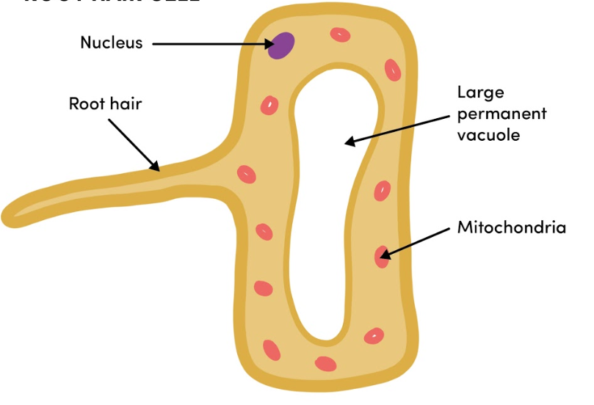
Root hair cell
Root hair cells has a large surface area to absorb water and minerals.
Image: Oak National Academy

Slide 19
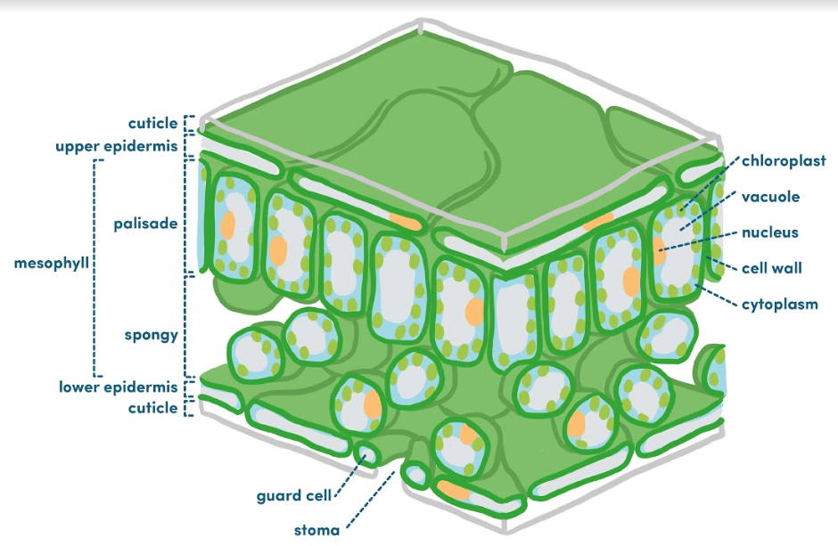
Palisade cell
The cell is packed with chloroplasts so that it can absorb more energy from the sun for photosynthesis.
Image: Oak National Academy

Slide 20
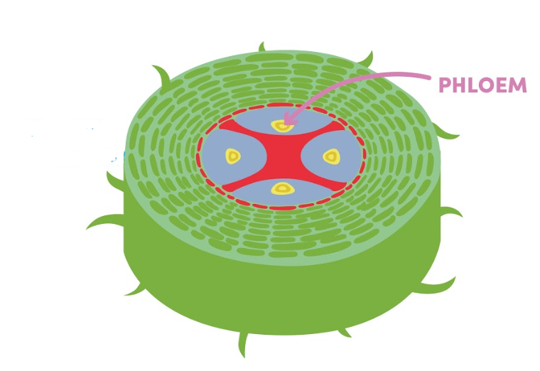
Phloem and xylem cells
The phloem cells have no nucleus and it has a large vacuole for the easy transfer of sugars up and down the plant.
Xylem cells are dead cells. They are strengthened by lignin.
These are hollow tubes for the transport of water.
Xylem
Image: Oak National Academy
Notes:
· Xylem: Transport water and mineral ions When first formed xylem cells are alive but due to build-up of lignin the cells dies and form long hollow tubes that allow water and mineral ions to travel up the plants
The lignin makes the xylem cells very strong and help them withstand the pressure of water moving up the plant
Phloem: Transports glucose around plant
• Cell walls between cells break down to form sieve plates that allow water carrying dissolved glucose to move up and down the phloem
• Supported by companion cells that keep them alive. Phloem cells don’t have cell structures like mitochondria instead they rely on companion cells for their energy needs

Slide 21
Multiple choice quiz
What is the cell being shown in the diagram?
Palisade cell
Phloem cell
Xylem cell
Root hair cell

Slide 22
Multiple choice quiz
Which of the following is a type of dead specialised cell?
Palisade cell
Phloem cell
Xylem cell
Root hair cell

Slide 23
Multiple choice quiz
Which two of the following are cells without a nucleus?
Red blood cell
Phloem cell
Xylem cell
Root hair cell

Slide 24
Multiple choice quiz
Which of the following has a large surface area for absorption of substances?
Palisade cell
Phloem cell
Xylem cell
Root hair cell

Slide 25
Multiple choice quiz
Which two of the following contains more mitochondria than other cells?
The sperm
Nerve cell
The egg
Muscle cell

Slide 26
Multiple choice quiz
Which of the following carry oxygen around the body?
The sperm
Nerve cell
Red blood cell
Muscle cell

Slide 27
Independent practice

Slide 28
Independent practice
Why does the nerve cell have lots of dendrites?
What is a specialised cell?
What is the function of the cell membrane?
What does differentiate mean?
What is the function of the nucleus?
The sperm cell has a tail because......
What is the function of a nerve cell?
Why do nerve cells contain lots of mitochondria?
What is the adaptation of the root hair cell?
What are palisade cells specailised for?

Slide 29
Answers to independent practice
Lots of dendrites allows it to make many connections to other cells.
A cell that has special features to perform a certain function.
To control the movement of substances in and out of the cell.
Adaptation of cells to perform a certain function.
It controls the cell and contain genetic material.
It needs to be able to move around easily and swim to the egg.
They carry nervous impulses around the body.
To release energy needed to make transmitter molecules.
The root hair cell has a finger-like structure that increases it surface area for water and mineral absorption.
Palisade cells are specialised for performing photosynthesis.

