Slide 1
Biological Systems and Processes
Lesson 10 - Smoking
KS3 Biology
Miss Hindle

Slide 2
Quick Recap...
What is the name of the tube running from the nose and mouth to the lung? T……………………..
Why are the alveoli membranes so highly folded? To give a L…………. S……………. A……………….
What happens to the oxygen that crosses the alveoli into the blood?
Where does respiration take place?

Slide 3
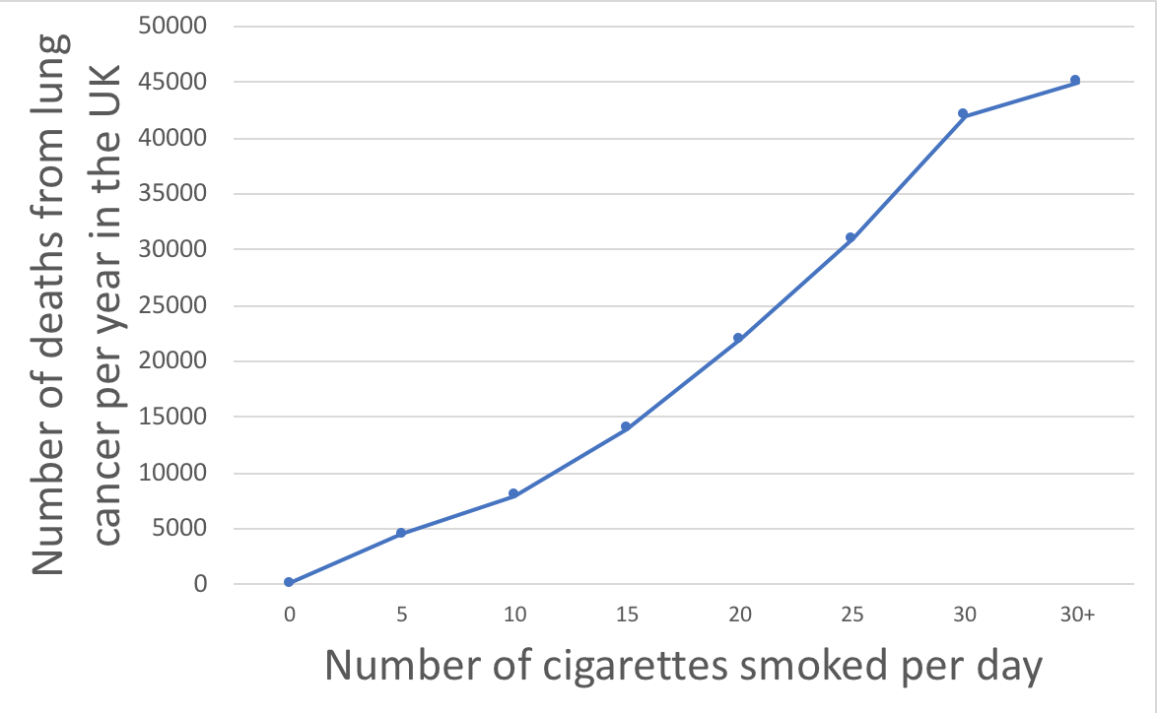
Describing Trends...
Describe the trend shown in this graph.
Explain the trend shown in this graph
Say what the graph is showing you!
Say why the graph shows this trend
Credit: Miss Hindle

Slide 4
Describing Trends...
Describe the trend shown in this graph.
Explain the trend shown in this graph
Credit: Miss Hindle

Slide 5
Written task:
Describe the difference between the alveoli of a healthy person and the smoker and how the difference will affect the smoker’s health
Describe the difference between the ciliated cells in the trachea of a healthy person and the smoker and how the difference will affect the smoker’s health
Describe the difference between the arteries,including the coronary artery, of a healthy person and the smoker and how the difference will affect the smoker’s health
Word bank: breathe, blood flow, chest infection, coughs, gas exchange, heart attack, mucus, stroke, surface area

Slide 6
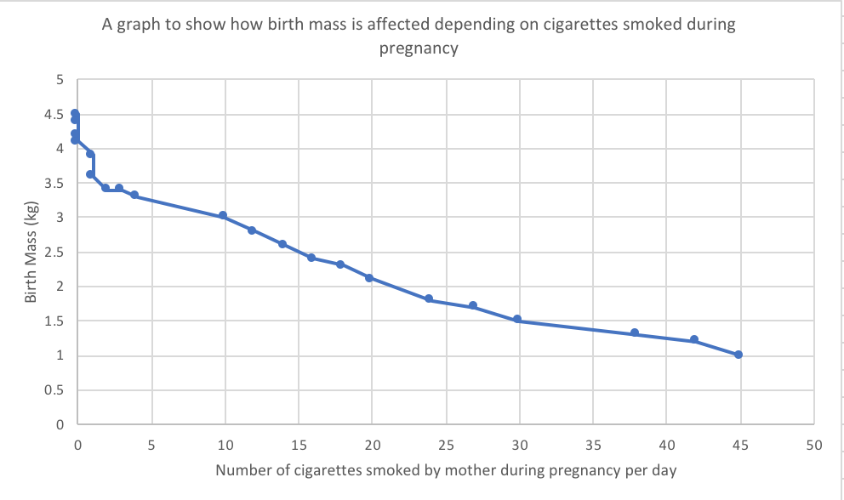
Looking at trends...
Describe the trend seen in the graph
Explain the trend seen in the graph
Credit: Miss Hindle

Slide 7
Looking at trends help...
What happens to the birth mass of baby as the number of cigarettes smoked each day, by the mother, increases?
When a mother smokes during pregnancy, what happens to the amount of oxygen that reaches the foetus?
How does this affect the development of the foetus?
Credit: Miss Hindle

