Slide 1
Independent Living Personal Care
Lesson 6 - How to relax
Oak Specialist
Building Understanding

Slide 2
Unit 2- Personal Care
Lesson 2- Morning hygiene routine
Lesson 1- Five a day
Making a healthy smoothie using five fruit and vegetables.
Identifying morning hygiene activities and creating a routine.
Lesson 3- Turn taking
Lesson 4- Fine/gross motor circuit
Games and activity suggestions to encourage turn-taking.
Activity suggestions to encourage development of fine and gross motor skills
Lesson 5- Managing emotions
Lesson 6- How to relax
Recognising familiar emotions and identifying strategies to manage these.
Activity suggestions to learn how to relax and self regulate.
‹#›

Slide 3
Teacher notes- How to relax
Learning Intention: To explore different activities to promote self regulation and relaxation.
What does relaxation mean and why is it important?
Explore alerting and calming activities and how they can both help with relaxation. Examples of alerting and calming environments.
Activity suggestions to try- two alerting and two calming.
Create a relaxation choice board so learner can choose preferred activities.
Resources needed- resources for each activity suggestion found on individual slides
Notes:
This is the equivalent to a loose lesson plan/overview for teachers before starting the lesson.

Slide 4
Safety notice
Some of the activities suggested in this lesson involve physical activity. Before beginning these activities, ensure the area is safe and that your learner is feeling fit and well to take part in the activity. Please also check your learner is wearing the right clothes for physical activity.

Slide 5
Lesson activity stages
What does ‘relax’ mean?
Alert and calm
Relaxing activities
Make a choosing board
Notes:
Lesson 1 breakdown of the lesson. Repeat for each lesson.

Slide 6
Relaxing
To relax means…...To become less tense or anxious.
Some people often need breaks throughout their day to help them focus, stay on track, or relax in order to self-regulate.
They may need support with choosing the correct activity.

Slide 7
Alerting vs. Calming
Calming sensory input de-escalates arousal level and over-stimulation
Alerting sensory input increases motivation and alertness
Notes:
Everyone has a different sensory profile and therefore respond to different activities to help to relax. Throughout the lesson we will refer to alerting and calming activities. If your learner has an Occupational Therapist they will be able to provide more information about specific strategies and activities.

Slide 8
Alerting
Alerting activities can help us to self regulate our emotions.
Alerting activities can help us to relax through movement.

Slide 9
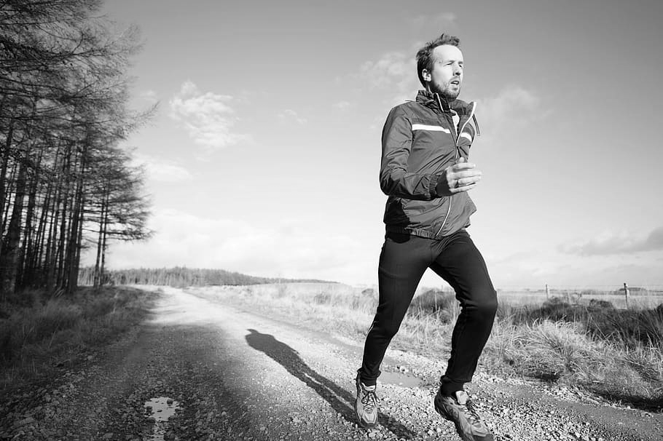
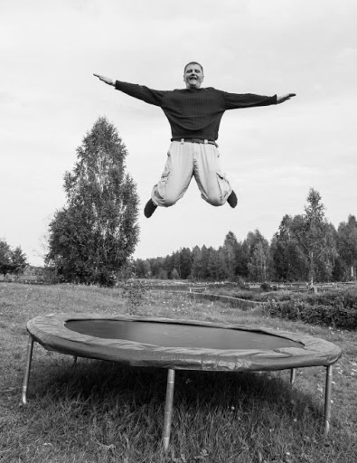
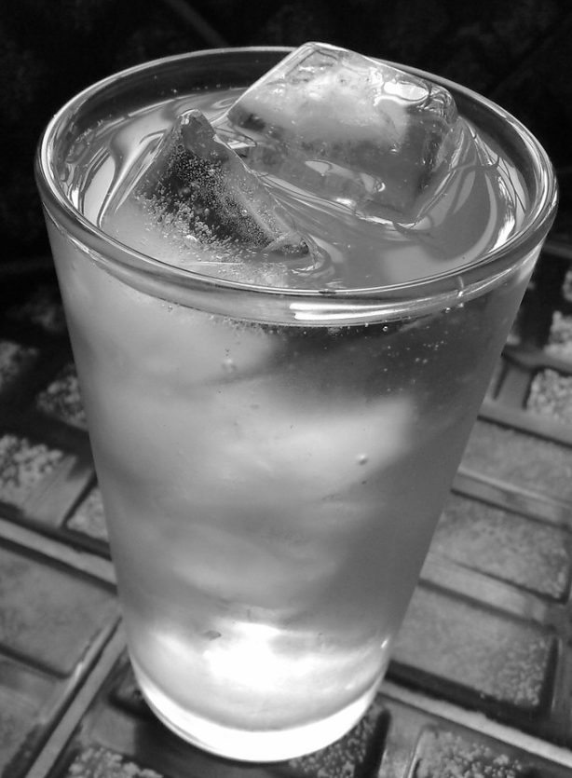
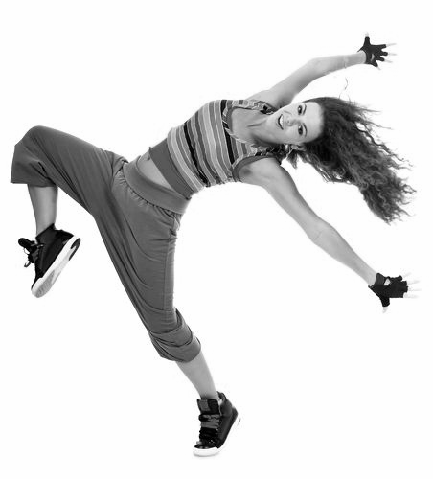
Alerting
These are some activities of alerting strategies that may help you to relax. Can you try some of them? Speak to your Occupational Therapist for more specific information and support.
Running | Jumping | Carrying heavy items
Cold water on body | Push ups off the wall or floor | Dancing to quick tempo music
Notes:
These are some activities of alerting strategies that may help your learner to relax. Can you try some of them? Speak to your Occupational Therapist for more specific information and support.

Slide 10
Calming
Calming activities can help us to self regulate our emotions.
Calming activities can help us to relax by slowing
down.

Slide 11
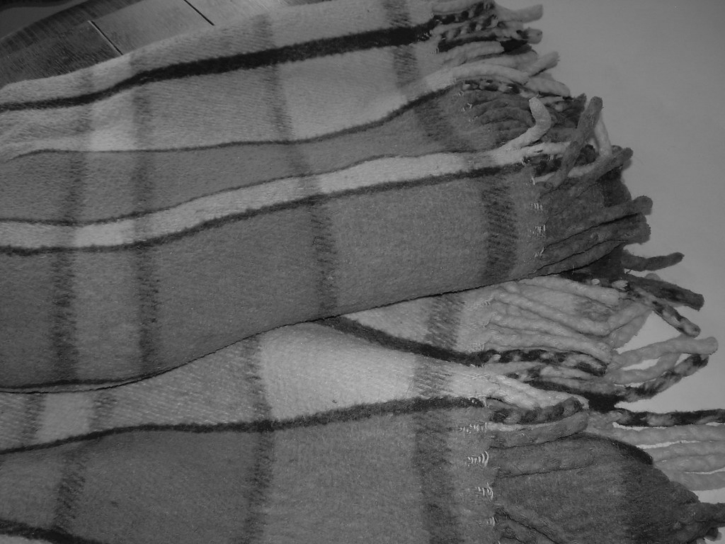
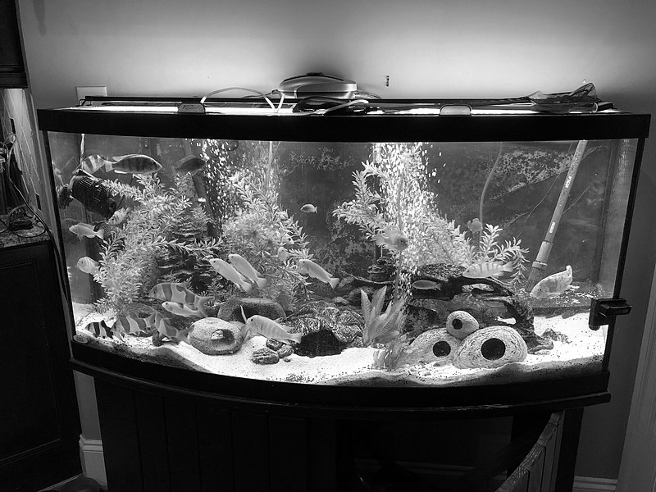
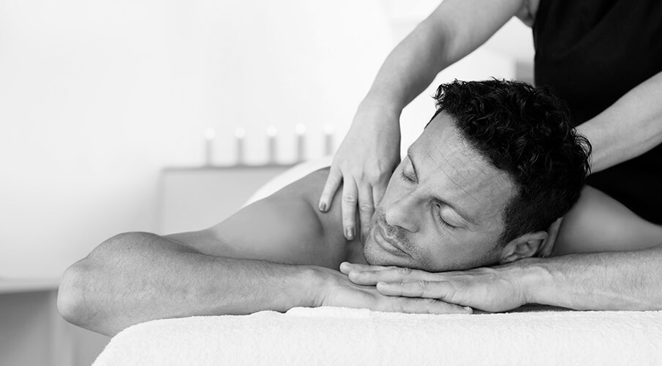
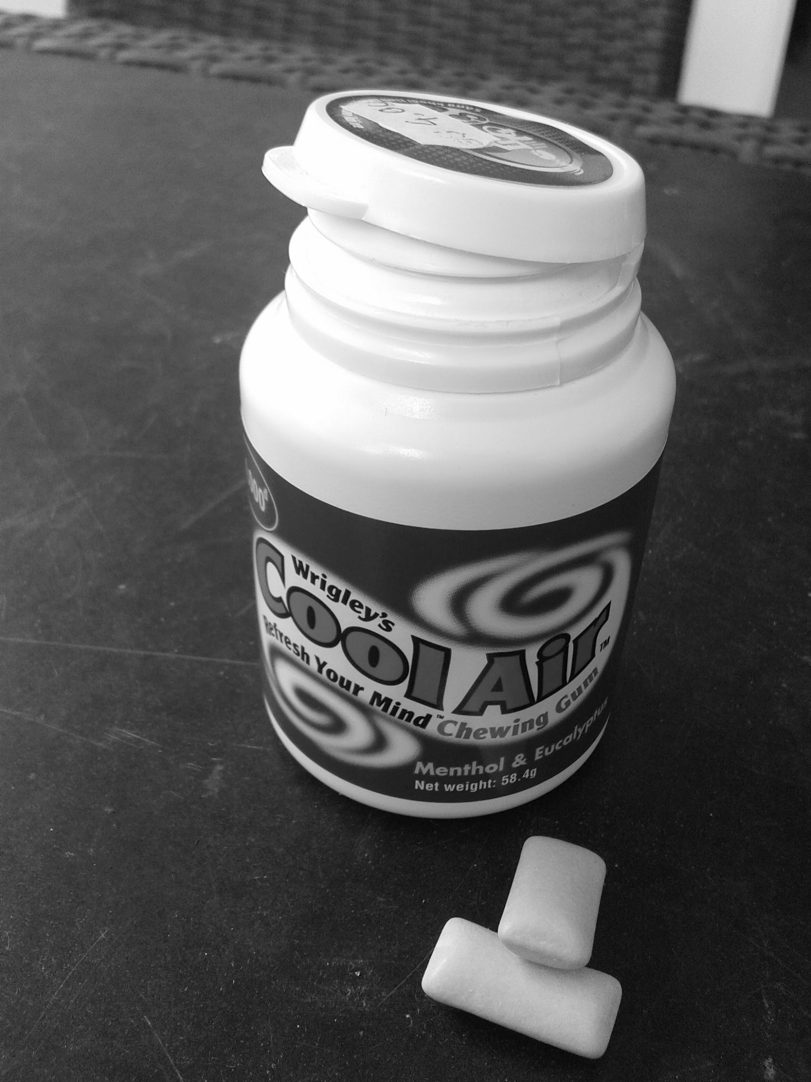
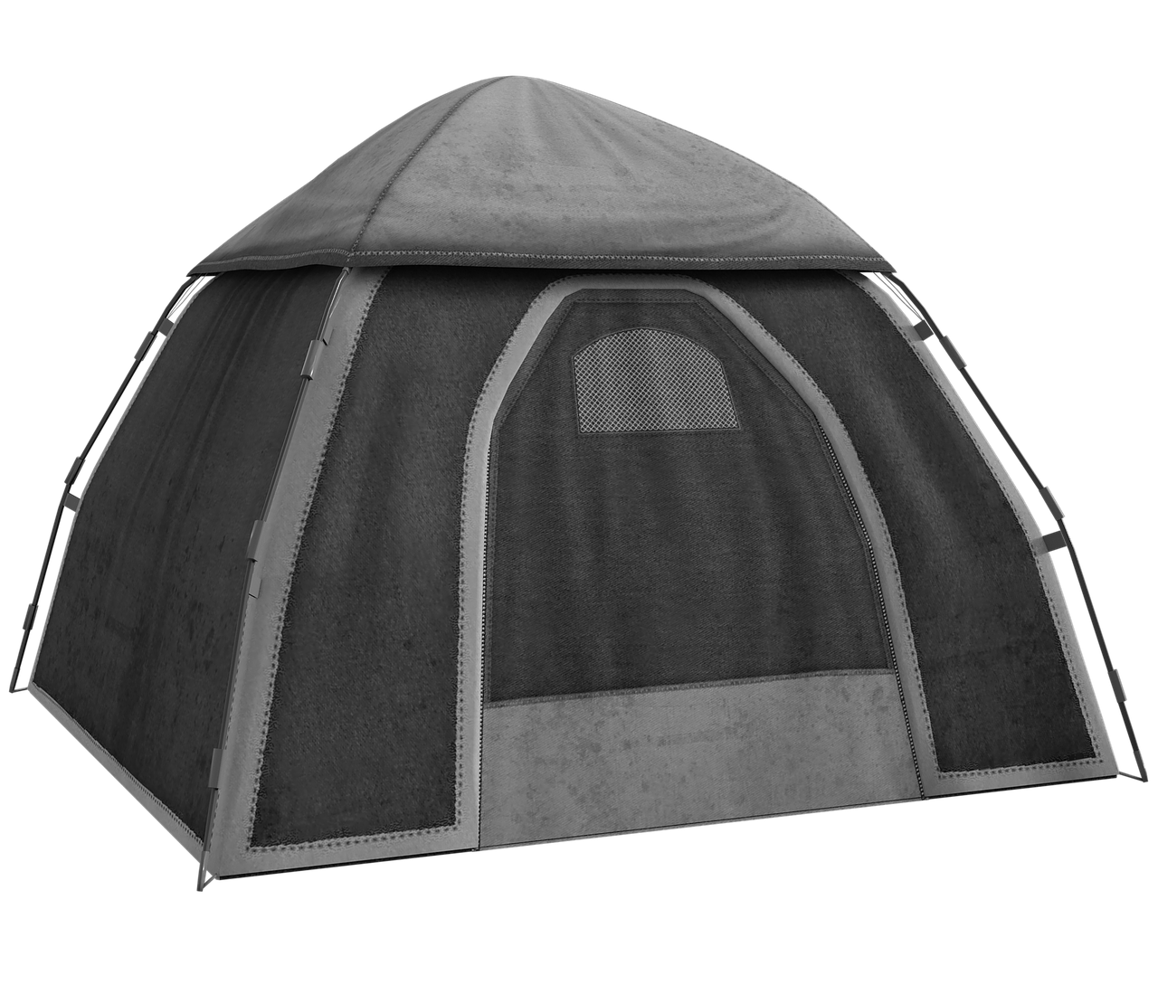
Calming
These are some activities of calming strategies that may help you to relax. Can you try some of them? Speak to your Occupational Therapist for more specific information and support.
Being wrapped in a blanket | Swinging | Watching a fish tank
Deep pressure/massage | Chewing chewy foods | Tent or enclosed space
Notes:
These are some activities of calming strategies that may help your learner to relax. Can you try some of them? Speak to your Occupational Therapist for more specific information and support.

Slide 12
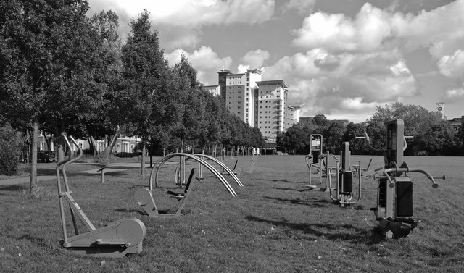
Relaxing alerting environment
Here is an example of an environment which can offer alerting activities.
Notes:
Here is an example of an environment which can offer alerting activities.

Slide 13
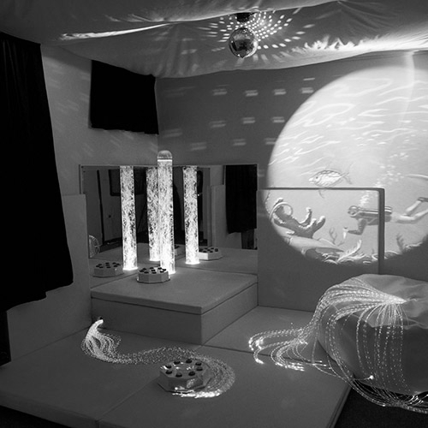
Relaxing calming environment
Here is an example of an environment which can offer calming activities. Can you recreate any of these ideas in your home?
Notes:
Here is an example of an environment which can offer calming activities. Can you recreate any of these ideas in your home?

Slide 14
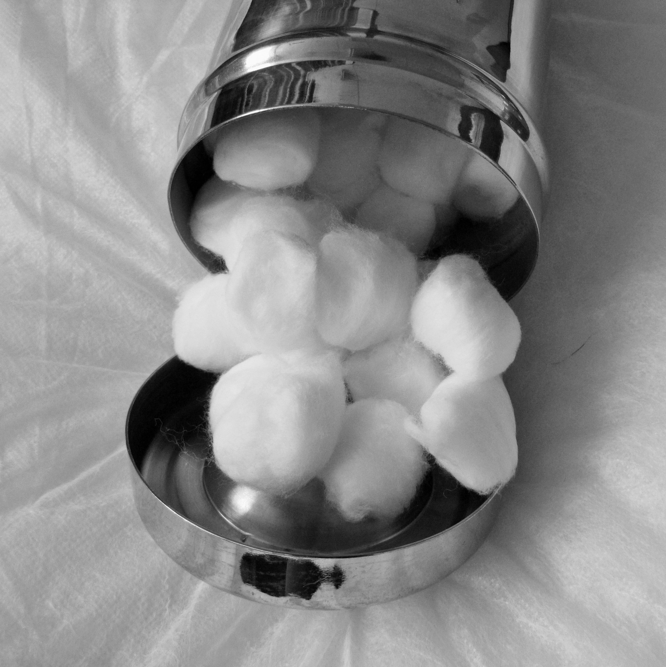
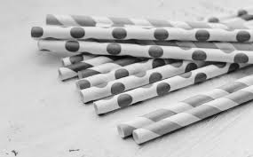
Alerting example activity 1
Finish!
Start
You will need: Floor or table, cotton wool balls, straws, tape or pen and paper
Notes:
To play the game draw two zigzag lines on a table or floor and mark a finish line. You could use tape. Take a straw and cotton wool ball each. Put your cotton wool ball at the start of the lines and use your straws to race each other to the finish line following the zigzag lines.

Slide 15
Alerting example activity 1
Finish!
To play the game:
Draw two zigzag lines on a table or floor and mark a finish line. You could use tape.
Take a straw and cotton wool ball each.
Put your cotton wool ball at the start of the lines and use your straws to race each other to the finish line following the zigzag lines.
Start
You will need: Floor or table, cotton wool balls, straws, tape or pen and paper

Slide 16
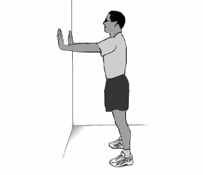
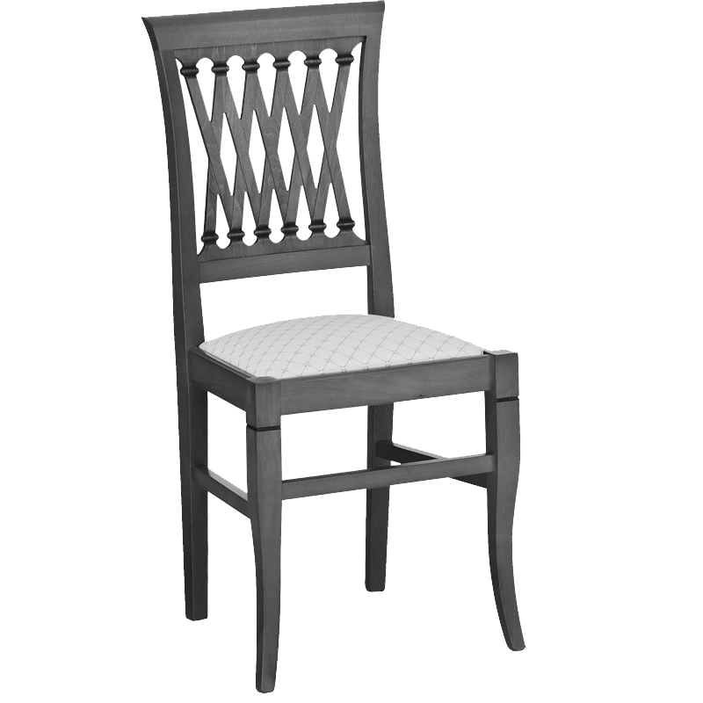
Alerting example activity 2
You will need: Wall, chair or floor
Notes:
For this activity use a wall, chair or floor to try different press ups. For a wall press-up ask your child face the wall. They should stand about an arms length away with their feet and knees a shoulder-width apart. Ask them to lean forward and put their hands palm flat against the wall, at the same height as their shoulders. Their hands should be shoulder width apart. Breathe in and slowly bend your elbows and bring your nose to the wall – keep your back straight. Now straighten your elbows and go back to standing up straight as you breathe out.

Slide 17
Alerting example activity 2
For this activity use a wall, chair or floor to try different press ups.
For a wall press-up:
Ask your child to face the wall.
They should stand about an arms length away with their feet and knees a shoulder-width apart.
Ask them to lean forward and put their palms flat against the wall, at the same height as their shoulders.
Their hands should be shoulder width apart.
Breathe in and slowly bend your elbows and bring your nose to the wall – keep your back straight.
Now straighten your elbows and go back to standing up straight as you breathe out.
You will need: Wall, chair or floor

Slide 18
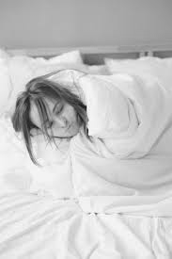
Calming example activity 1
You will need: Blanket, towel or duvet
Notes:
For this activity you will roll your learner up in a blanket or towel. Lay the blanket on the floor. As your learner to lay down on top of the blanket at one end. Ensure their head is are outside of the blanket. Sing “roll, roll, roll you up, like a sausage roll” to the tune of ‘row, row, row your boat’ as you roll them up one way until they are wrapped in the blanket. Sing it again as you roll them undone!

Slide 19
Calming example activity 1
For this activity you will roll your learner up in a blanket or towel.
Lay the blanket on the floor.
Ask your learner to lay down on top of the blanket at one end.
Ensure their head is outside of the blanket. Sing “roll, roll, roll you up, like a sausage roll” to the tune of ‘row, row, row your boat’ as you roll them up one way until they are wrapped in the blanket.
Sing it again as you roll them undone!
You will need: Blanket, towel or duvet

Slide 20
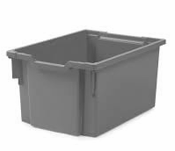
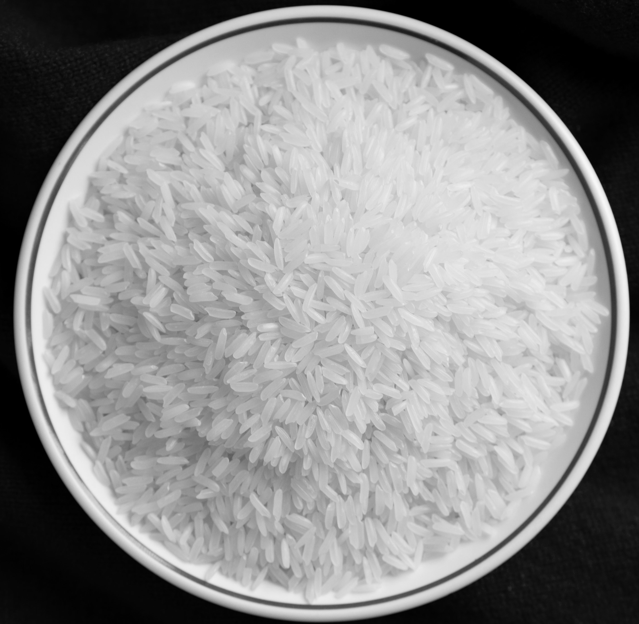
Calming example activity 2
You will need: A box or deep tray, uncooked rice, small toys or plastic animals
Notes:
For this activity, fill a box or tray with uncooked rice and let your learner explore it by putting their hands in. You could hide small toys or plastic animals in the rice so that your learner has to search for them and retrieve them.

Slide 21
Calming example activity 2
For this activity, fill a box or tray with uncooked rice and let your learner explore it by putting their hands in.
You could hide small toys or plastic animals in the rice so that your learner has to search for them and retrieve them.
You will need: A box or deep tray, uncooked rice, small toys or plastic animals

Slide 22
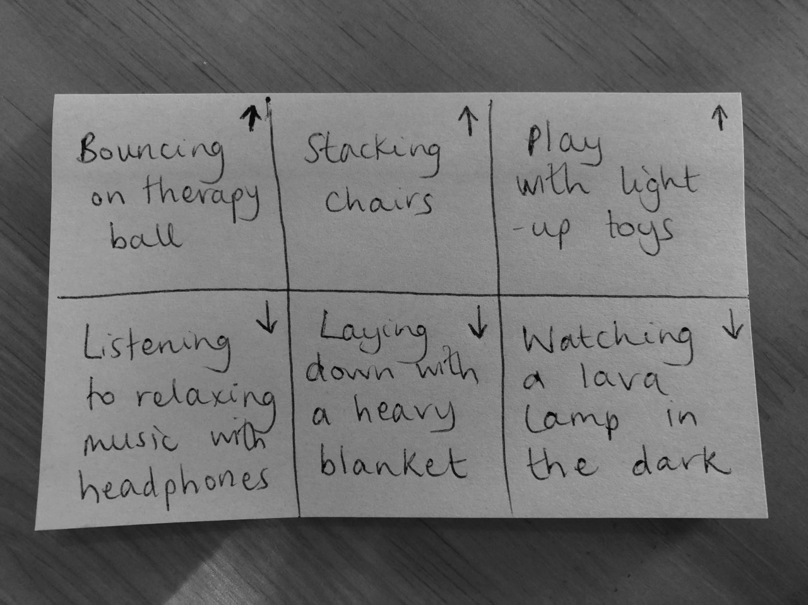
Creating a choice board
After you have tried some different relaxing activities, either calming or alerting, and have spoken to your learner’s teacher or Occupational Therapist, make a choice board with different options for your learner to choose from when taking a relaxation break. You could draw or write the different choices.
Image teacher’s own
Notes:
After you have tried some different relaxing activities either calming or alerting and have spoken to your learner’s teacher or Occupational Therapist, make a choice board with different options for your learner to choose from when taking a relaxation break. You could draw or write the different choices.

Slide 23
Independent Living: Personal Care
How to relax
Make it easier
Make it harder
More ideas
Help your learner explore the internet for sensory strategy ideas both calming and alerting.
Create a ‘break plan’ to go with the choice board. Link the activities to feelings e.g. if I am feeling over excited….I can jump on the trampoline for 10 minutes.
Speak to your learner’s teacher or Occupational Therapist for support with specific alerting and calming activities to support with relaxation.
Notes:
Final slide of the lesson. Suggest adaptations for teachers/parents.

Slide 24
Further Learning with Oak National
Independent Living:
Building Understanding- How to relax (Unit 2)
Applying Learning- Managing feelings (Unit 2)
Applying Learning- Balanced leisure activities (Unit 2)
Communication and Language:
Building Understanding/Applying Learning- Our World (Unit 5)
Occupational Therapy:
Gross Motor Skills (Unit 1)
Notes:
Insert info for subject/lesson name/stage (if appropriate)

Slide 25
References
Slide 11- Guy doing push up, Pikrepo / Man running, Pxfuel / One man’s dance party, Cynthia D’Amour / Man on trampoline, Fake brothers productions / Carrying books in Peckham library, Libraries Taskforce, Wikimedia Commons / 365 Days of Happiness: Tall glass of ice-cold water, Jade, Flickr Attribution-NonCommercial-ShareAlike 2.0 Generic (CC BY-NC-SA 2.0)
Slide 13- Wrigley's Cool Air Chewing Gum, Radishslice, Wikimedia Commons / Tent, Needpix / Massage, Indulge mobile spa / Wool blanket, Joanna Bourne, Flickr Attribution 2.0 Generic (CC BY 2.0)/ Smiling boy, Pxfuel / African Cichlid Fish Tank, LizWinfreyV, Wikimedia Commons
Slide 14-Outdoor gym equipment on Nelson Mandela Park, Mat Fascione, Geograph
Slide 15- Sensory room, Experia USA
Slide 16- The truth about straws, Madison Family Dental Associates / Bright colorful paper straws, Marco Verch, Flickr Attribution 2.0 Generic (CC BY 2.0) / Canister With Cotton Balls, Publicdomainpictures
Slide 17- Wallpushup-CDC strength training for older adults, Wikimedia Commons / Chair, PNGIMG
Slide 18- Girl in bed, Elvira Gibadullina, Pexels
Slide 19- 2014 uncooked Thai jasmine rice, Takeaway, Wikimedia Commons / Various animal toy figures in a colorful background, Pxhere / Gratnells Extra Deep Storage Tray, Gratnells, Wikimedia Commons

