Slide 1
Measuring length in centimetres
Mathematics
Miss Mitchell

Slide 2
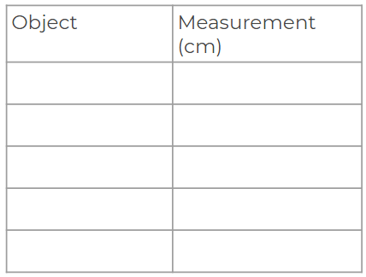
Question 1
Measure the length of your objects in centimetres.
Notes:
Why do we use standard units? Why not non standard units?

