Slide 1
Lesson 5: RSC Stock Control
KS4 - Spreadsheets
Kashif Ahmed
Materials from the Teach Computing Curriculum created by the National Centre for Computing Education

Slide 2
Task 1 - After the beep
Using the Lesson 5 starter spreadsheet
On the left are statements about the advantages of barcodes
Select a matching disadvantage from the drop-down list on the right
The spreadsheet will show when a correct match is made

Slide 3
Task 2 - Complete the model - part 1
Enter an item number in cell A8 of the ‘RSC merchandise database’ spreadsheet. There are lookup formulae already entered in cells B8, C8, and D8.
In the ‘RSC merchandise’ sheet, cell B8 has this formula:
=VLOOKUP(A8,'Lookup sheet'!$A$2:$C$17,3,FALSE)
We are looking up the contents of cell A8.

Slide 4
Task 2 - Complete the model - part 2
You can use the fill handle to drag this formula down to the cells below. But, if you want to type it yourself: after typing the first comma, use the mouse to click on the ‘Lookup sheet’ and then select the cells A2–C17.
Click the mouse between A and 2 in the formula and press the F4 key to make the range ABSOLUTE – or type it out, whichever you find easier!
The 3 refers to the third column of ‘Lookup sheet’.
FALSE asks for an exact match to be found.

Slide 5
Task 2 - Complete the model - part 3
There is another lookup formula in cell C8:
=VLOOKUP(A8,'Lookup sheet'!$A$2:$E$17,4,FALSE)
This returns the selling price of the item including VAT.
There is another lookup formula in cell D8:
=VLOOKUP(A8,'Lookup sheet'!$A$2:$E$17,5,FALSE)
This returns the amount of VAT paid on the item.
Note: The lookup list must be sorted in ascending order on the lookup value, in this case column A of ‘Lookup sheet’, which holds the item number.

Slide 6
Task 2 - Complete the model - part 4
Enter some data
In cells E8–E28 enter a number to indicate how many of each item have been sold.

Slide 7
Task 2 - Complete the model - part 5
In cells G8–G28 enter a number for an initial stock level; for example, we could start out with 1000 of each item.

Slide 8
Task 2 - Complete the model - part 6
There is a formula in cell H8, =G8-E8, which subtracts the number of each item sold from the amount in stock to calculate a remaining stock level.

Slide 9
Task 3 - Add a status output - part 1
In the final column (I8–I28) we will flag up when an item needs to be reordered.
In cell I8 there is a formula for this; use the fill handle to drag it down to I28.
=IF(H8<100,”Reorder”,””)
If the ‘Remaining Stock’ is less than 100, output the text, else output nothing

Slide 10
Task 3 - Add a status output - part 2
Colour code the cells that a user should not manually make changes to, this will help reduce user error.

Slide 11
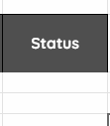
Task 4 - Conditional formatting - part 1
In the final column (I8–I28), the cells will either be blank or will show the text ‘Reorder’.
A conditional format could be added to these cells to add a stronger visual reminder for the user.

Slide 12
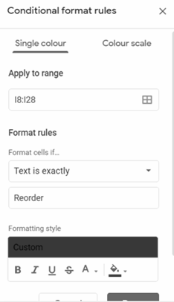
Task 4 - Conditional formatting - part 2
Highlight the cells I8:I28
Click Format -> Conditional formatting
Under the Format rules section, click on the dropdown and select Text is exactly
Enter the word Reorder in the field below.
Under the Format style section, click on the paint bucket tool and select the colour red

Slide 13
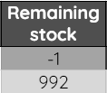
Task 4 - Conditional formatting - part 3
In the final column (H8–H28), the cells show the remaining stock. Apply conditional formatting to highlight negative stock levels.
A conditional format could be added to these cells to add a stronger visual reminder for the user.

Slide 14
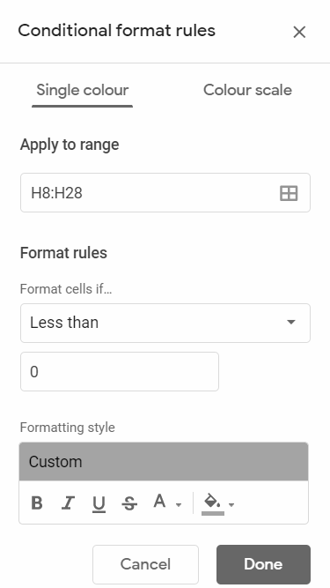
Task 4 - Conditional formatting - part 4
Highlight the cells H8:H28
Click Format -> Conditional formatting
Under the Format rules section, click on the dropdown and select Less than
Enter the number 0 in the field below.
Under the Format style section, click on the paint bucket tool and select the colour orange

Slide 15
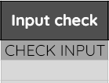
Task 4 - Conditional formatting - part 5
In the final column (F8–F28), the cells show the remaining stock. Apply conditional formatting to highlight the CHECK INPUT text.
A conditional format could be added to these cells to add a stronger visual reminder for the user.

Slide 16
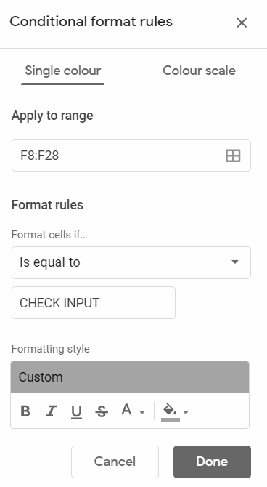
Task 4 - Conditional formatting - part 6
Highlight the cells F8:F28
Click Format -> Conditional formatting
Under the Format rules section, click on the dropdown and select Is equal to
Enter the word CHECK INPUT in the field below.
Under the Format style section, click on the paint bucket tool and select the colour orange

Slide 17
Task 5 - Testing the database - part 1
Check
What happens if the item number entered is incorrect?
Change
Change the VAT rate to 15%; change it to 21%. Check that each change correctly affects the cells in column E of ‘Lookup sheet’ and column D of ‘RSC merchandise sheet’.
Change the IF formula in I8–I28 (‘RSC merchandise sheet’) to display a message when the stock level falls below 50.

Slide 18
Task 5 - Testing the database - part 2
Not all items need the same trigger level to reorder stock. Some items will sell in greater numbers than others, for example the cheaper items are likely to sell more than the more expensive items, and large t-shirts and hoodies will sell in lower numbers than the small and medium sizes.
Change the stock reorder levels for the cheaper items (keyrings, posters) and the expensive items (large hoodies and t-shirts) to reflect this.

Slide 19
Task 5 - Testing the database - part 3
Add
Add some more items to ‘Lookup sheet’, then add these items to ‘RSC merchandise sheet’. Ensure that all the necessary cells are formatted correctly, e.g. currency, etc. Check that the formulas work correctly.

