Slide 1
How to analyse and develop a dish for a ready meal
Design and technology - Chilled ready meals
Mr Donnelly

Slide 2
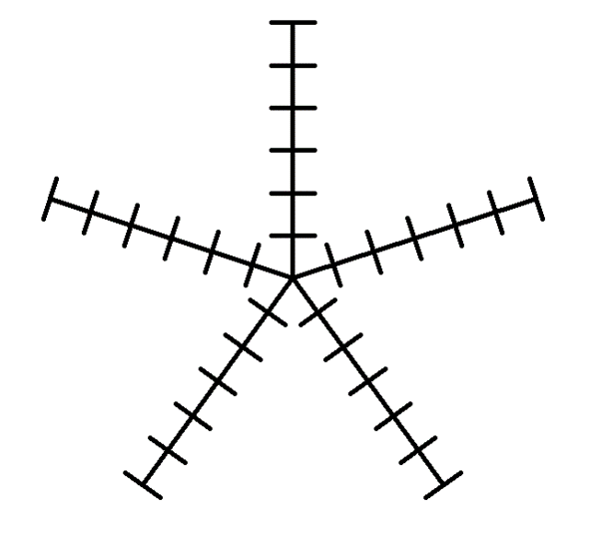
Star profiling
List the five key attributes you will look for in your dish.
Then add dots and join them up as I have on slide 13 of the lesson.
1
2
3
4
5

