Slide 1
Lesson 2: SQL Searches
Databases and SQL
Computing
Ben Garside
Materials from the Teach Computing Curriculum created by the National Centre for Computing Education

Slide 2
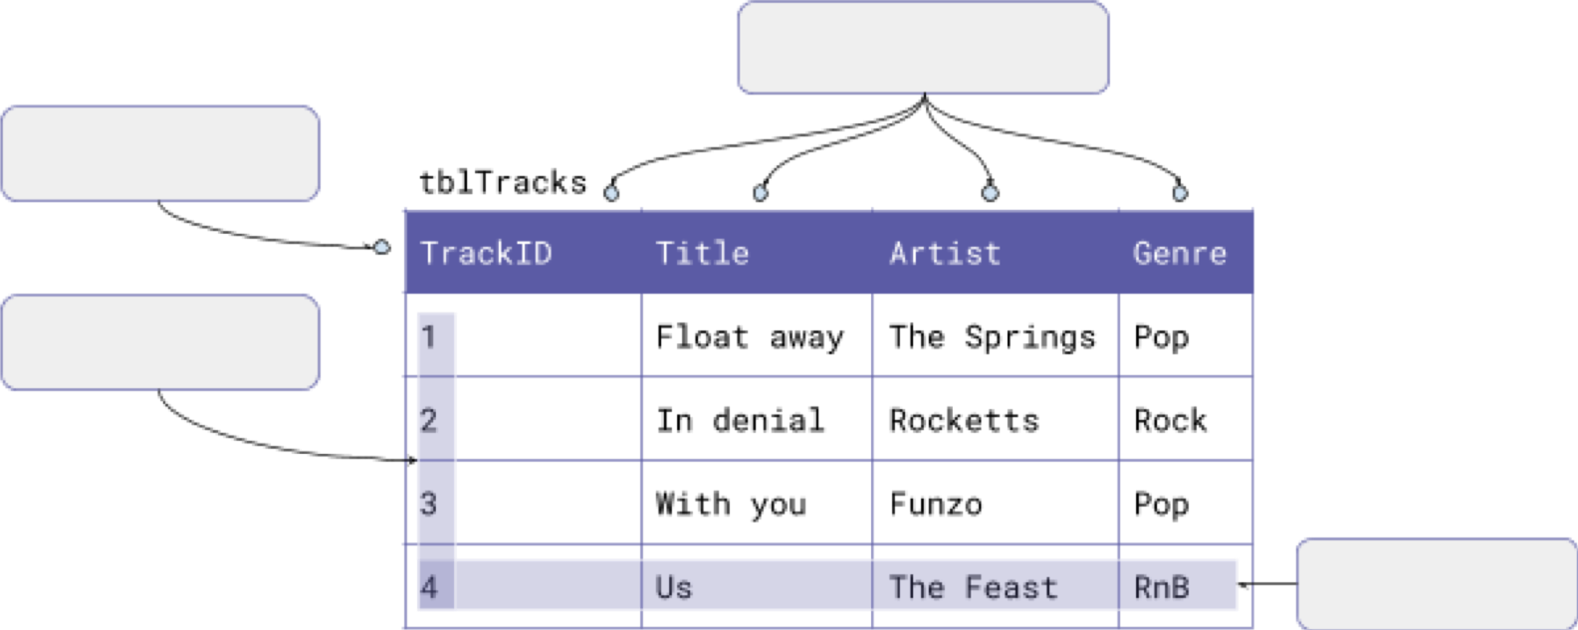
Task 1 - Keyword recap activity
label the database and fill in the missing blanks with the following key terms:
Record
Fields
Table
Primary Key
Foreign Key

Slide 3
Task 2 – Retrieving data with SQL (Operators)
For this activity you will need:
DB Browser for SQLite
A copy of the dbMusic.db file which you used last lesson.
Comparison operator | Function
= | Equal to
> | Greater than
< | Less than
=> | Greater than or equal to
<= | Less than or equal to
<> | Not equal to

Slide 4
Task 2 – Retrieving data with SQL (operators)
Logical operator | Function | Example
AND | TRUE if both conditions are TRUE | SELECT * FROM tblTracks Genre = "Pop" AND Artist = "The Springs";
BETWEEN | TRUE if the range is within the comparisons | SELECT * FROM tblDownloads WHERE Time BETWEEN "06:00" AND "07:00";
OR | TRUE if any of the conditions are TRUE | SELECT * FROM tblTracks WHERE Genre = "Pop" OR Genre = "Rock";

Slide 5
Task 2 – Retrieving data with SQL (Code snippets)
Select all of the columns and records from the tblTracks table
1 2 | SELECT * FROM tblTracks;
Select the Title and Artist columns from the tblTracks table where the Genre is not equal to Pop.
1 2 3 | SELECT Title, Artist FROM tblTracks WHERE Genre <> "Pop";

Slide 6
Task 2 part 1 – Retrieving data from the tblTracks table
Retrieve data from the tblTracks table
For each question, design an SQL search that will reveal the answer.
Question 1: How many tracks in the database have the genre Rock ?
Answer
Code

Slide 7
Task 2 part 1 – Retrieving data from the tblTracks table
Retrieve data from the tblTracks table
For each question, design an SQL search that will reveal the answer.
Question 2: How many tracks in the database are created by the artist A Box of Spoons ?
Answer
Code

Slide 8
Task 2 part 1 – Retrieving data from the tblTracks table
Retrieve data from the tblTracks table
For each question, design an SQL search that will reveal the answer.
Question 3: How many tracks in the database have a TrackID that is greater than 30 and are of the Soul genre?
Answer
Code

Slide 9
Task 2 part 2 – Retrieving data from the tblDownloads table
Retrieve data from the tblDownloads table
For each question, design an SQL search that will reveal the answer.
Question 1: How many downloads were made in 2011?
Answer
Code

Slide 10
Task 2 part 2 – Retrieving data from the tblDownloads table
Retrieve data from the tblDownloads table
For each question, design an SQL search that will reveal the answer.
Question 2: How many tracks were either downloaded before 6AM or after 10PM?
Answer
Code

Slide 11
Task 2 part 3 – Using ORDER BY
You can change the order of the retrieved records by sorting the data into ascending or descending order. The following steps will show you how this works.
Step 1: Take a look at the code snippet below. What do you think will happen when the data is retrieved?
1 2 3 | SELECT * FROM tblMembers ORDER BY Surname ASC;

Slide 12
Task 2 part 3 – Using ORDER BY
Step 2: Copy the code into DB Browser and execute it. Was your prediction correct?
Answer

Slide 13
Task 2 part 3 – Using ORDER BY
Step 3: Change the final three letters from ASC to DESC.
What changed compared to when you used ASC?
1 2 3 | SELECT * FROM tblMembers ORDER BY Surname DESC;

Slide 14
Task 2 part 4 – Sorting retrieved data
For each question, design an SQL search that will reveal the answer.
Question 1: What is the TrackID of the first ever download recorded in the database?
Answer
Code

Slide 15
Task 2 part 4 – Sorting retrieved data
For each question, design an SQL search that will reveal the answer.
Question 1: What is the earliest time of day that a track has been downloaded?
Answer
Code

Slide 16
Task 3 – Retrieving data from more than one table
For this activity you will need:
DB Browser for SQLite
A copy of the dbMusic.db file which you used last lesson
Slides 4 and 5 on this worksheet to remind you of the operators

Slide 17
Task 3 – Code snippet
This query does the following:
Select the Surname, Download and Title columns from the Members, Downloads and Tracks table. Specify the links between the three tables and retrieve the data for the member with the surname Bibi.
1 . 3 4 5 | SELECT tblMembers.Surname, tblDownloads.DownlID, tblTracks.Title FROM tblMembers, tblDownloads, tblTracks WHERE tblMembers.MemberID = tblDownloads.MemberID AND tblTracks.TrackID = tblDownloads.TrackID AND tblMembers.Surname = "Bibi";

Slide 18
Task 3 questions
Design an SQL search that will reveal the answer.
Question 1: How many tracks has Percy Winn downloaded?
Answer
Code

Slide 19
Task 3 questions
Design an SQL search that will reveal the answer.
Question 2: How many Pop tracks were downloaded in the year 2012?
Answer
Code

Slide 20
Task 3 questions
Design an SQL search that will reveal the answer.
Question 2: What was the title of the first track downloaded in 2014?
Answer
Code

Slide 21
Task 3 questions
Design an SQL search that will reveal the answer.
Question 3: How many downloads did Nadim Abe make after 1st January 2013?
Answer
Code

Slide 22
Task 4 – Parson’s puzzle
The code below has been jumbled up. The SQL search should list the title of the tracks that users with the surname Ferner have downloaded. Place the code into the correct order.
 | WHERE tblMembers.MemberID = tblDownloads.MemberID FROM tblMembers, tblDownloads, tblTracks AND tblMembers.MemberID = 1; AND tblTracks.TrackID = tblDownloads.TrackID SELECT tblMembers.Surname, tblDownloads.DownlID, tblTracks.Title
Answer

