Slide 1
Relative Formula Mass - Higher
Combined Science - Chemistry - Key Stage 4
Quantitative Chemistry
Mrs. Begum

Slide 2
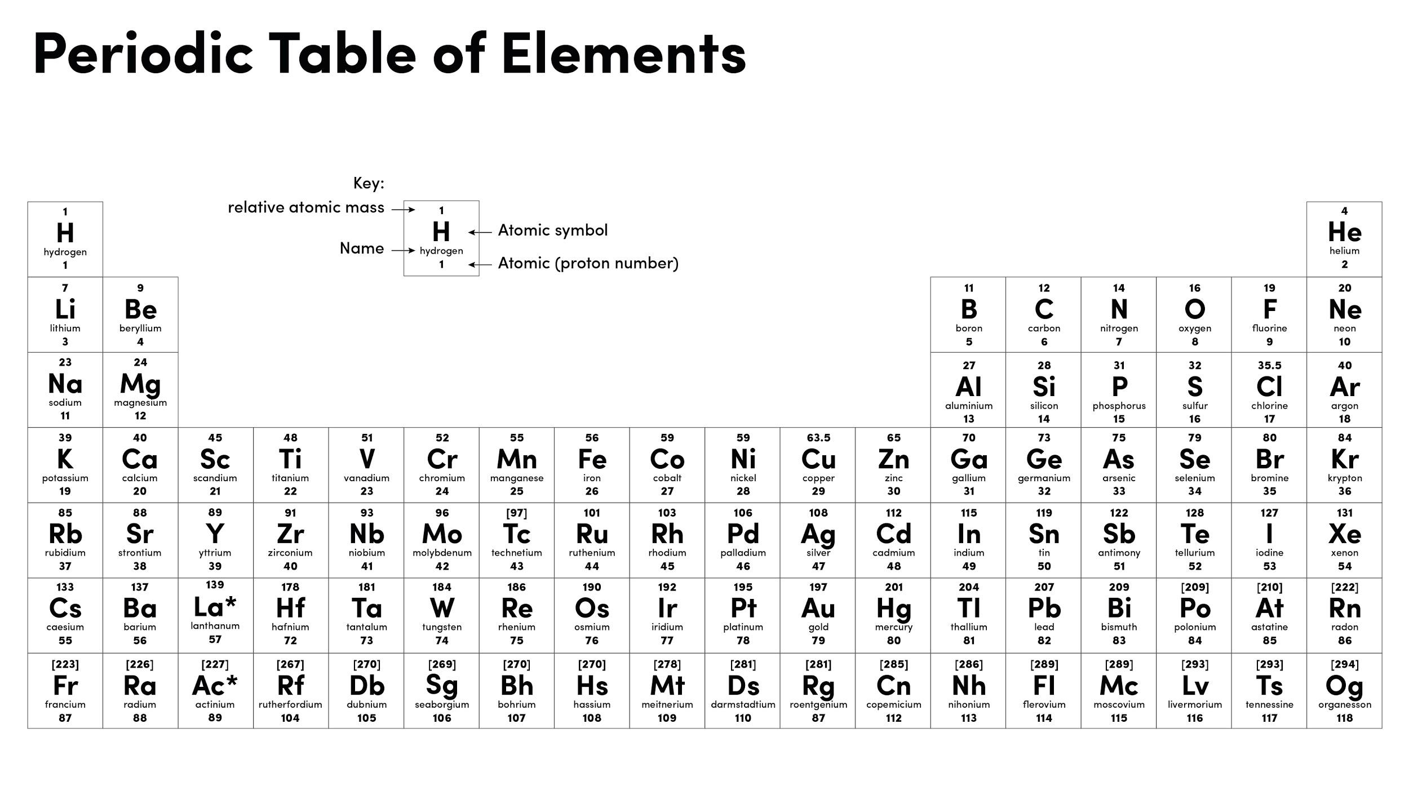
Resume once you’re finished
Notes:
Not sure I’ve done this right

Slide 3
Percentage composition questions
Calculate the percentage composition for the named element in these compounds:
Aluminium in Al₂O₃
Oxygen in K₂SO₄
Hydrogen in Al(OH)₃
Nitrogen in Mg(NO₃)₂
Relative atomic masses:
Al = 27
H = 1
K = 39
Mg = 24
N = 14
O = 16
S = 32
Cu = 63.5

Slide 4
Relative formula mass question
2. The relative formula mass of a Group 1 sulphate is 174.
The formula is X₂SO₄.
Relative atomic masses (A_{r}): S = 32 O = 16
Calculate the relative atomic mass of the Group 1 metal.
Name the metal.

Slide 5
Exam Question 1
3. Potassium nitrate is another nitrogen compound. It is used in fertilisers. It has the formula KNO_{3.}
The M_{r} of potassium nitrate is 101.
Calculate the percentage of oxygen by mass in potassium nitrate.
Relative atomic mass: O = 16.
___________________________________________________________________
___________________________________________________________________
Percentage of oxygen = _______________ %
(2)

Slide 6
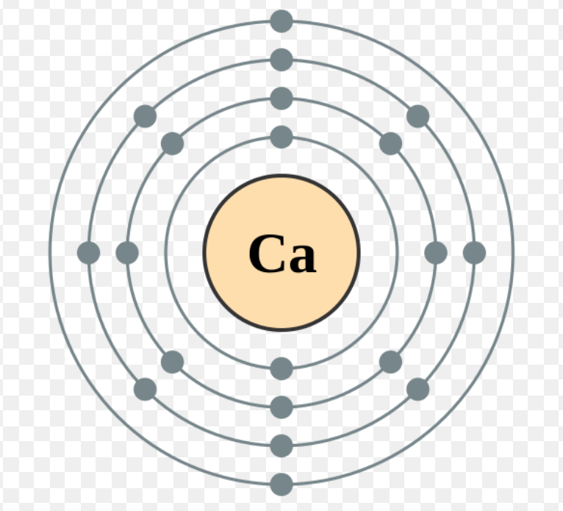
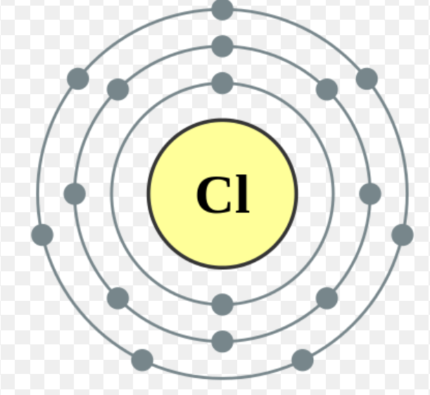
Exam Question 2
4. (a) The diagram shows an atom of calcium and an atom of chlorine.
Calcium Chlorine
Describe, in terms of electrons, how calcium atoms and chlorine atoms change into ions to produce calcium chloride (CaCl₂). (4)
(b) Calculate the relative formula mass (M_{r}) of calcium chloride (CaCl₂).
Relative atomic masses (A_{r}): calcium = 40; chlorine = 35.5
Relative formula mass (M_{r}) = ________
(2)
Credit - Calcium and chlorine atom by Pumbaa, Wikimedia Commons.

Slide 7
Exam Question 3
5.

Slide 8
Answers
a) 52.9%
b) 45.1%
c) 3.8%
d) 18.9%
a) 39
b) Potassium
47.5%
4. a) Calcium loses two electrons
two atoms of chlorine gain one electron each
b) 40 + (2 × 35.5) = 111
5. a) M_{r} = 12 + (2 × 16)
M_{r} = 44
Mass of oxygen = 2 × 16 = 32
32/44 × 100 = 72.7%

