Slide 1
Adding Two Numbers in Standard Form
Miss Davies
Maths

Slide 2
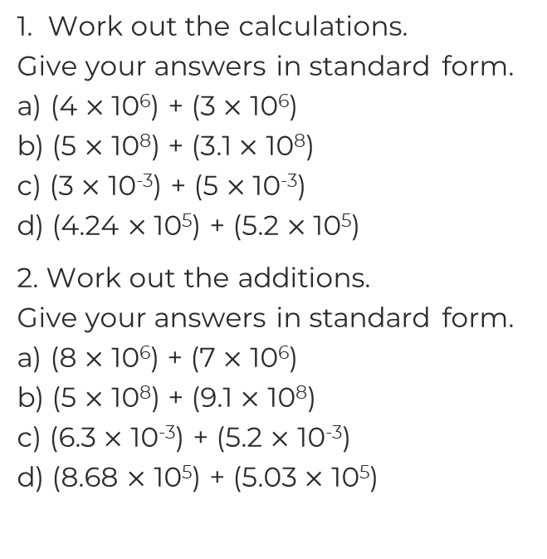
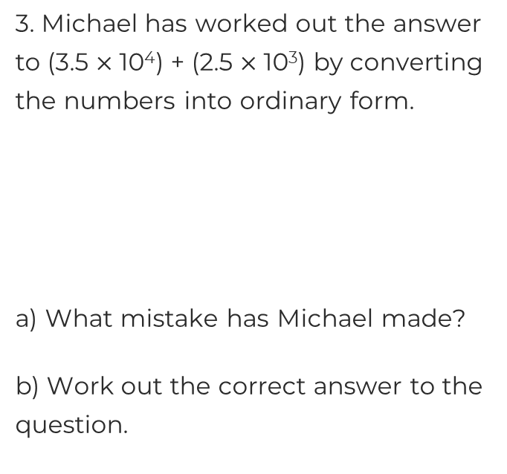
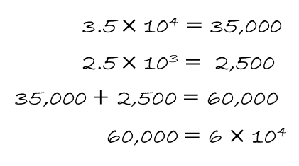
Adding Two Numbers in Standard Form

Slide 3
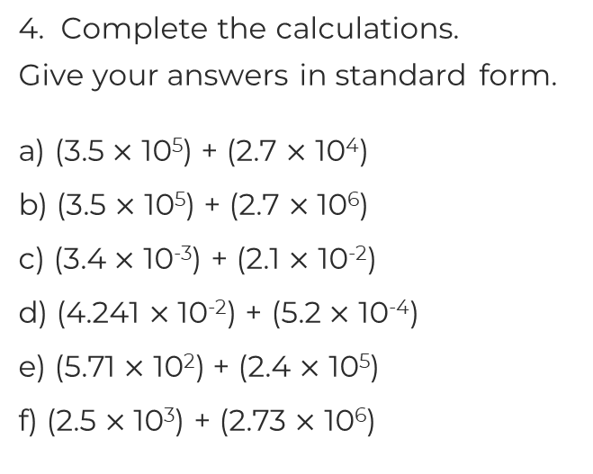
Adding Two Numbers in Standard Form
5. The United Kingdom is made up of England, Scotland, Wales and
Northern Ireland.
The approximate population of each is shown in the table.
What is the approximate population of the United Kingdom?
England | Scotland | Wales | Northern Ireland
5.4 x 10⁶
3.1 x 10⁶
1,880,000

Slide 4
Answers

Slide 5
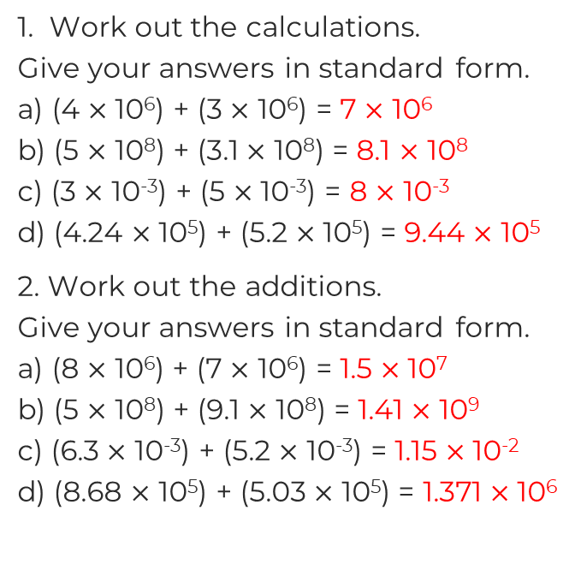
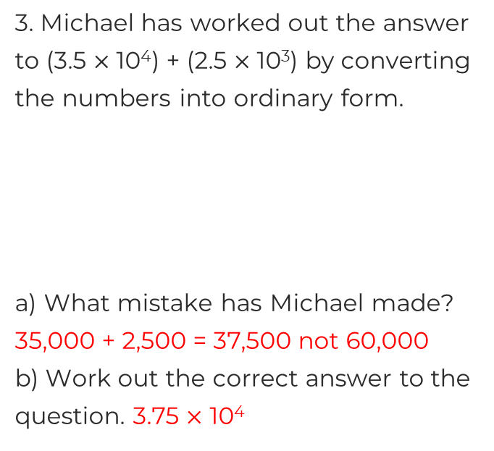
Adding Two Numbers in Standard Form

Slide 6
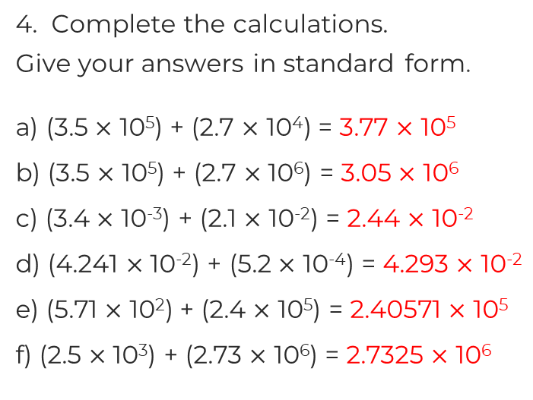
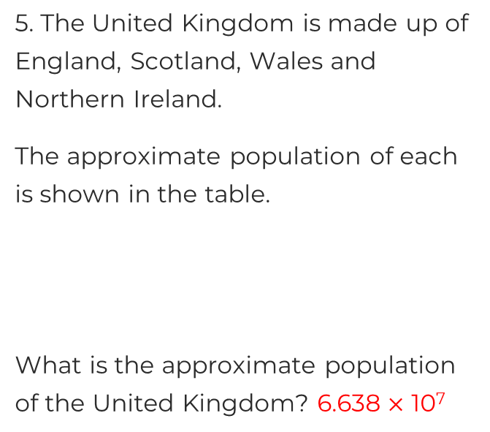
Adding Two Numbers in Standard Form
England | Scotland | Wales | Northern Ireland
5.4 x 10⁶
3.1 x 10⁶
1,880,000

